Slide 1
Bicycle Advisory Committee
Education Subcommittee
December 18, 2024

Slide 2
Mission and Vision
BAC Mission
To advise and make recommendations to the commission and the director on issues related to bicycling in the city including, but not limited to, amendments to the Bike Plan, bicycle safety and education, implementation of the Bike Plan, development of strategies for funding projects related to bicycling, and promoting public participation in bicycling.
BAC Vision
By 2027, the City of Houston will be a Safer, More Accessible, Gold Level Bike-Friendly City

Slide 3
BAC Education Subcommittee Roll Call
Leah Chambers, Chair
Tom Compson, BAC Chair
Carl B. Salazar
Joe Cutrufo
Lisa Graiff
Ben Drews
Robin Holzer
Ex-Officio Members
Ian Hlavacek
Nicole Broussard
Patricc Fortiori

Slide 4
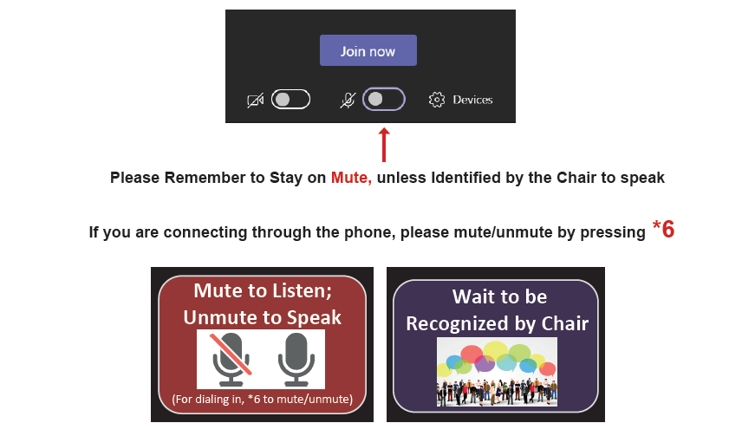
Microsoft Teams Meeting Instructions

Slide 5
Agenda
Director’s Report
Chair’s Report
Public Comment
Open Forum
Announcements/Events
The public is invited to speak for up to two (2) minutes each at the beginning of the meeting.

Slide 6
Director’s Report Nicole Broussard Deputy Assistant Director, Planning & Development

Slide 7
Chair’s Report Leah Chambers Chair, Education Subcommittee Outside Voices

Slide 8
Public Comment
Send written comments to bac@houstontx.gov by 5:00pm the day before a BAC meeting. Comments will be read aloud by staff during the meeting.
Comment by Phone: to join dial 936-755-1521; ID 675 511 783# Press *6 to unmute when called upon by the Chair
Comment via Microsoft Teams: Type your name and that you would like to comment

Slide 9
Open Forum

Slide 10
Announcements and Events

Slide 11
Announcements
Next Meetings
Bicycle Advisory Committee: January 22
Infrastructure Subcommittee: February 26
Education Subcommittee: March 26

Slide 12
Thank You
832-393-6600 | www.houston.tx.gov/planning

