Slide 2
HOW DO WE DETERMINE COMMUNITY NEEDS?
Under HUD’s Consolidated Planning Process, participating jurisdictions are required to conduct a Needs Assessment of the priority needs of the community. The analysis must cover the following:
Housing –
Cost burden
Over crowding
Substandard Housing Conditions
Homelessness
Other Special Needs –
Supportive housing for elderly and persons with disabilities
Persons with alcohol or other drug addiction
Persons with HIV/AIDS and their families
Citizen Input –
Surveys
Public Hearings
Community Forums
The Needs Assessment is updated on an annual basis in the Action Plan to ensure that proposed projects address the specific housing needs and special housing needs and special needs indicated in the five year analysis.

Slide 3
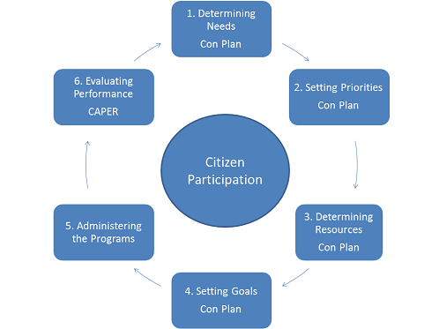
HOW DO WE DETERMINE COMMUNITY NEEDS?

Slide 4
ENTITLEMENT GRANTS THAT MEETS NEEDS
Community Development Block Grants (CDBG)
CDBG activities must meet one of three broad objectives that either serve low- and moderate – income people, prevent slum and blight, or address the urgent threat to health or safety.

Slide 5
Community Development Block Grant (CDBG)
Public Facilities & Improvements Activities/Projects African American Library (Gregory School) Southwest Multi-Service Center Street Construction Waste Water Improvements
Housing Activities/Projects Single Family Home Repair Retrofitting for Accessibility Lead-Based Paint Testing Demolition of Dangerous Structures
Public Services Activities/Projects Meals on Wheels S.E.A.R.C.H Mobile Outreach Childcare Services Mobile Library El Centro De Corazon Clinic Sunnyside Health Center

Slide 6
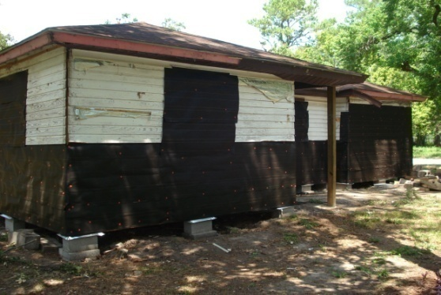
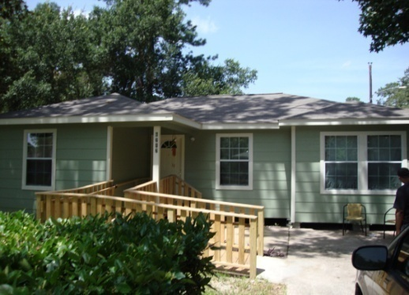
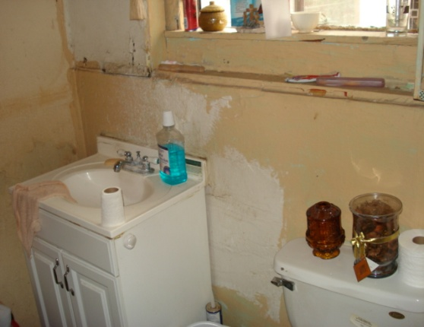
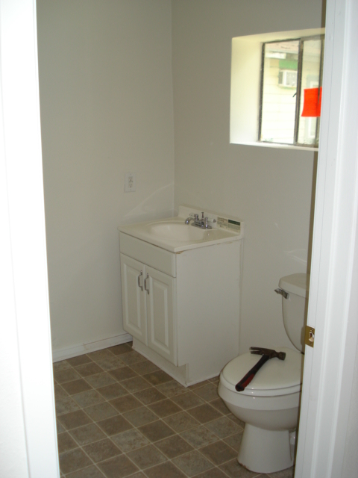
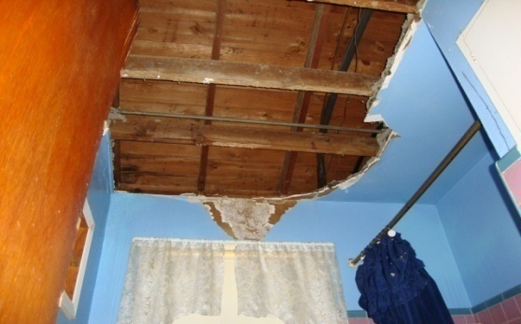
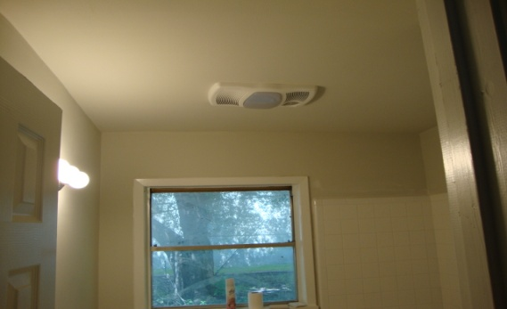
FUNDED BY CDBG
Before & After – Single Family Home Repair Program

Slide 7
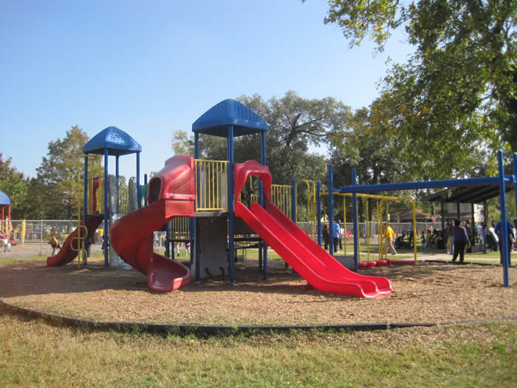
FUNDED BY CDBG
Hererra Elementary School Spark Park

Slide 8
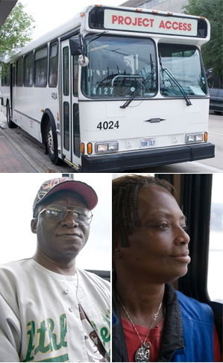
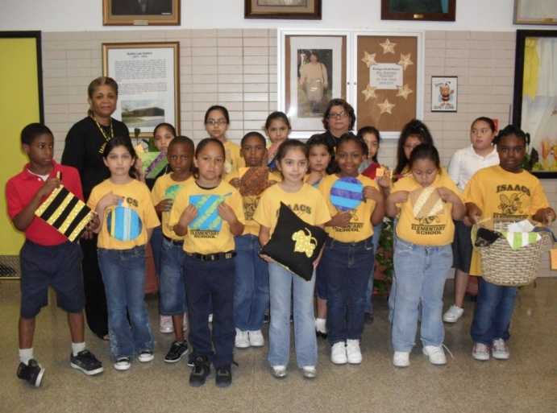
FUNDED BY CDBG
Youth Enrichment & Afterschool Programs

Slide 9
ENTITLEMENT GRANTS THAT MEETS NEEDS
The purpose of the HOME Investment Partnership Act (HOME)
Is to increase homeownership opportunities for low and very low-income Americans.

Slide 10
Home Investment Partnership Grant (HOME)
Multi-Family Housing Activities/Projects Gap financing for Tax-Credit Units The Women’s Home – A Place of Her Own Corinthian Pointe Senior Living Facility Single Room Occupancy (SRO)
Single Family Housing Activities/Projects Downpayment Assistance for new and existing homes Community Housing Development Organization (CHDO) Acquisition, operation, & administrative grants to non profit to build low to moderate income housing.

Slide 11
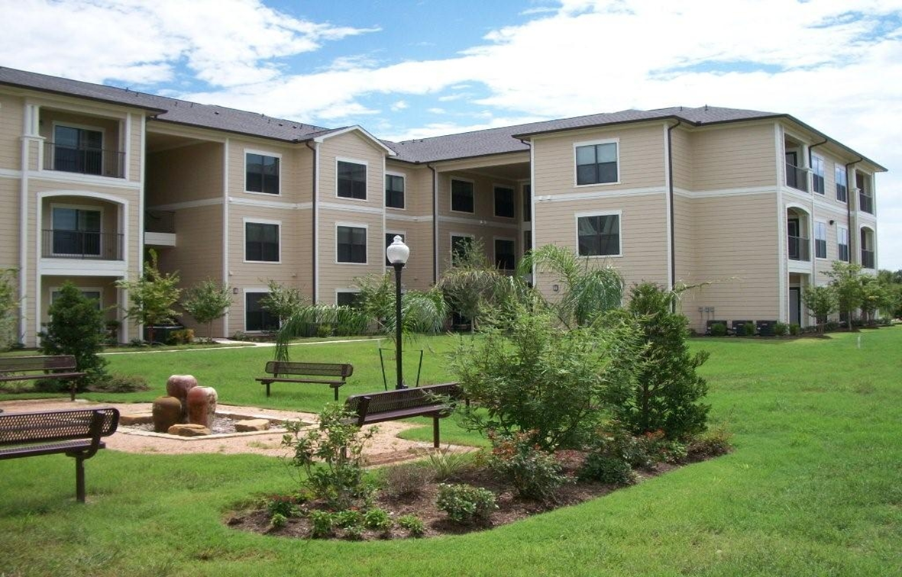
FUNDED BY HOME
Home Town on Wayside Senior Living Facility
Corinthian Village Senior Living Facility

Slide 12
ENTITLEMENT GRANTS THAT MEETS NEEDS
Housing Opportunities for Persons with AIDS (HOPWA)
HOPWA Funding is used for a wide range of housing, social services, program planning, and development costs, which include the acquisition, rehabilitation, or new construction of housing units.
HOPWA funds may also be used for health care and mental health services, chemical dependency treatment, nutritional services, case management, assistance with daily living, and other supportive services.

Slide 13
Housing Opportunities for Persons with AIDS (HOPWA)
Housing Assistance Activities/Projects Tenant Base Rental Assistance Short term mortgage and utility assistance A Caring Safe Place Multi-Family New Construction
Social Services Activities Healthcare & Counseling Career and Recovery (substance abuse) Reentry program support

Slide 14
ENTITLEMENT GRANTS THAT MEETS NEEDS
Emergency Solutions Grant (ESG)
Provides emergency assistance and rapid transitional housing (shelters) to allow the homeless population to quickly regain stability in permanent housing after experiencing a housing crisis and/or homelessness.

Slide 15
Emergency Solutions Grants (ESG)
Shelter & services to agencies that serve the homeless Coalition for the Homeless Homeless Management Database Healthcare for the Homeless Star of Hope Houston Area Women’s Center Asian American Family Services

Slide 16
2012 HUD ENTITLEMENT GRANT ALLOCATIONS
GRANTS | AMOUNTS
Community Development Block Grant (CDBG) | $24,227,493
Home Investment Partnership Grant (HOME) | $7,867,615
Housing Opportunities for Persons With AIDS (HOPWA) | $7,572,952
Emergency Solutions Grant (ESG) | $2,367,794
TOTAL | $42,085,854

Slide 17
WHAT TO CONSIDER WHEN APPLYING FOR ENTITLEMENT GRANTS
Fair Housing Act – Law passed by the U.S. Congress in 1968 prohibits discrimination in housing based on race, color, religion, national origin, sex, disability, familiar status.
Landlords, Real Estate Agents, Lenders, Cities, Counties, States, and Individuals cannot discriminate in housing.
Leverage Funds – Use different types of funding sources for community projects, such as philanthropic organizations, nonprofit fund raising, and individual donations.
Avoid Redundancy – Know the area you are serving and what it needs. An example: If the 5th Ward Area lacks affordable childcare facilities then it is a prime target for a CDBG public services grant to assist low – and moderate – income families with childcare services.

Slide 18
WHAT YOU NEED TO KNOW, NOW!
Fall Public Hearings – TELL US ABOUT YOUR COMMUNITY NEEDS!
Community Needs Survey (New!)
Both public hearings will use new and innovative technology to assess demographic, individual and community needs, as well as budget priorities for the 2013 Action Plan application for Entitlement Grants.
The public may also communicate their respective community needs by:
Presenting comments on the record at a hearing; and or
Taking the community needs survey online (posting to website 10/9/2012)
Write a letter to: Housing and Community Development Department, 601 Sawyer, 4th Floor, Houston, TX 77007, Attn: Andrea Jones, Public Hearing Coordinator (andrea.jones@houstontx.gov)
Monday, October 29, 2012
6:00 pm – 8:00 pm
Acres Homes Multi-Service Center
6719 W. Montgomery
Houston, TX 77091
For public transportation use
METRO: Acres Homes Transit Center
Thursday, November 8, 2012
6:00 pm – 8:00 pm
City Hall Annex
900 Bagby
Houston, TX 77002
For public transportation use
METRO: 6, 18, 36,40, 50

