Slide 1
Healthy Eating:
What does Community Have to do with It?
Carra Moroni, M.Ed., RD, LD
Arnulfo Rosario, Jr., MD, MPH

Slide 2
Overview
Some information about obesity
Brainstorm ideas to help people eat healthier
Define Healthy Eating
ABC’s of Healthy Eating

Slide 3
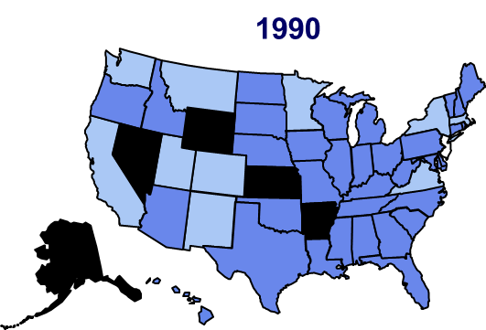
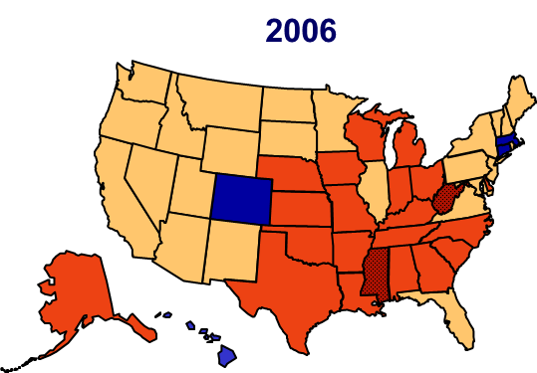
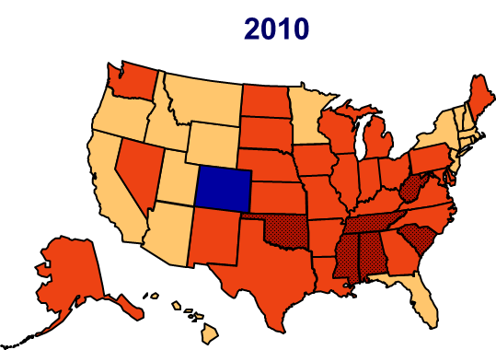
CDC Reports Overweight and Obesity
Notes:
Increased rates are not due to lack of knowledge

Slide 4
2012 Overweight & Obesity Trends
Notes:
Texas falls into the ‘too fat’ range.

Slide 5
Overweight and Obesity Facts
Texas Adults that are Obese: 30.4%
  Ranks 10th
Texas Adults Overweight and Obese: 65.9%
Texas Children Overweight and Obese: 32.2%
  Ranks 20th
Texas 2030 Obesity Rates: 57.2%
Harris County: Overweight and Obese 63%
RWJF: F as in Fat Report, 2011, 2012

Slide 6
People Don’t Eat Healthy Because….
People Would Eat Healthier if…

Slide 7
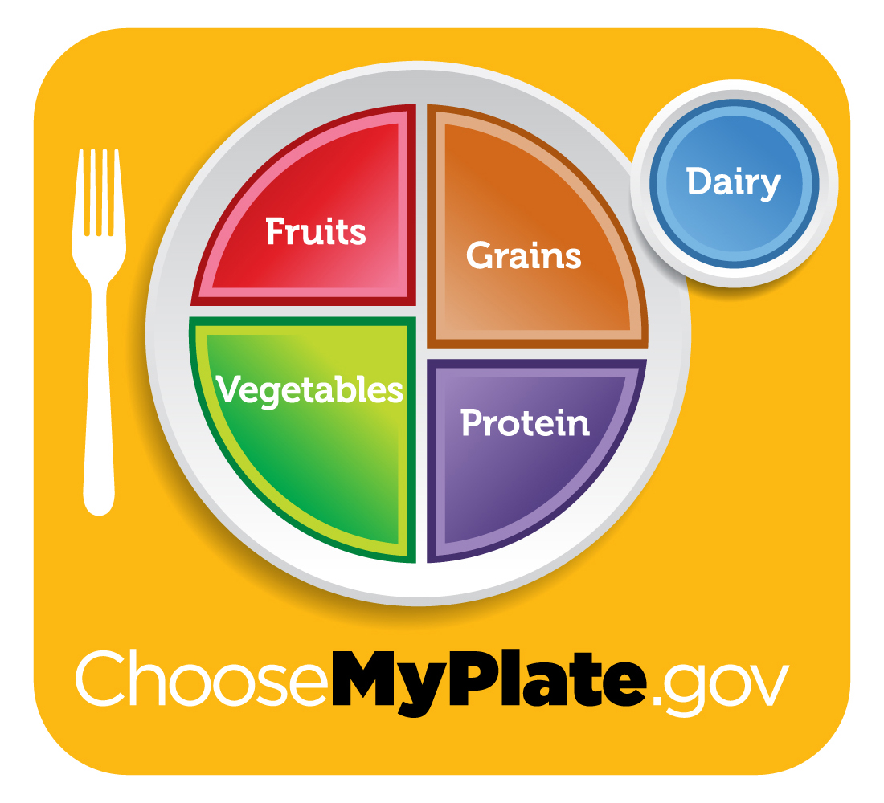
Healthy Eating is…
Healthy
Or
Not?

Slide 8
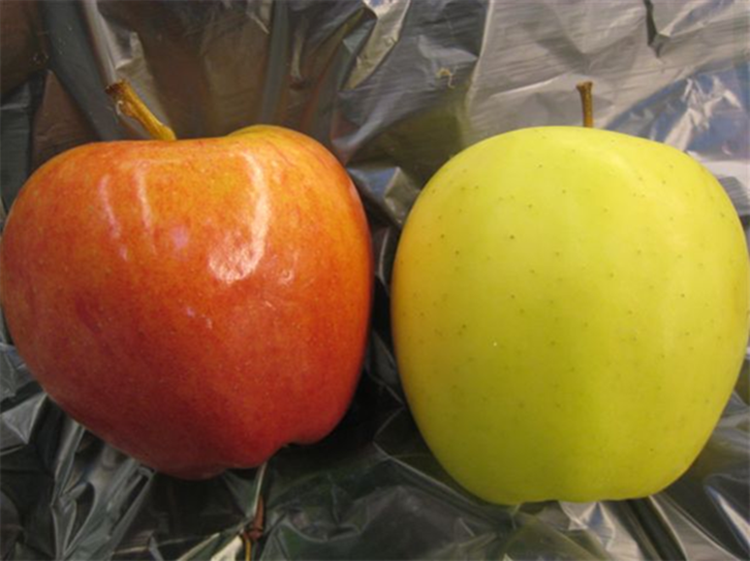
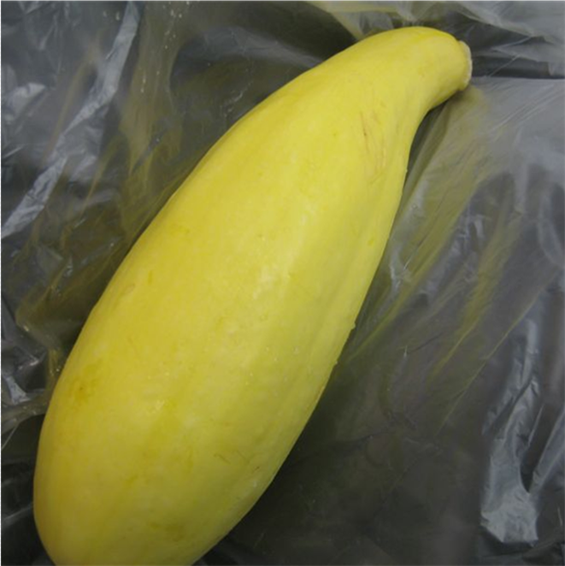
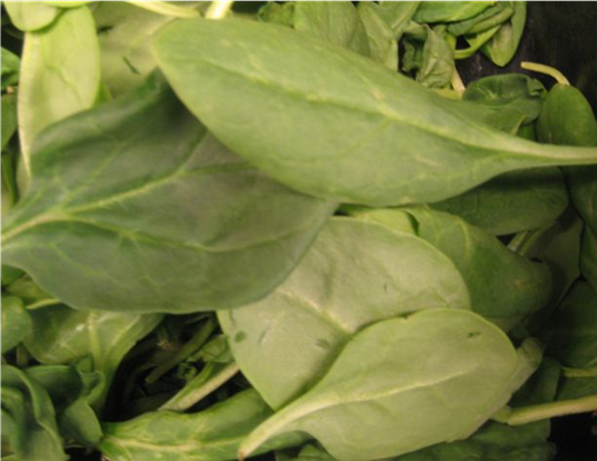
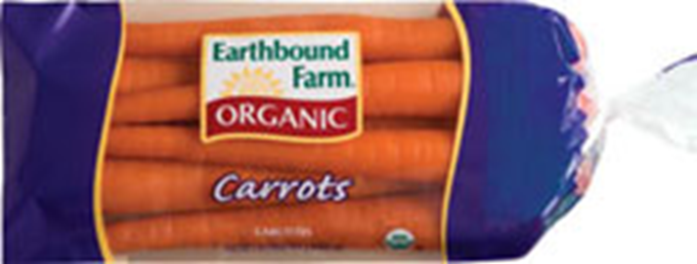

Slide 9
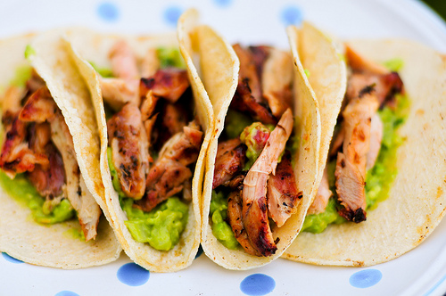

Slide 10
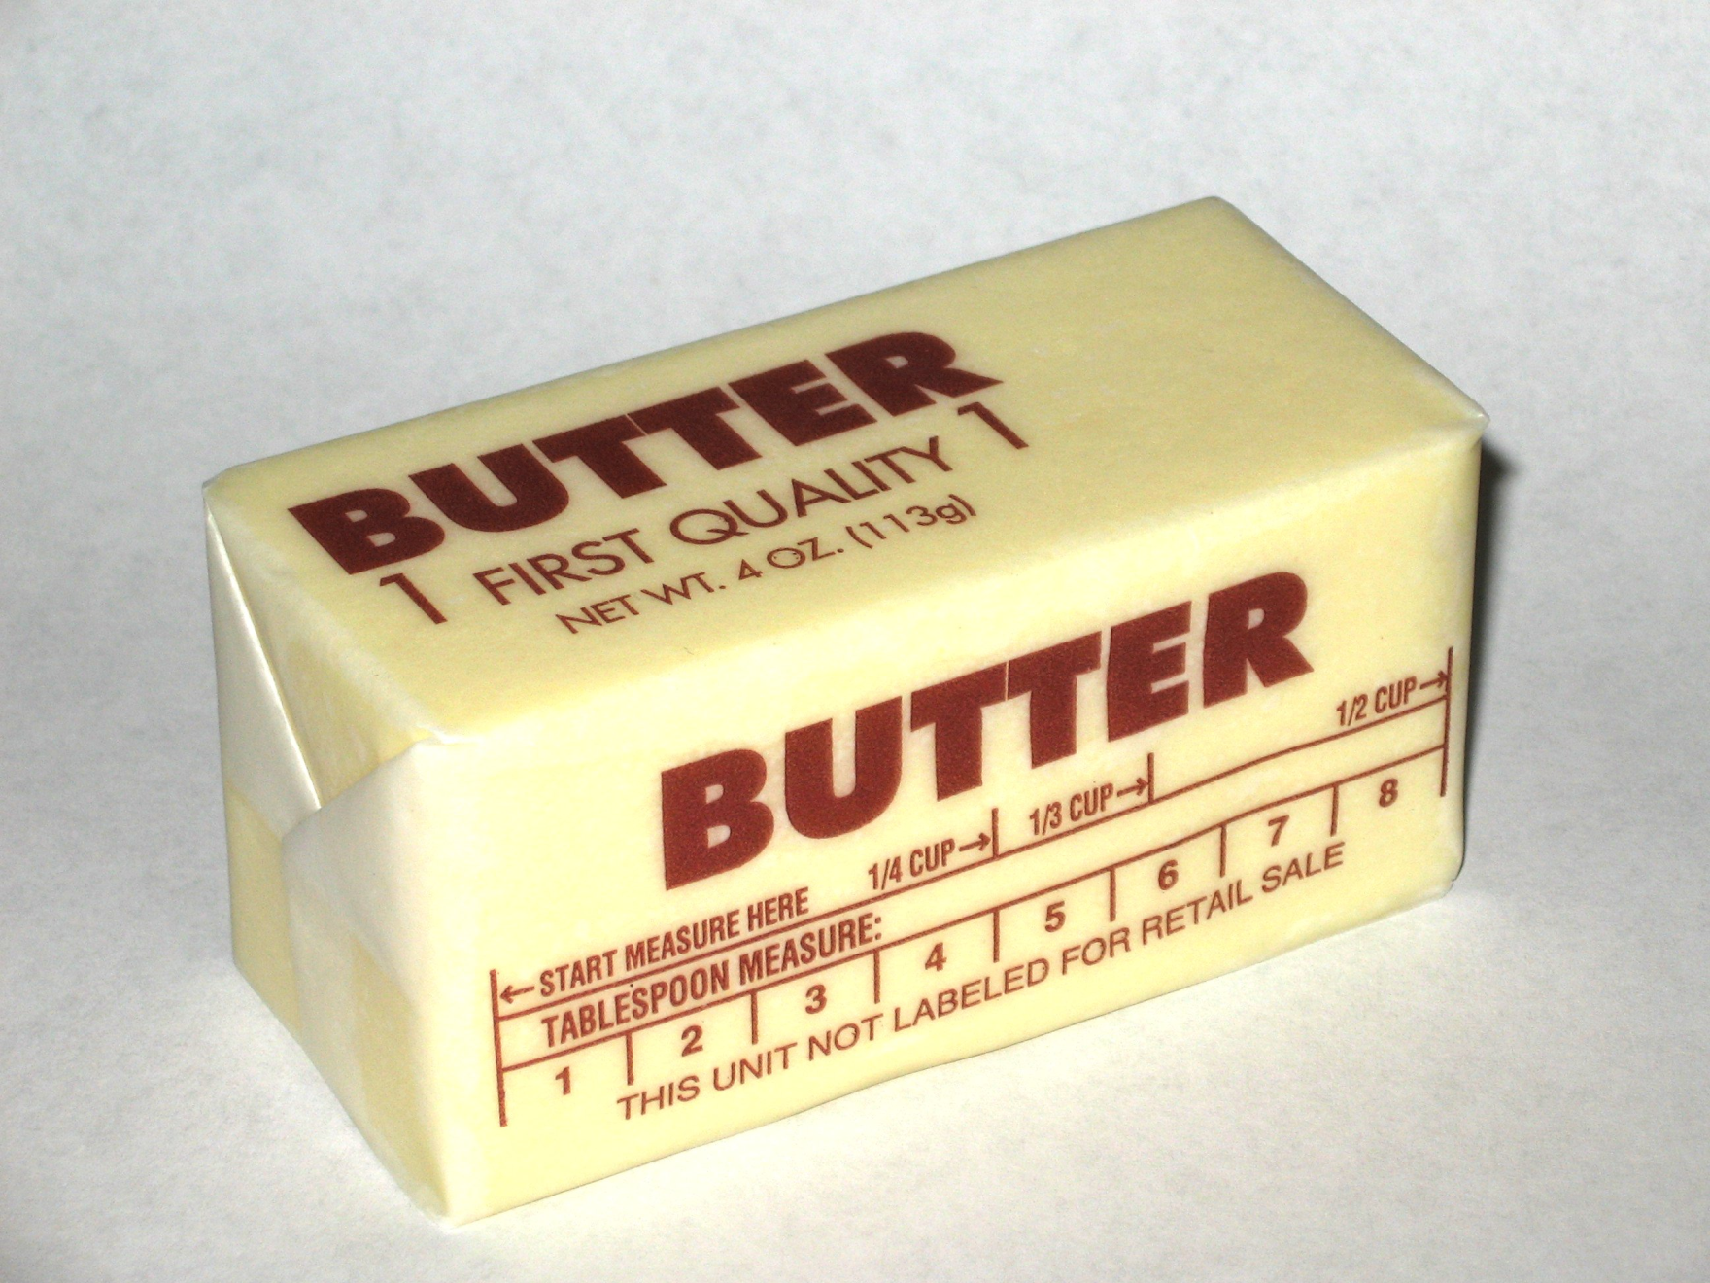

Slide 11
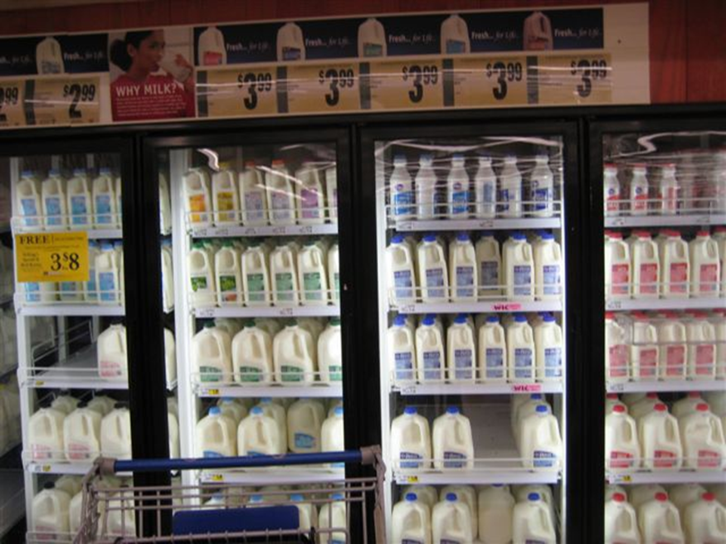

Slide 12
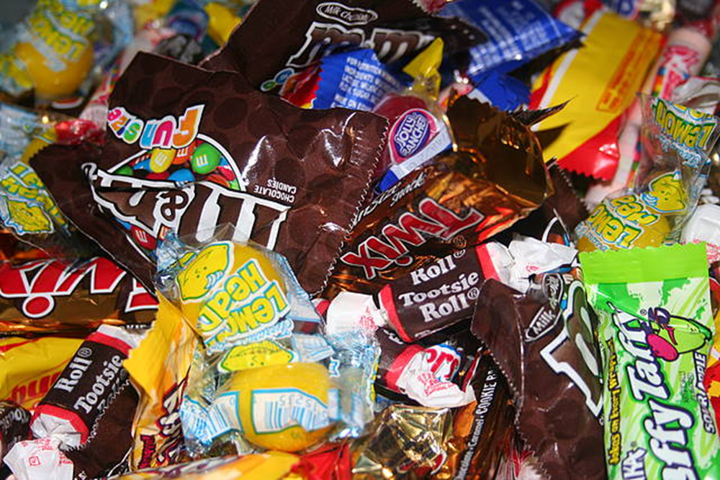

Slide 13
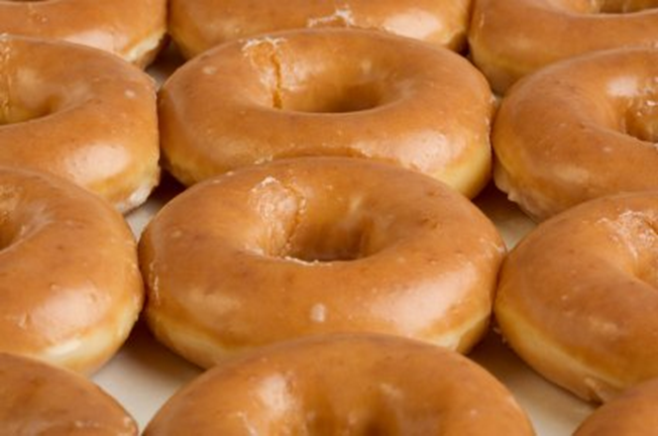

Slide 14
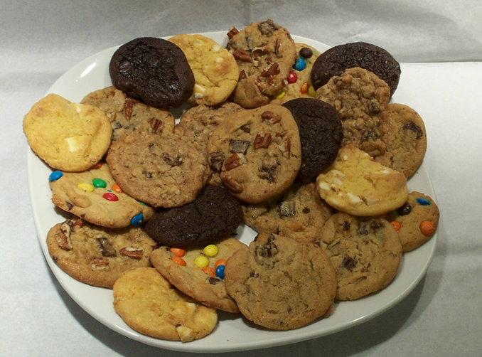

Slide 15
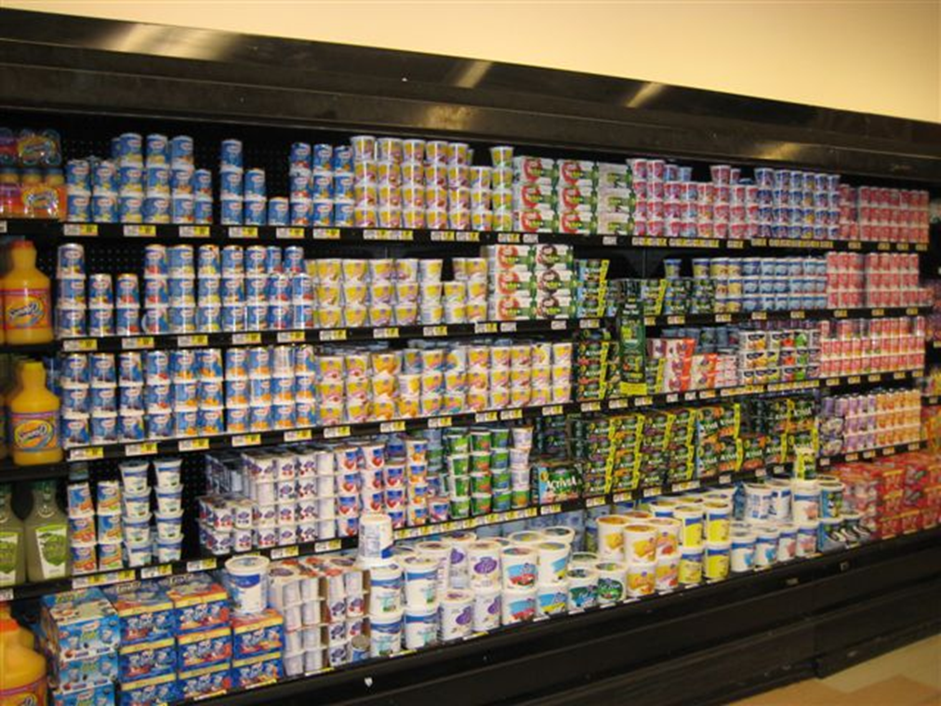

Slide 16
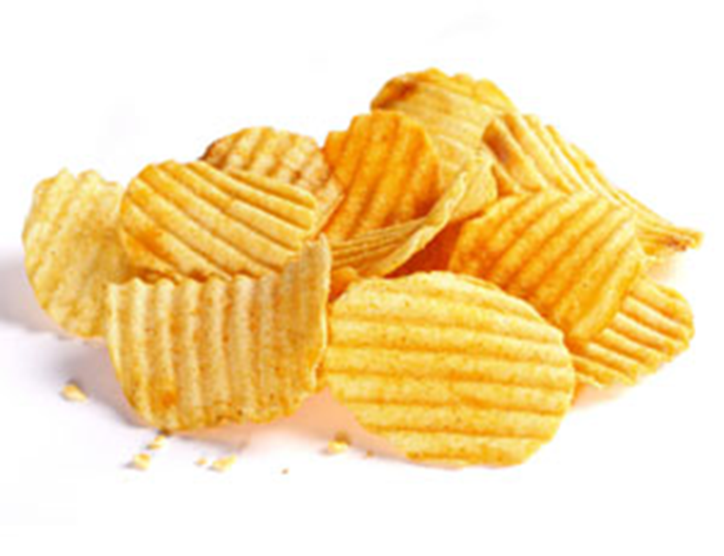

Slide 17
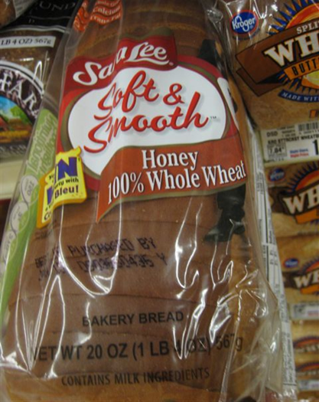

Slide 18
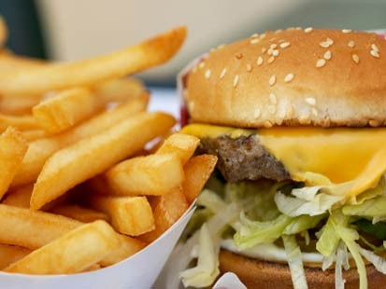

Slide 19
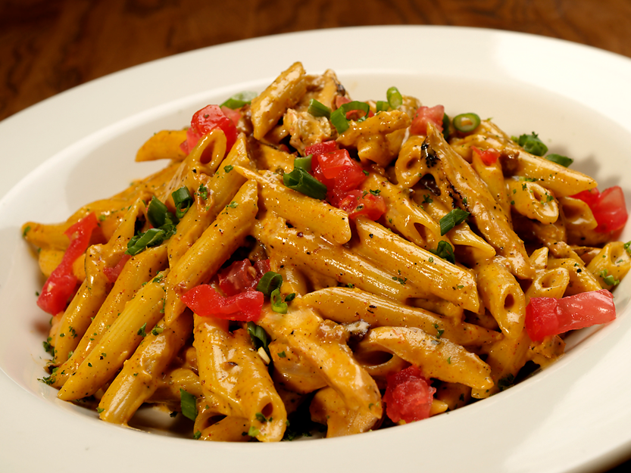

Slide 20
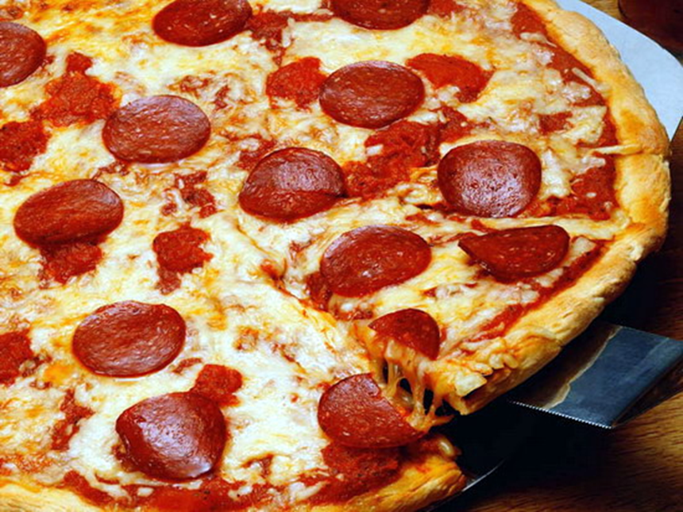

Slide 21
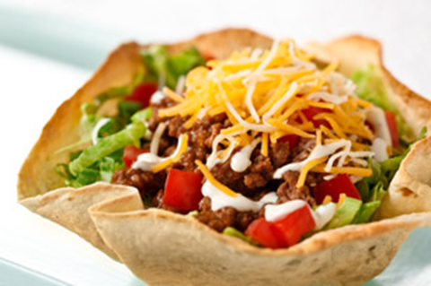

Slide 22
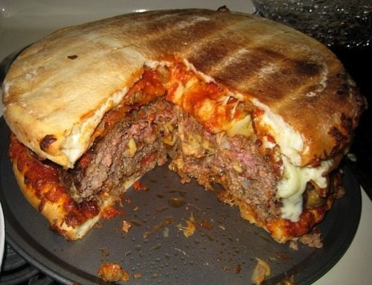

Slide 23
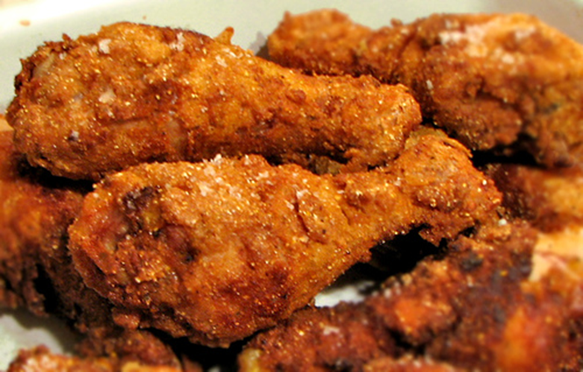

Slide 24
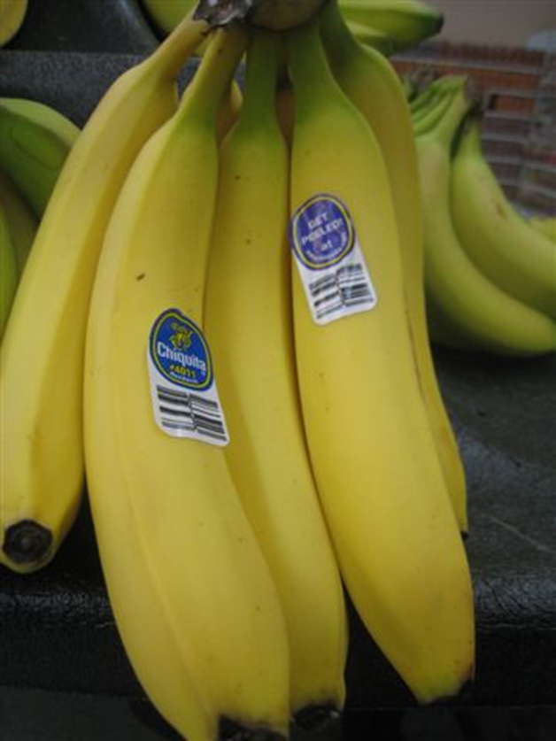

Slide 25
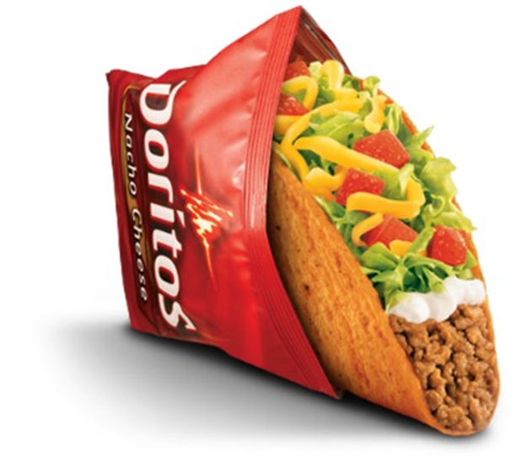

Slide 26
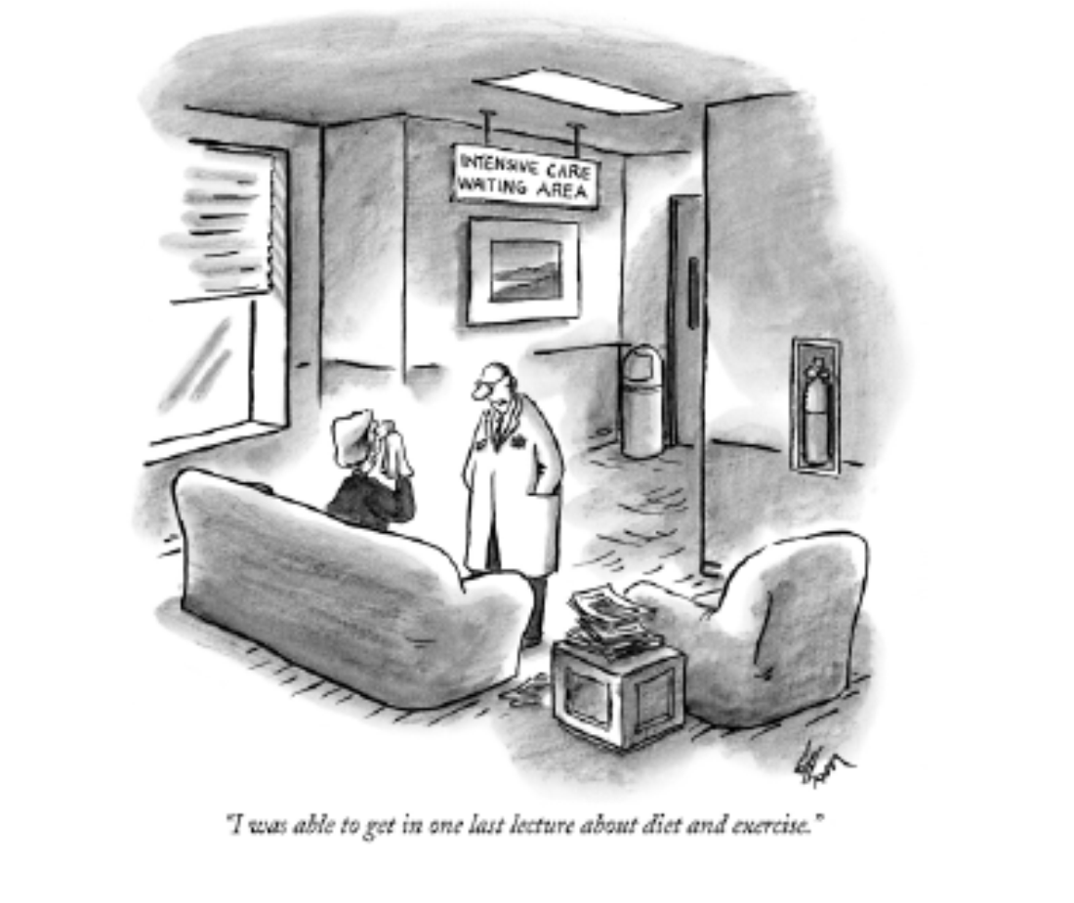
If we teach them, they will eat healthy?

Slide 27
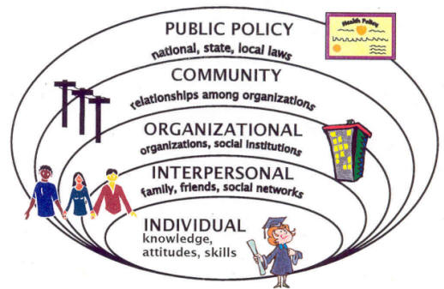
Social-Ecological Model
Notes:
The Social-Ecological model explains the interplay between and individual and their environment. As we go forth in our obesity prevention efforts we should use the model as a guide. A successful intervention targets multiple levels of the model. Strategies that focus on the outer rings of the model have an impact on a greater number of people (or individuals).
Aimed at changing the physical and sociopolitical environments
Provide opportunities, support, and cues to help people develop healthier behaviors
May directly affect behaviors or may alter social norms
More permanent than many public health programs focused on individual-level behavior changes (although an important complement)

Slide 28
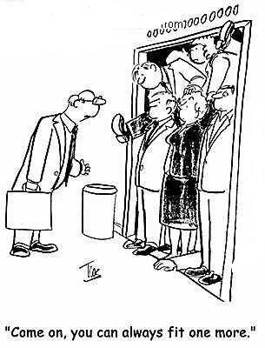
Population Based (Community) Solutions
cartoonstock.com
Notes:
Population Based Health
It is all about the number of people you impact, not the number of individuals served.

Slide 29
Focus Areas
Increased consumption of fresh fruits and vegetables
Decreased consumption of high energy-dense foods
Decreased consumption of sugar-sweetened beverages

Slide 30
A is for…
Availability
and
Access

Slide 31
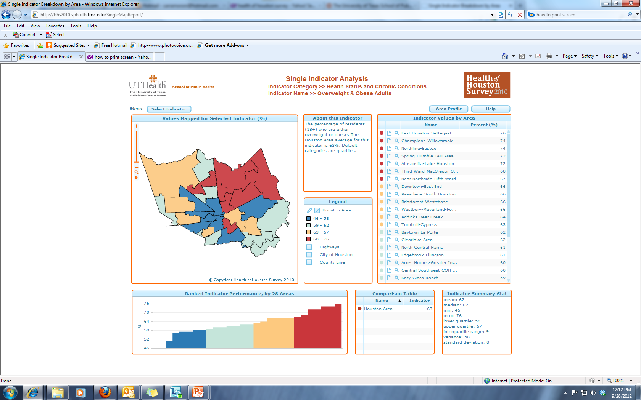
Place Matters

Slide 32
Availability and Access
Grocery stores, corner stores, convenience stores
Restaurants
Car ownership
Transit Options
Design
Farmers Markets
Community Gardens
Mobile Food Carts
Notes:
Impact of where you live on what you eat:
Communities that have no or distant grocery stores but INSTEAD nearby fast food restaurants and convenience stores:
• More likely have increased premature death and chronic health conditions
wHeRe you LIVe matteRs: moVInG to HIGHeR-Income aReas ReDuces
RIsK oF obesIty anD DIabetes FoR pooR women:
between 1994 and 1998 the u.s. Department of Housing and urban Development (HuD) randomly assigned
families living in public housing projects in high-poverty neighborhoods into an experimental and
control group. the experimen- tal group was given vouchers to move to higher- income neighborhoods,
and the control group did not receive vouchers. Findings of the study, which were released in the New England Journal
Of Medicine, revealed that having the option to move to lower-poverty neighborhoods lowered the risk
of obesity and diabetes among poor women.100 women who were given the vouchers were almost
one-fifth less likely to become extremely obese and were one-fifth less likely to develop diabetes
compared with women who were not offered the housing voucher.101

Slide 33
B is for…
Budget
Bucks
Bottom Line

Slide 34
Thinking about the costs
Individual
Community
Notes:
Healthy food versus unhealthy foods: Appears to be cheaper but long term is more expensive.
Economic development. High end grocery versus staples.

Slide 35
C is for…
Convenience
and
Community

Slide 36
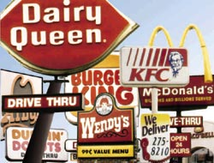
What is the easy choice?

Slide 37
Brainstorming: Ways a Community can help to make healthy eating easy for our citizens?
Decreasing Sugar–Sweetened Beverages:
  How easy and available are sugar-sweetened beverages?
  How accessible are drinking fountains in our community?
  Is water an easy and available choice at work? Community events? What about vending machines around the community? How about restaurants?

Slide 38
Brainstorming: Ways a Community can help to make healthy eating easy for our citizens?
Decreasing Consumption of High–Energy–Dense Foods/Increasing Consumption of Fruits and Vegetables:
  Do we have accessible healthy or unhealthy food options at work? Near schools? At community events? Sporting events?

Slide 39
Brainstorming: Ways a Community can help to make healthy eating easy for our citizens?
What other changes could we make in our community to help foster healthy eating and active living?
Who should be involved in this initiative?

Slide 40
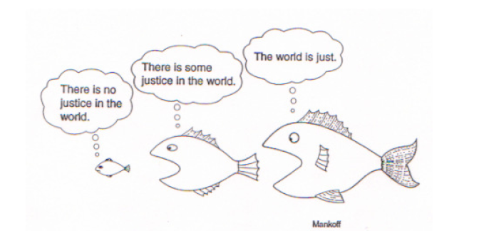
Notes:
As just a little fish in the sea, it may seem that the world has no justice or that it is hard to make changes. However, I beg to differ.

Slide 41
Notes:
Margaret Mead once wrote ‘Never doubt that a small group of thoughtful committed citizens can change the world; indeed it’s the only thing that ever has.’

Slide 42
Policy + Environmental + Community Changes = Obesity Prevention
Many people believe that dealing with overweight and obesity is a personal responsibility. To some degree they are right, but it is also a community responsibility. When there are no safe, accessible places for children to play or adults to walk, jog or ride a bike, that is a community responsibility”
–David Satcher, The Surgeon General’s Call to Action to Prevent and Decrease Overweight and Obesity, 2001

Slide 43
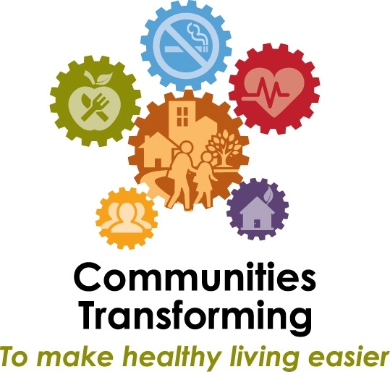
Community Transformation Initiative

Slide 44
Notes:
What type of change do you want to make in your community?

Slide 45
communitytransformation@houstontx.gov
Thank you!

