Slide 1
GO Neighborhoods
Engaging Community Leaders for Neighborhood Change
Presentation to Community U
September 29, 2012
(
Amanda Timm Jenifer Wagley
Executive Director Assistant Director
Houston LISC Avenue CDC

Slide 2
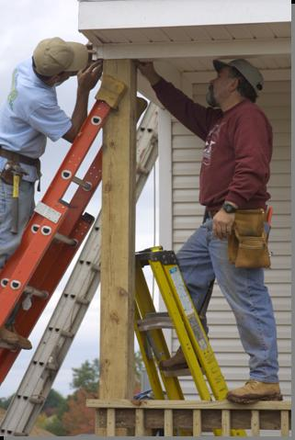
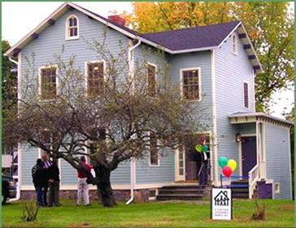
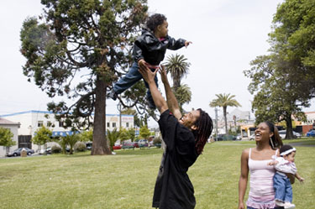
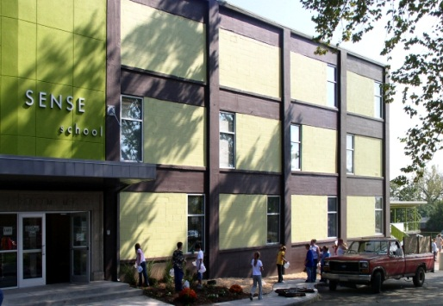
2. Increasing family income and wealth
1. Expanding investment in housing and other real estate
3. Stimulating economic activity, locally and regionally
Five Goals of
Building Sustainable
Communities =
Comprehensive Community Development
5. Fostering livable, safe and healthy environments
4. Improving access to quality education

Slide 3
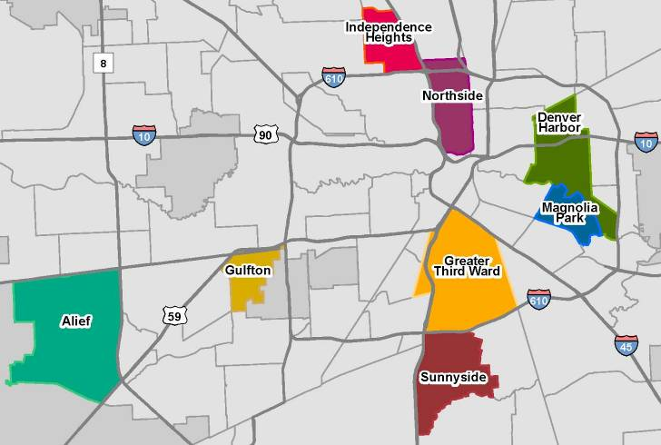
GO Neighborhoods and Pipeline Communities

Slide 4
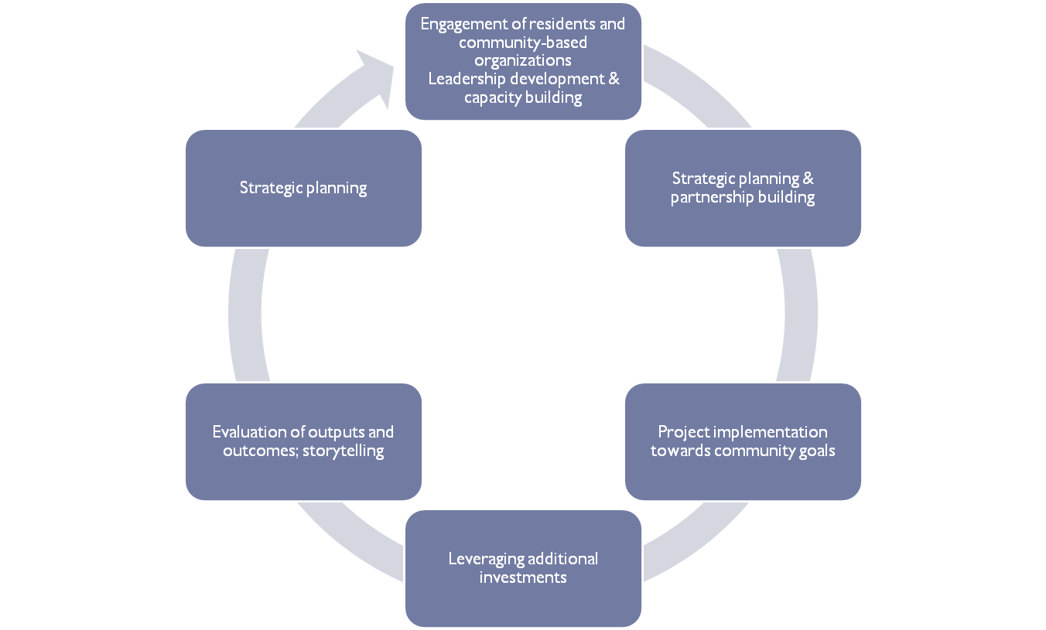
GO Neighborhoods Process

Slide 5
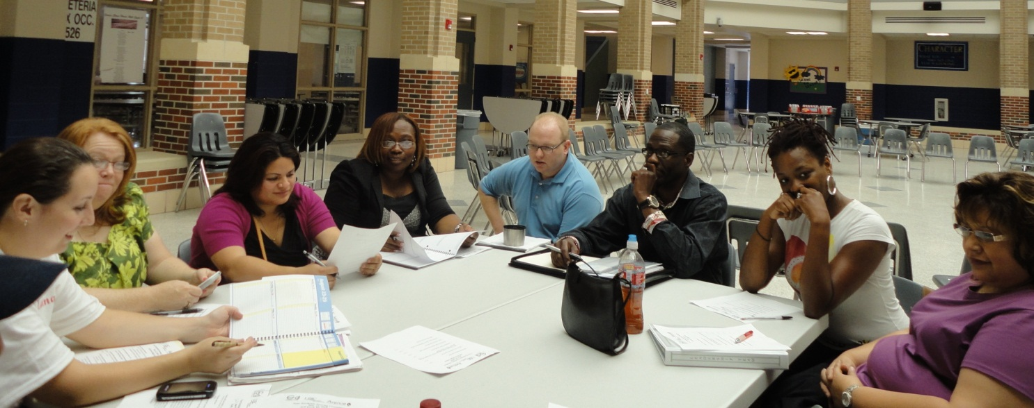
Elements
Community Engagement
Early Action Projects
Quality of Life Agreements
Implementation - Projects and Programs
Leadership Development and Support
Partnerships and Resources

Slide 6
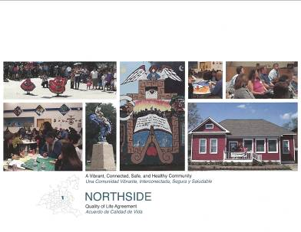
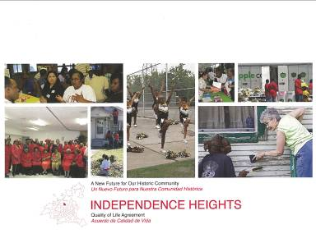
Quality of Life Agreements www.go-neighborhoods.org – Tools and Publications
Focus Areas
Physical Development
Social Services
Housing
Community Safety
Public Services
Health
Environment & Beautification

Slide 7
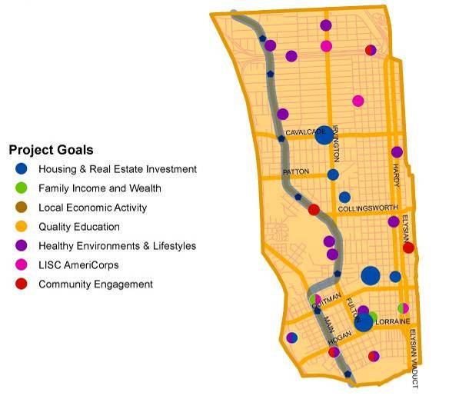
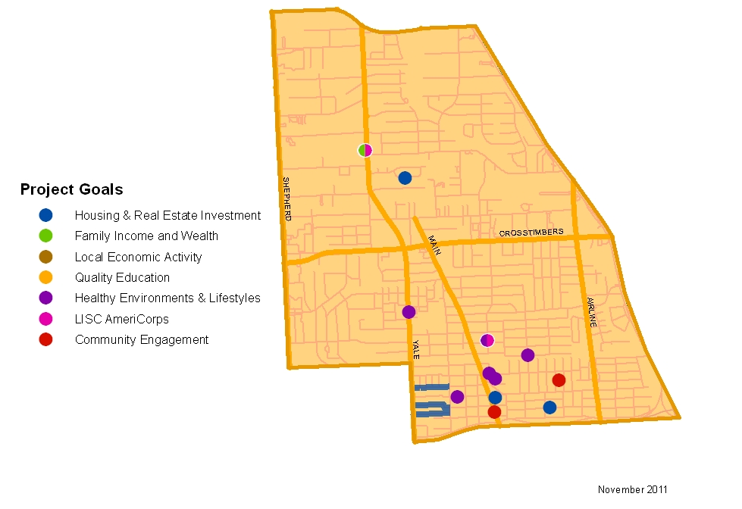
Investments and Projects
Northside
Independence Heights

Slide 8
Program Investors
United Way of Greater Houston
Houston Endowment
U.S. Department of Housing and Urban Development
State Farm Insurance Companies
JPMorgan Chase Foundation
Barlovento Foundation
Bank of America

Slide 9
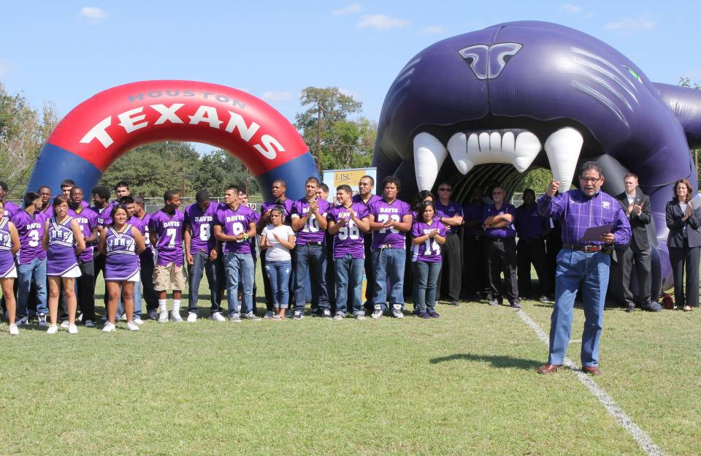
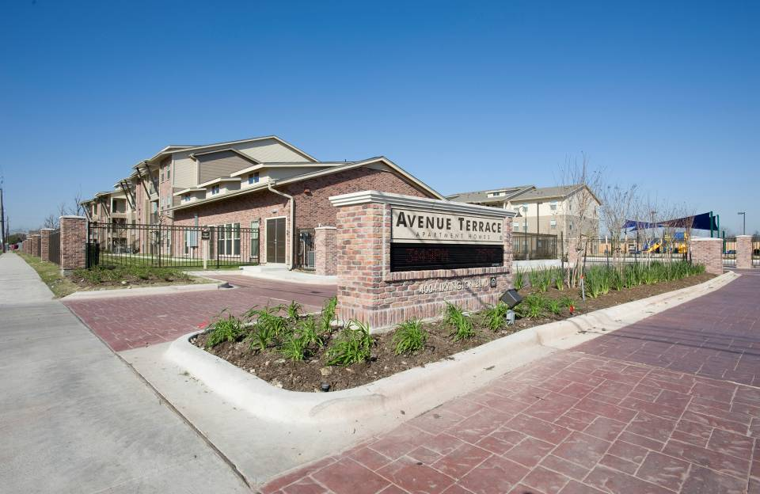

Slide 10
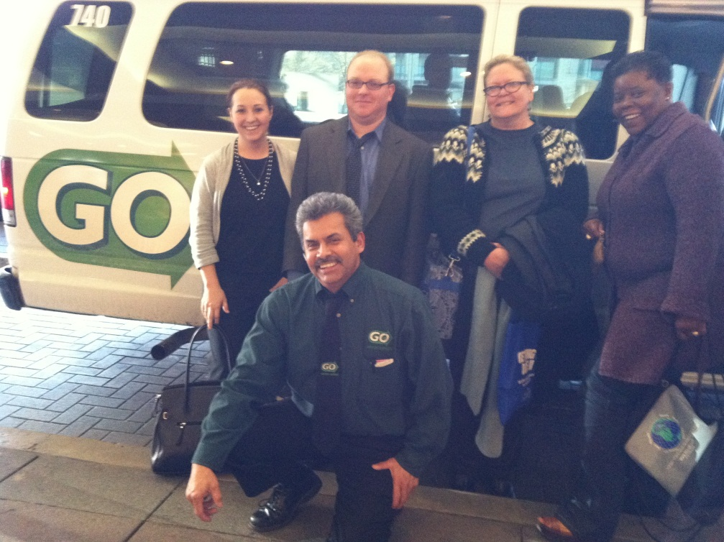
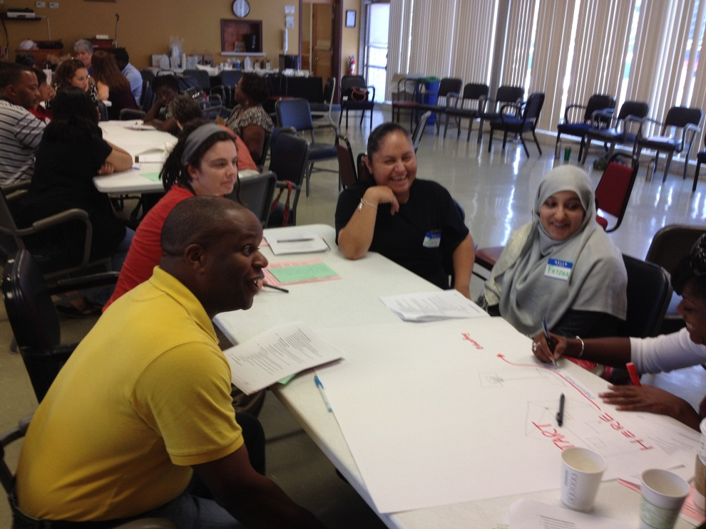
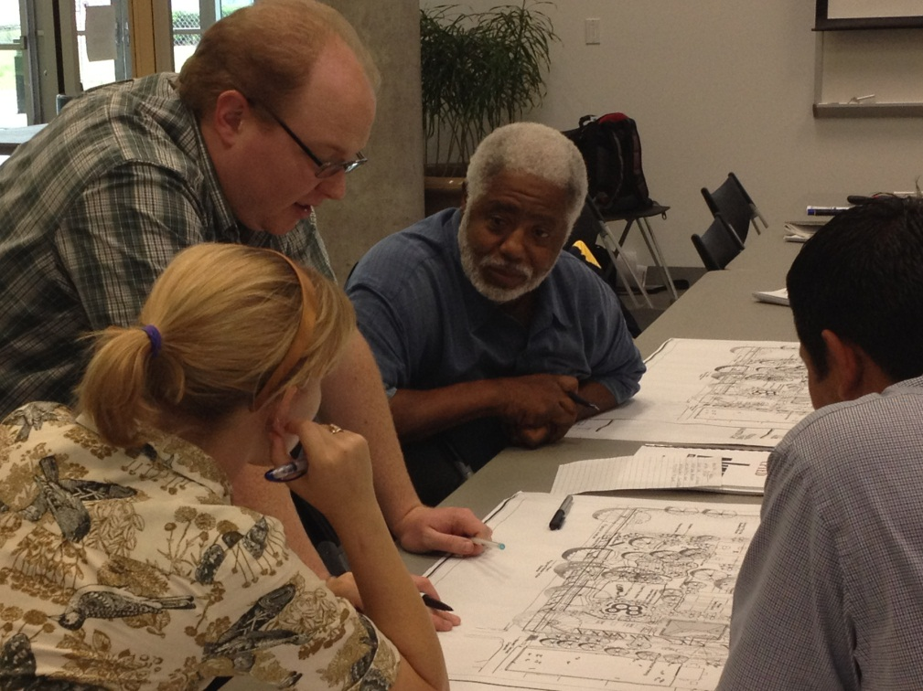

Slide 11
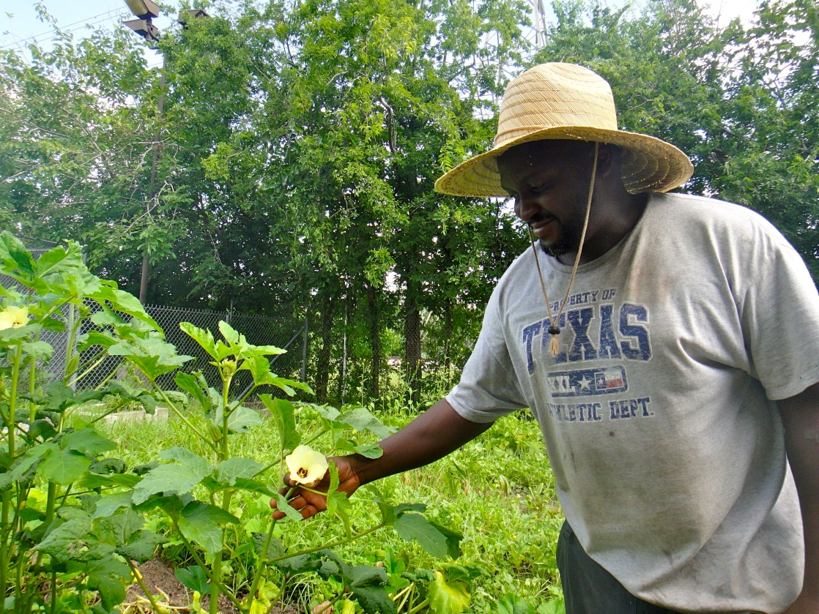
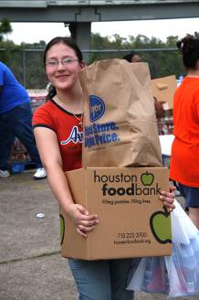
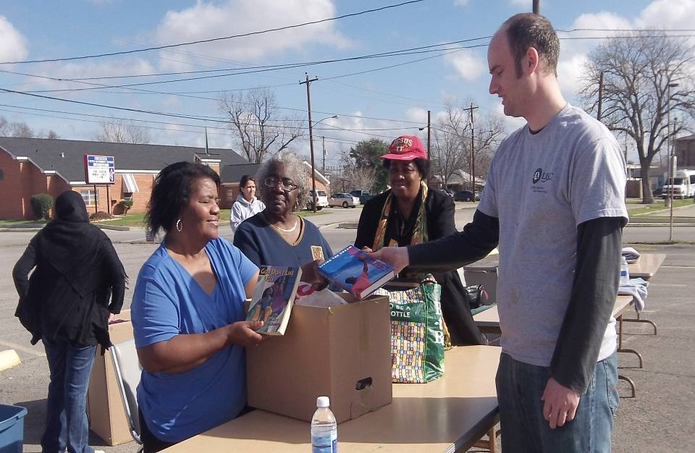

Slide 12
Local Initiatives Support Corporation
Amanda Timm
Executive Director
atimm@lisc.org
www.lisc.org/houston
Avenue CDC
Jenifer Wagley
Assistant Director
Jenniferw@avenuecdc.org
www.avenuecdc.org

