Slide 1

Houston Police Department
Differential Response Team
Charles A. McClelland, Jr.
Chief of Police
Problem Solving Strategies Community Policing Concepts
Presented by Sgt. Mike Hill
Notes:
Introduction Page of the D.R.T. presentation, officers introduce themselves

Slide 2
Differential Response Team
Mission Statement
The mission of the Houston Police Department’s Differential Response Team (DRT) is to use non-traditional policing methodology to improve the quality of life in the community. The mission is accomplished by actively seeking the involvement of all stakeholders in the community to identify quality of life issues with a crime nexus, which are then addressed by DRT officers via direct involvement using applicable available resources. The neighborhoods are the basic segments of the community and the DRT officers work pro-actively to solve problems and reduce the fear of crime at the neighborhood level.
Notes:
Paraphrase, explain nexus

Slide 3
D.R.T. - About Us
Uniformed officers that operate as separate units within patrol divisions
All patrol divisions have at least one D.R.T. Officer - the largest having 18
Separate chain of command working closely with patrol
Division Commander directs the focus of the unit for the community they serve
Shifts vary from among the divisions
Notes:
Speaker will go over the make-up and composition of a D.R.T. team.

Slide 4
D.R.T. Explained
Highly trained multi-discipline unit
Expertise in City Codes and their applications as enforcement tools
Scan Analysis Response Access (S.A.R.A) method (Problem Solving)
Broken Windows Theory
Notes:
Speaker will go over the qualifications of a D.R.T. unit member and give insight into their training. Our conversion from SARA to Problem solving

Slide 5
The Broken Windows Theory
A broken window, a weeded lot or a junk motor vehicle, do no great harm to a neighborhood if promptly addressed. But left untended, it sends a signal: no one cares about this neighborhood. Those who engage in such behaviors will feel safe here.
In short the smallest symptoms of antisocial behavior will, left to fester, breed greater and greater crimes, all the way down to murder.
Notes:
Speaker will explain the broken windows theory credit Wickipedia

Slide 6
Divisional Crime Alert Network (DCAN)
Your Logo
Here
The DCAN network is being activated to look for a suspect in your area
Notes:
Pilot approved by Chief Hurtt in March 2007 at Fondren Division, approved for city-wide usage. Used in conjunction with out Positive Intervention Program or PIP

Slide 7


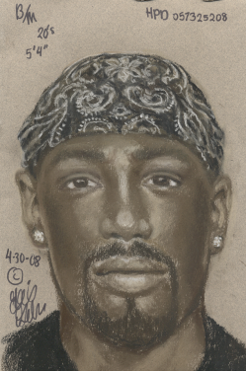
ALERT
ALERT
ALERT
FONDREN
CRIME ALERT
NETWORK
Positive Interaction Program
The FCAN network is being activated to look for a suspect in your area.
If you see this person DO NOT APPROACH OR MAKE
CONTACT CALL THE POLICE IMMEDIATELY!!
911
-
911
-
911
Wanted in an Aggravated Robbery case # 57325208
Black Male
20 to 30 years of age 5'05" to 5'08" in height
medium to heavy build (suspect’s baggy clothing hid some features)
light brown skin complexion, Used a described black semi automatic handgun.
A .25 caliber casing was found on the scene.
Vehicle description: Large White 4 Door Vehicle
For more information call Officer J. Esquivel, P.I.P
Coordinator at (713) 981-7051 at the Braeburn Storefront,
or Officer Beasley (281) 584-4773, Westside Robbery.
Notes:
This is one of the earliest alerts from the pilot. Several successful leads have been produced and the programs was very well received by the PIP community. Sketch by Lois Gibson from witness interview.

Slide 8
Crime Triangle
Victim
Offender
Location
Notes:
The three legs are in proportion to the stats… V=42 O=55 L=60

Slide 9
Statistics Show
10 % of offenders commit 55% of all crimes
10% of victims account for 42% of victimization
10% of locations account for 60% of calls for service
Source TIPPS
Notes:
Focus on the location and the environment that makes it conducive to crime. CFS reduction will be lowered

Slide 10
State Law
LOCAL GOVERNMENT CODE
TITLE 2. ORGANIZATION OF MUNICIPAL GOVERNMENT
SUBTITLE D. GENERAL POWERS OF MUNICIPALITIES
CHAPTER 54 . ENFORCEMENT OF MUNICIPAL ORDINANCES
SUBCHAPTER A. GENERAL PROVISIONS
Sec. 54.001. GENERAL ENFORCEMENT AUTHORITY OF MUNICIPALITIES; PENALTY.
(a) The governing body of a municipality may enforce each rule, ordinance, or police regulation of the municipality and may punish a violation of a rule, ordinance, or police regulation.
(b) A fine or penalty for the violation of a rule, ordinance, or police regulation may not exceed $500. However, a fine or penalty for the violation of a rule, ordinance, or police regulation that governs fire safety, zoning, or public health and sanitation, including dumping of refuse, may not exceed $2,000.
(c) This section applies to a municipality regardless of any contrary provision in a municipal charter.
Notes:
All municipalities are empowered by state law to enact ordinances similar to ours to regulate these public safety issue

Slide 11
Chapter 10
Houston does not have Zoning we have Chapter 10 which focuses on Neighborhood Protection
Sec. 10-451. - Nuisances, generally.
(a) - Whatever is dangerous to human health or welfare, or whatever renders the ground, the water, the air, or food a hazard to human health is hereby declared to be a nuisance.
Notes:
The ordinance is over 30 pages long, but this section encapsulates the spirit of the intent

Slide 12
Our Authority
Houston Police Officers are authorized to write city code violations (non-traditional for police), with additional training in the areas of the violations
D.R.T. Officers first take a departmental certification class consisting of several disciplines (Health Dept, Building Inspectors, ect.) then continue with field training by experienced officers and inspectors on investigations
Notes:
Speaker will explain the limits of powers granted to Houston Police Officers when it comes to Municipal Codes.

Slide 13
Legitimate Expectations of Problem Solving
Eliminate the problem
Reduce the problem
Repair an Element of the problem
Move the problem
Notes:
Best to least case outcomes, even moving the problem may cause an overall reduction

Slide 14
OUR GOAL
Abatement!!
DRT’s primary objective is:
  Take care of the problem!
  Warnings (verbal and written)
  Citations (criminal and civil summons)
  Arrest
  Civil lawsuits
Notes:
First DRT educates and warns usually with a written notice, then citations, next arrest if warranted, finally civil law suit by city

Slide 15
Training
Notes:
In training handbooks with photos and explanations are issued, initial certification is not complete until all field training items are completed, CW DRT provide guidance with check list, SOP’s and required annual training.

Slide 16
How Do We Get There?
Positive Interaction Program - P.I.P
Super Neighborhood groups
Homeowners Associations
Crime prevention presentations
311 (phoned or email)
Emails and letters to elected officials
Complaints to units by: Phone /Email/Fax
Mayor, City Council and Chief of Police
Notes:
Many sources (stakeholders) send complaints that are directed to DRT officers

Slide 17
Citizen’s complaint form
Notes:
Complaint forms are given out at community meetings and can be Faxed, emailed or dropped off at the divisional DRT offices

Slide 18
NOTICE OF VIOLATION
Notes:
DRT officers use written violation warning forms with due dates listed for compliance. ID info for violator is listed and citations issued at a later date based on initial investigation
DRT officers use written violation warning forms with due dates listed for compliance. ID info for violator is listed and citations issued at a later date based on initial investigation

Slide 19
Solving Problems Through Traditional and Untraditional Means
INSERT CHESHIRE
Notes:
Multiple burglaries, patrol officer referred to DRT. Solution found bar and lights added – no more burglaries

Slide 20
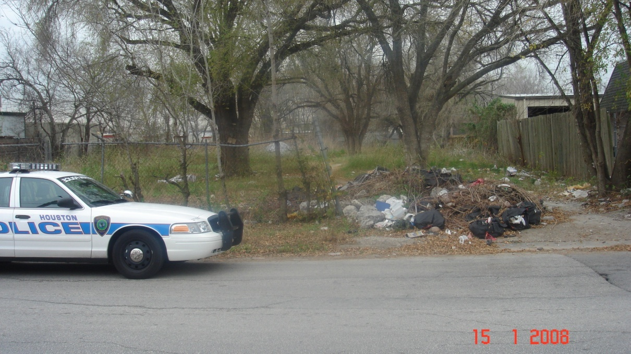
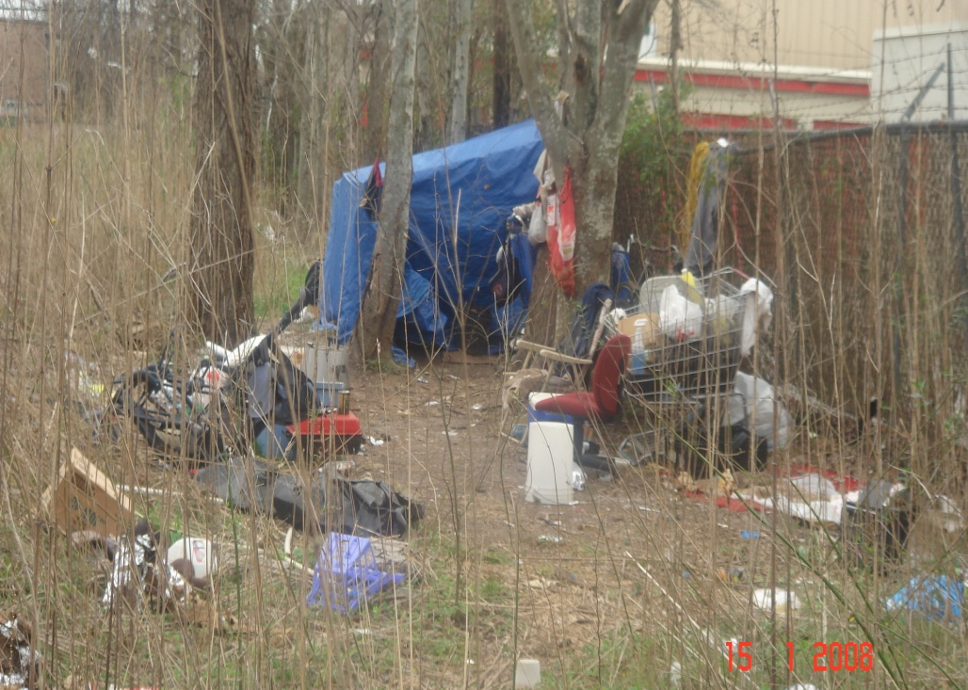
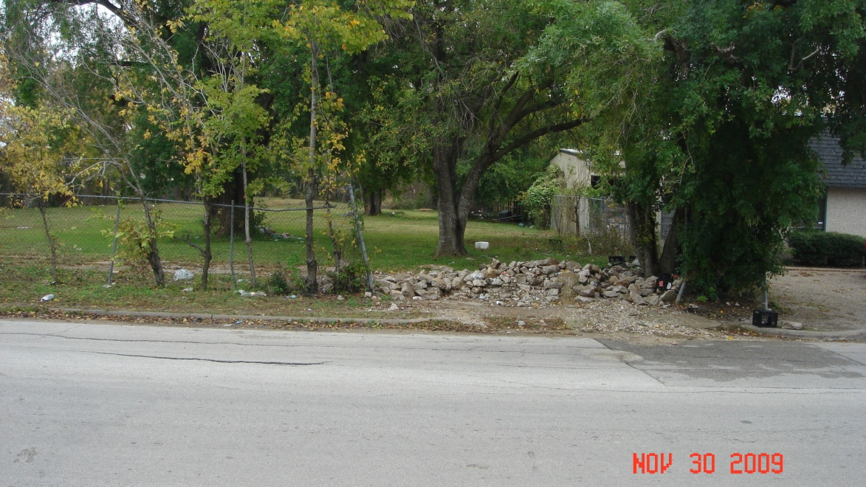
Weeded Lots
Notes:
Residences on both sides, elementary school one blk away, several men camped out on property. Warnings given, citations issued, fines levied then progress lot cleaned up and maintained.

Slide 21
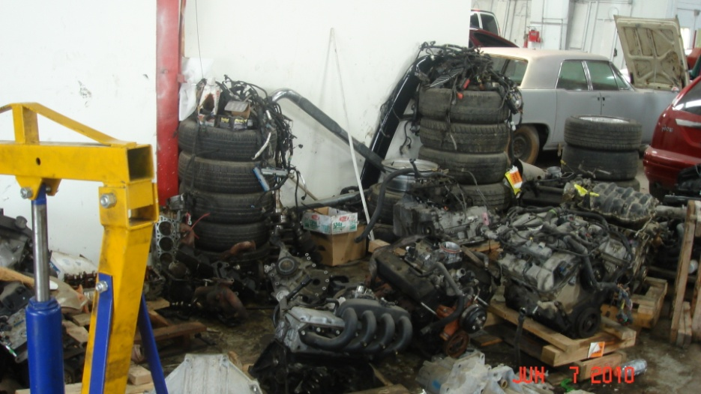
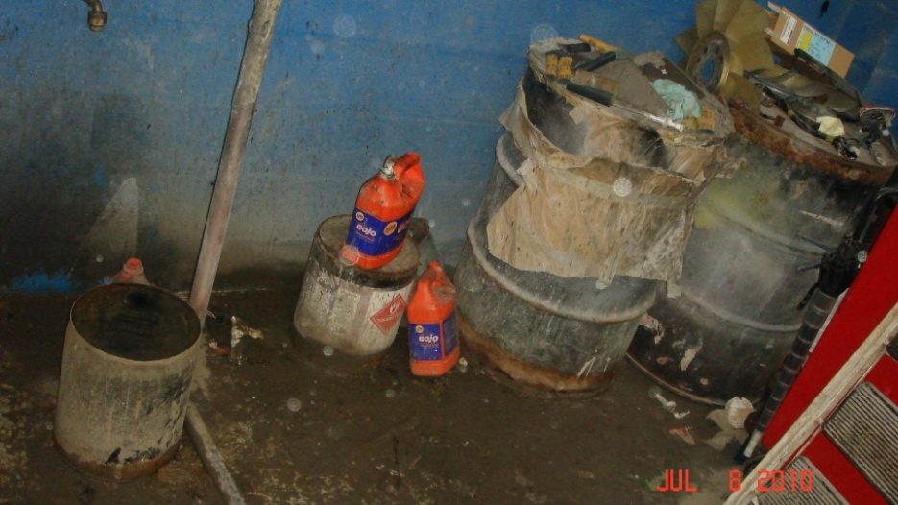
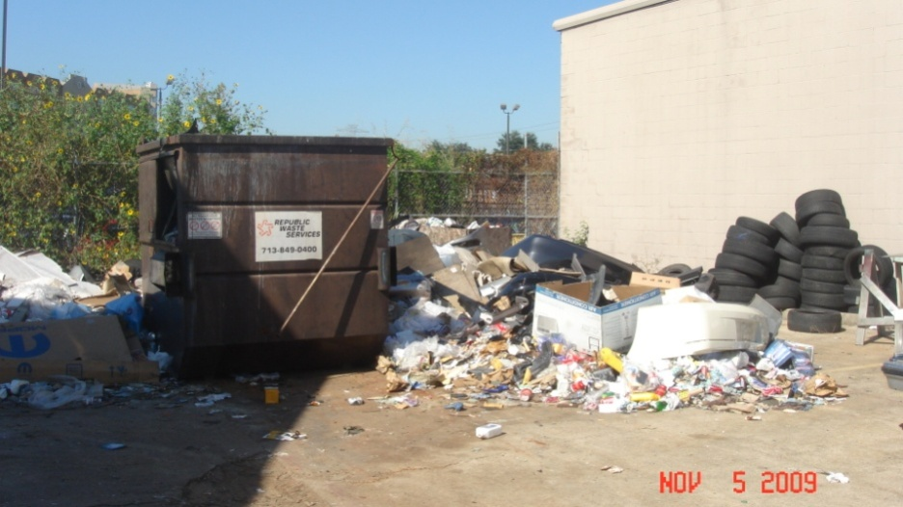
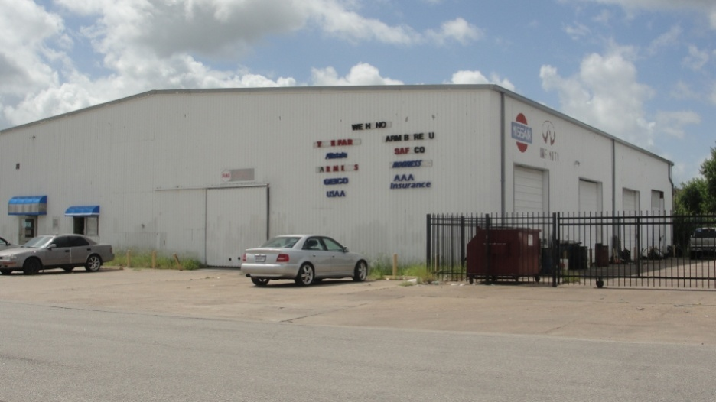
Auto Repair Facilities
Notes:
Auto facilities create water pollution and fire dangers, in Houston tires left outside quickly become breeding grounds for mosquitoes

Slide 22
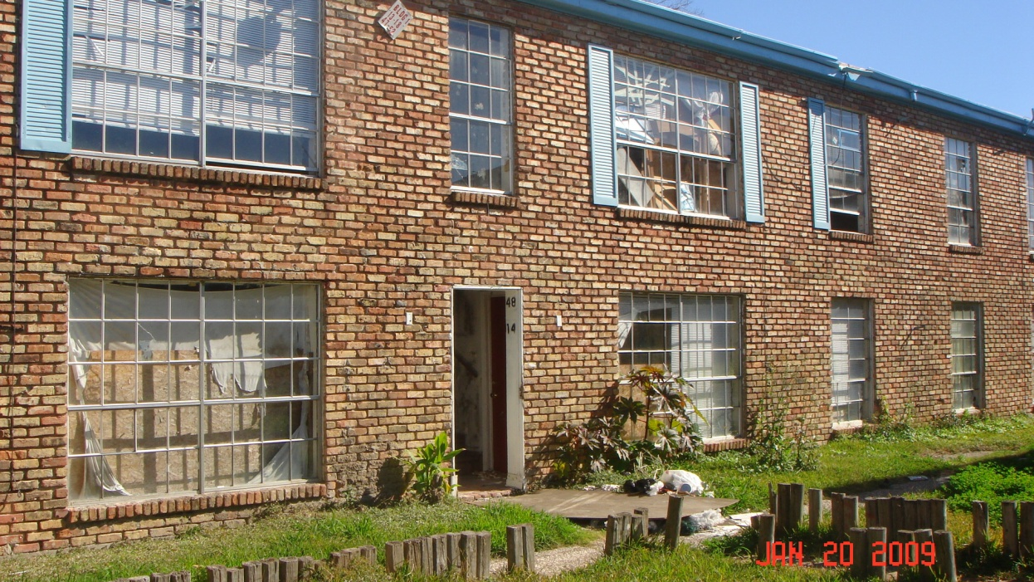
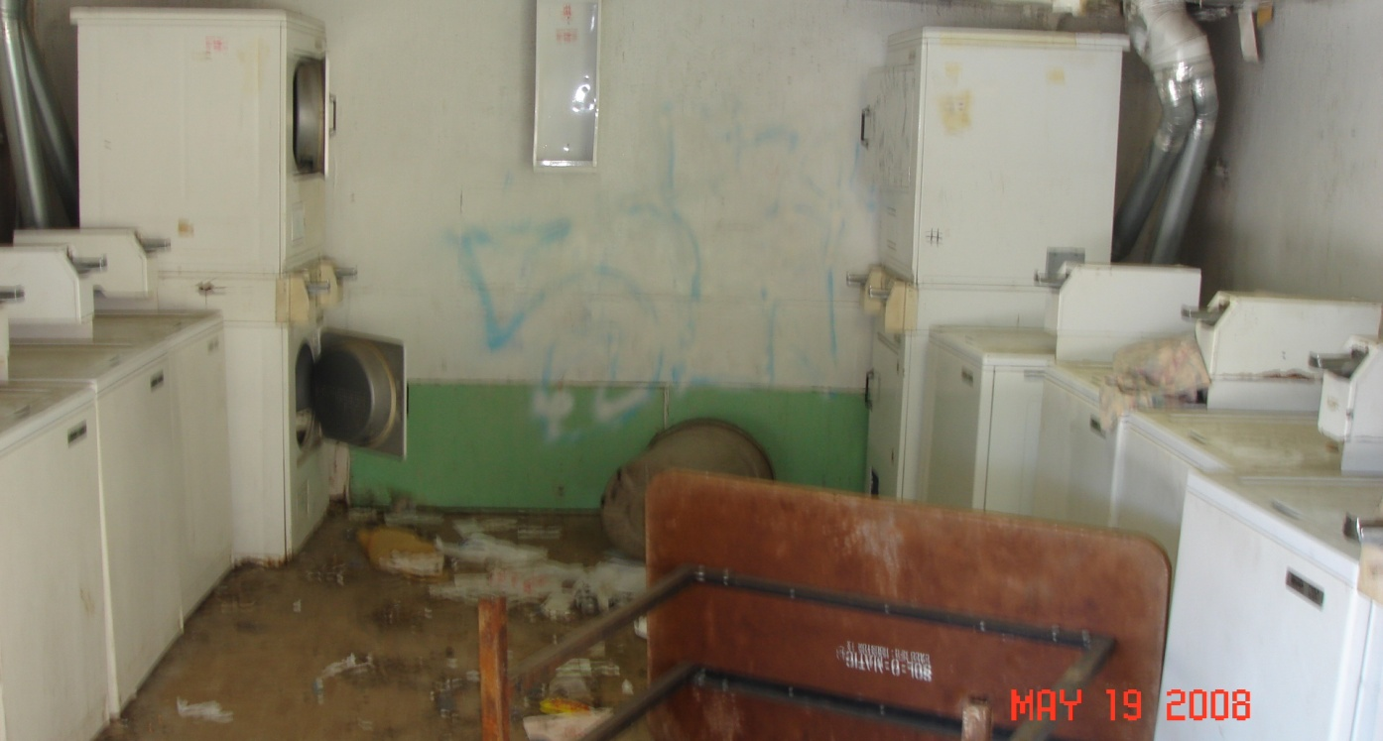
Apartment Buildings
Notes:
These apartments are occupied, with residents trying to wash their clothes here. This small complex averaged over 300 CFS a year. DRT worked with Public Works to “Red Tag” the property.

Slide 23
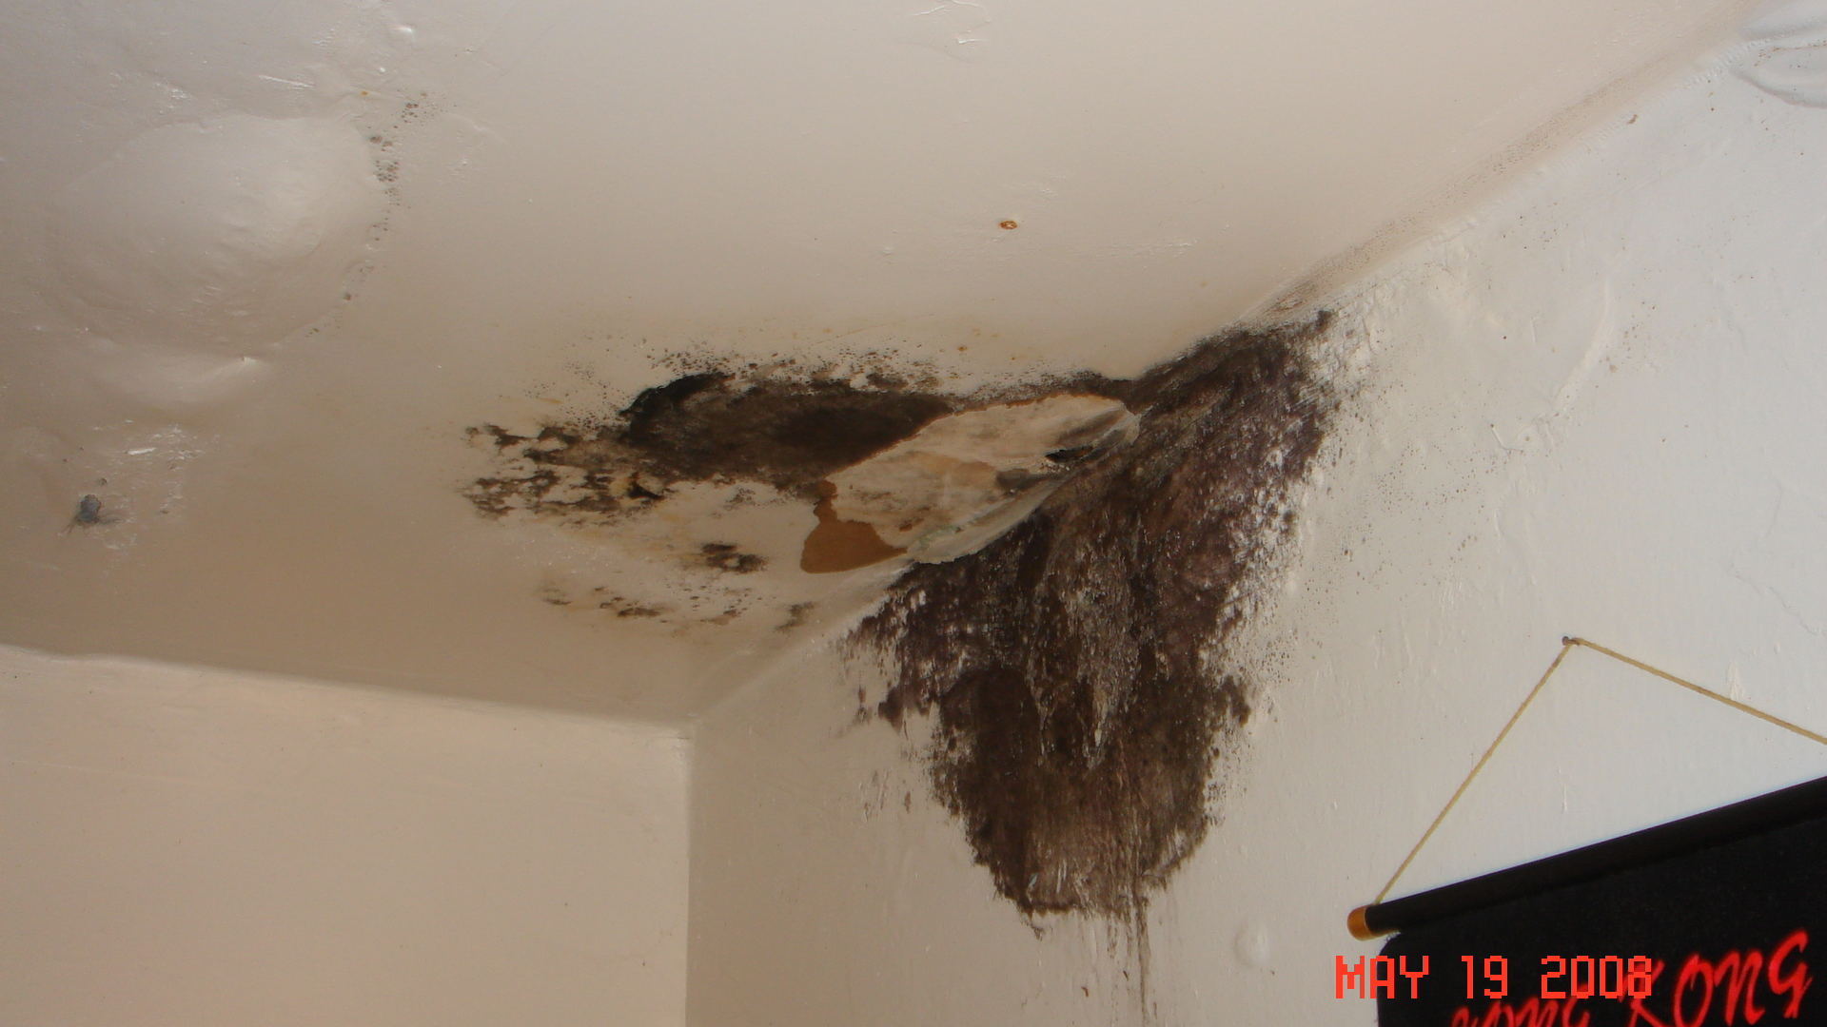
Notes:
Black mold growing inside an occupied apartment, caused by roof leakage which owner refused to fix.

Slide 24
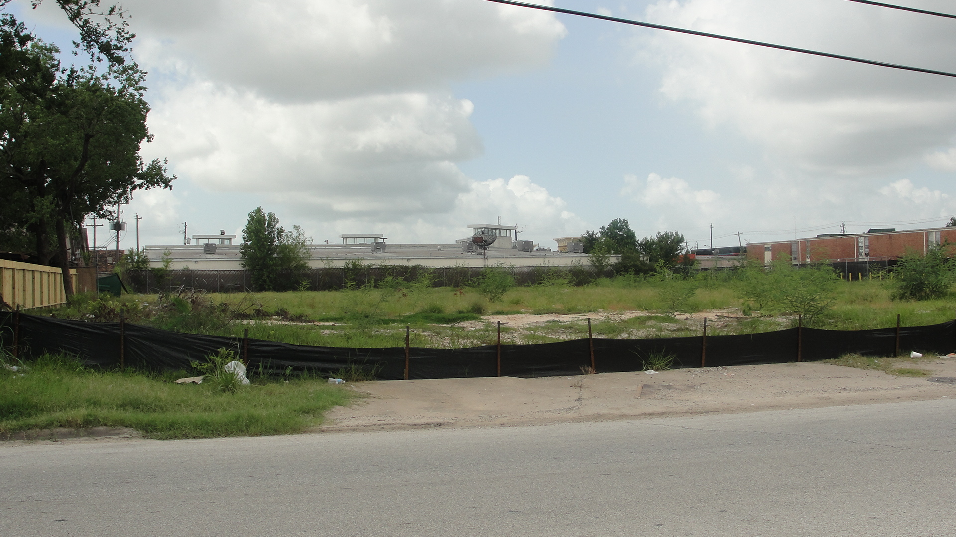
Notes:
After thousand of dollars in fines accessed and city PWE “Red Tags” requiring repair, owner sold the property to a Charter school.

Slide 25
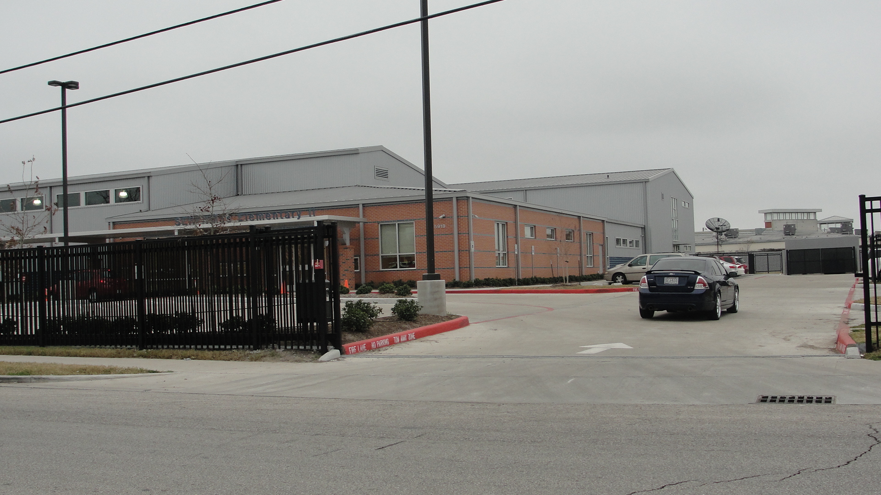

Slide 26
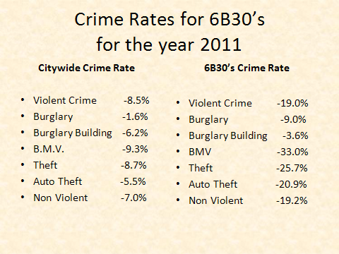

Slide 27

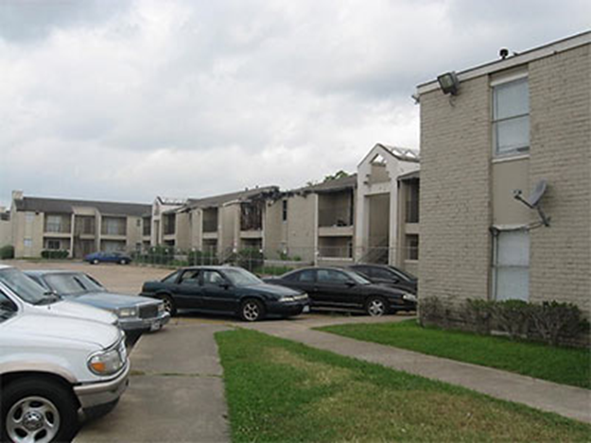
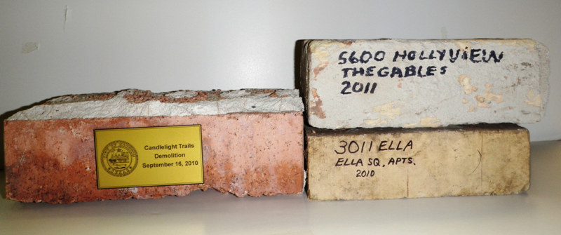
North Division 6B30’s Apartments Closed or Demolished
5600 Holly View Demolished (The Gables)
5900 DeSoto Demolished (Candlelight Trails)
5353 DeSoto Closed- Demolition Pending (Oakbrook)
5399 DeSoto Partially Closed
(Candlewood Glen)
3902 W. Little York Closed- Demolition Pending (Inwood Oaks)
3500 W. Little York Partially Closed (Oak Villa)
Notes:
Properties along the Antoine corridor

Slide 28
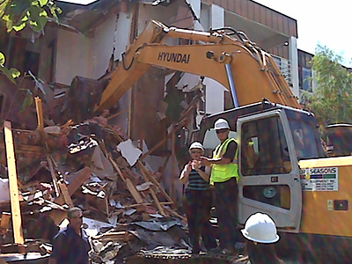
Mayor Parker Takes Care of Business
Notes:
The other apartment complexes got the hint at this point. They either complied or became a parking lot.

Slide 29
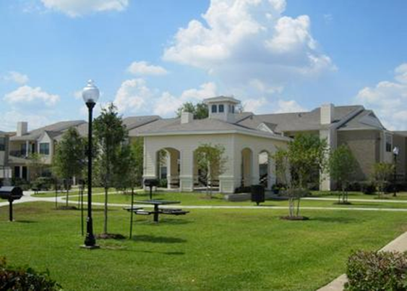
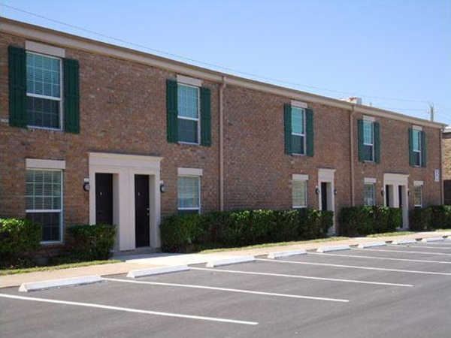
North Division 6B30’s Apartments Remodeled and Rehabilitated
5555 Hollyview
5550 Hollyview
6240 Antoine
6101 Antoine
5300 DeSoto
HPD worked with C.O.H. and Management District to get block grants for apartment complex rehab

Slide 30
Narcotics Trafficking
Prostitution
Chapter 125 Investigations
F.A.S.T. Unit
Integrated investigations

Slide 31
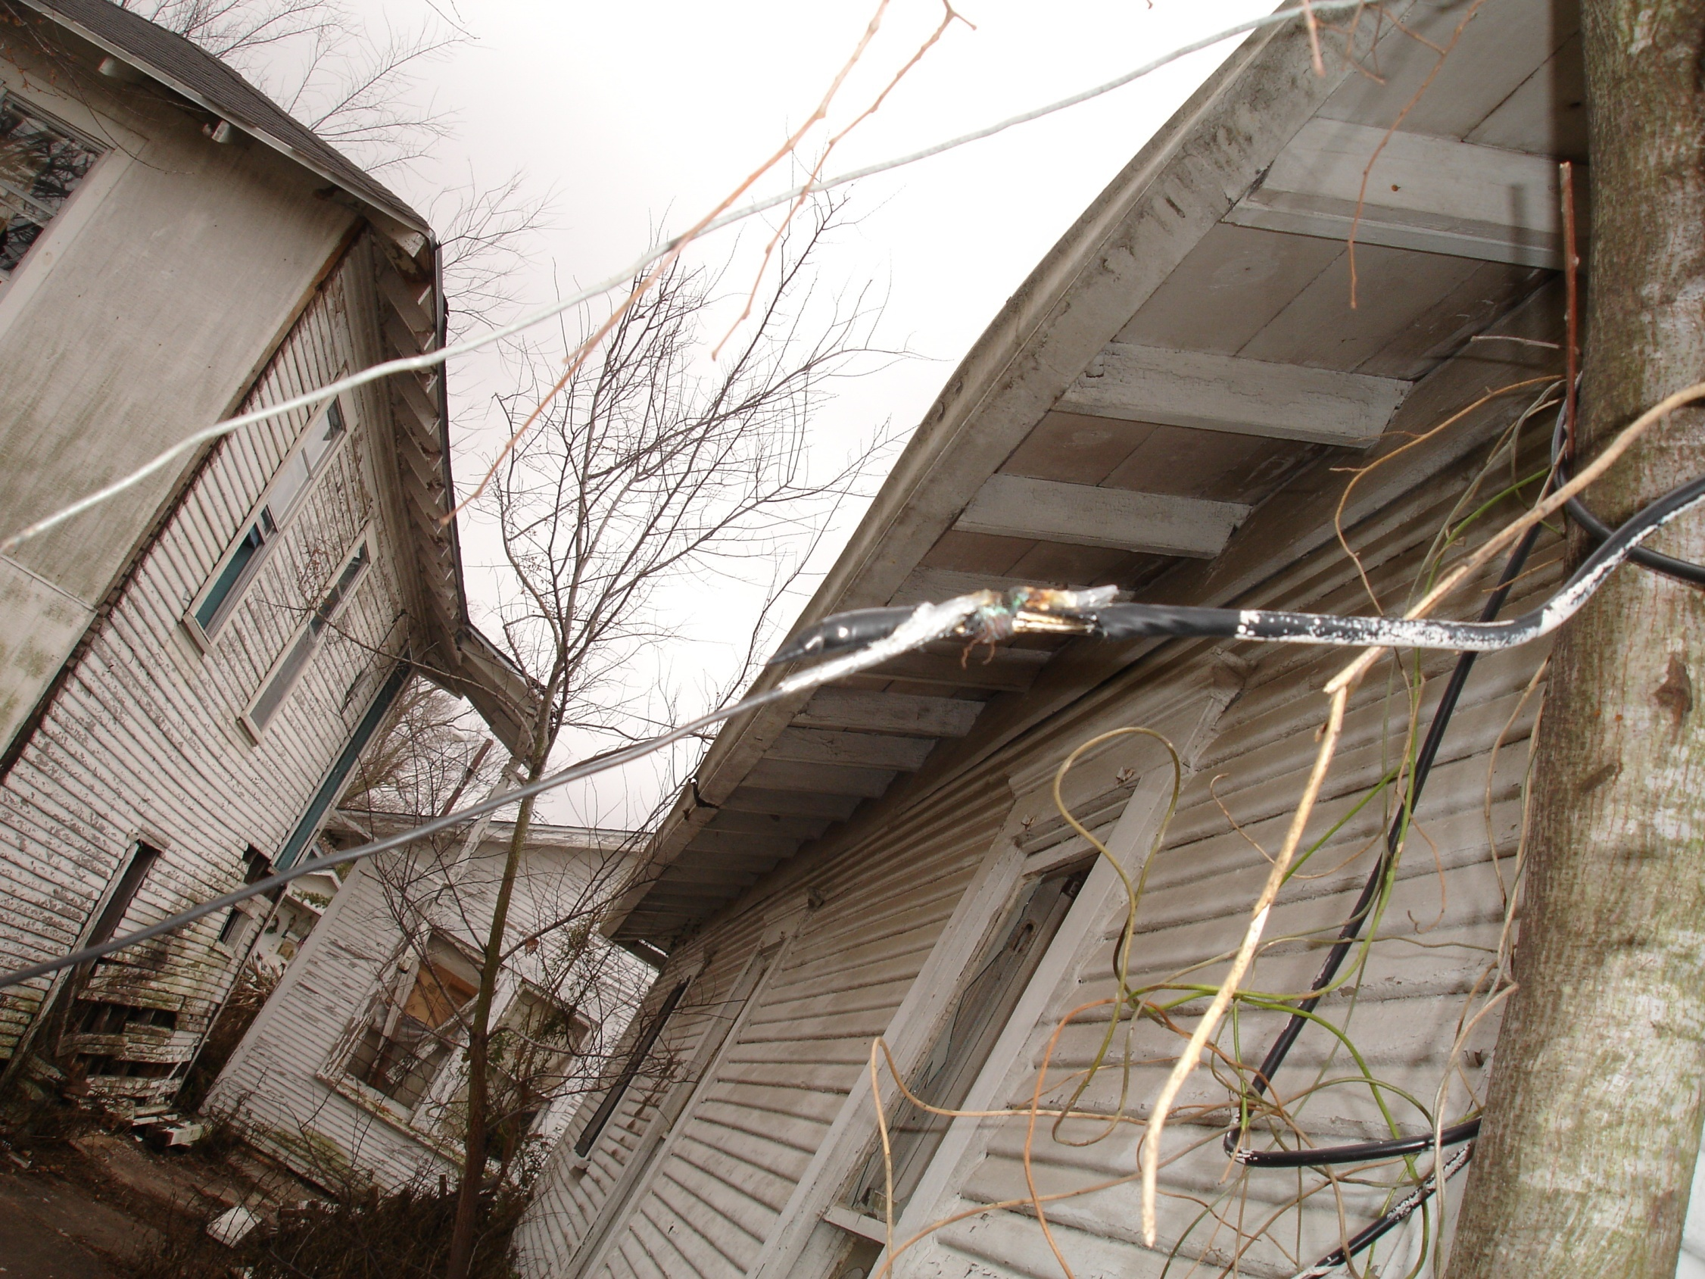
Notes:
Electricity diversion is more than a property crime… it’s a threat to human life from fire and electrocution.

Slide 32
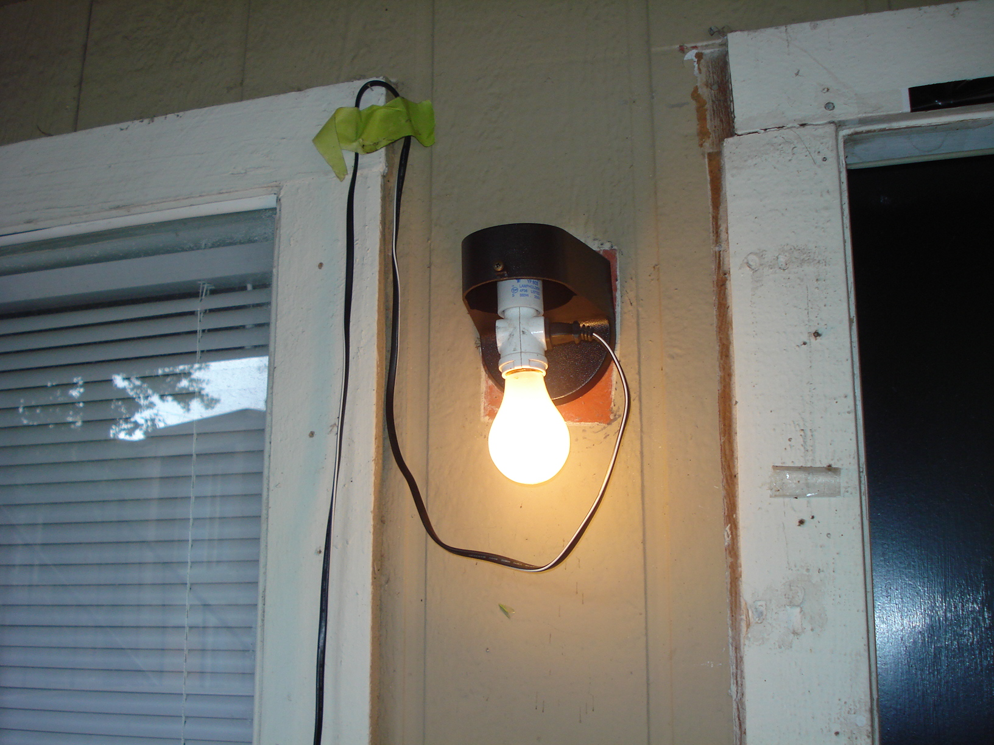
Notes:
Bad neighbor… Rat infestation, fleas, other problems migrate from problem properties.

Slide 33
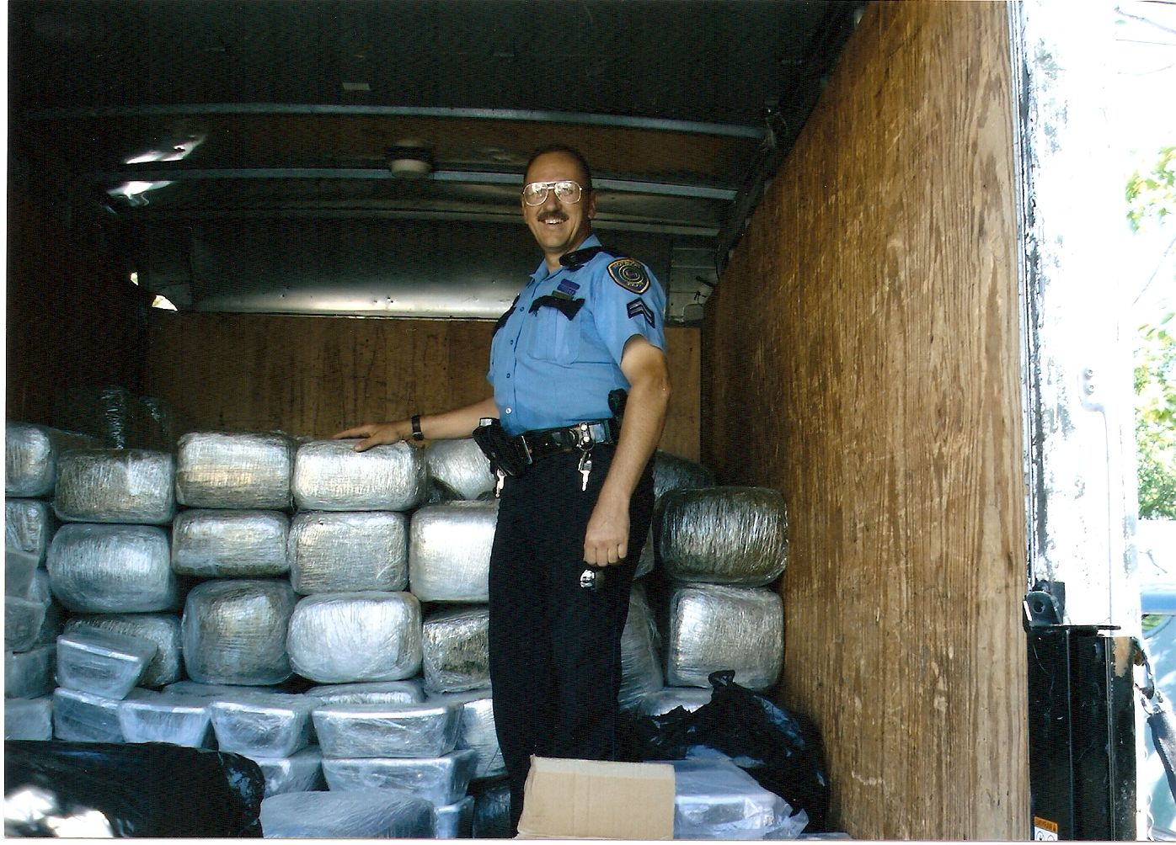
Transition from Inspector to Officer
Officer David Eagan
3600 lbs of Marijuana during D.R.T. investigation
He is D.R.T. certified and one of the original D.R.T. officers of North Division

Slide 34
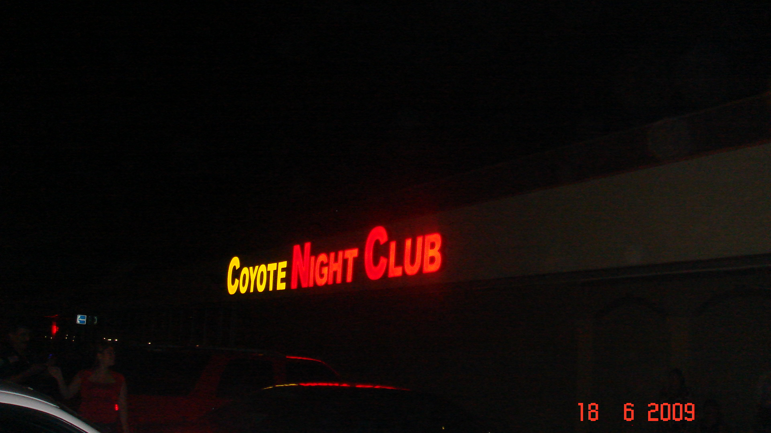
Notes:
Some TABC establishments are fronts for prostitution, human trafficking, and narcotics sales. This one was the first two. Check coolers to see how much beer is on hand to sell, look for couches and bed in back rooms and closets. The hidden room at this location was found by following and electrical cord used for lighting. Also had a hidden room for watching.

Slide 35
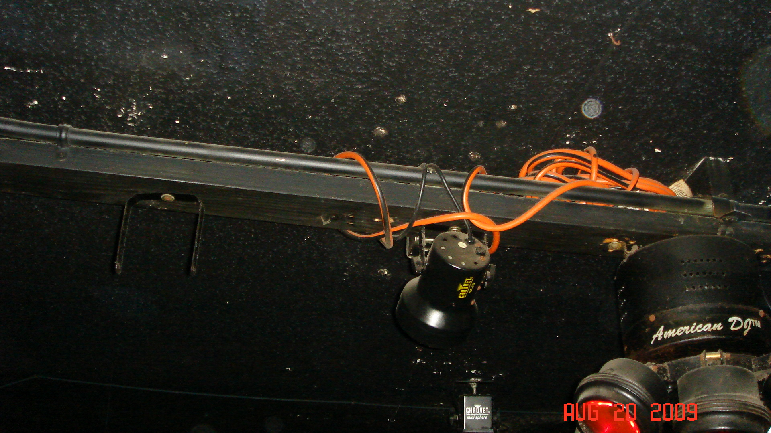
Notes:
Faulting/bootleg wiring lead to fires, often the fire exits are blocked or chain closed. Initial inspection during club hours, when violations discovered, manager ordered to meet officers during the day for a full inspection.

Slide 36
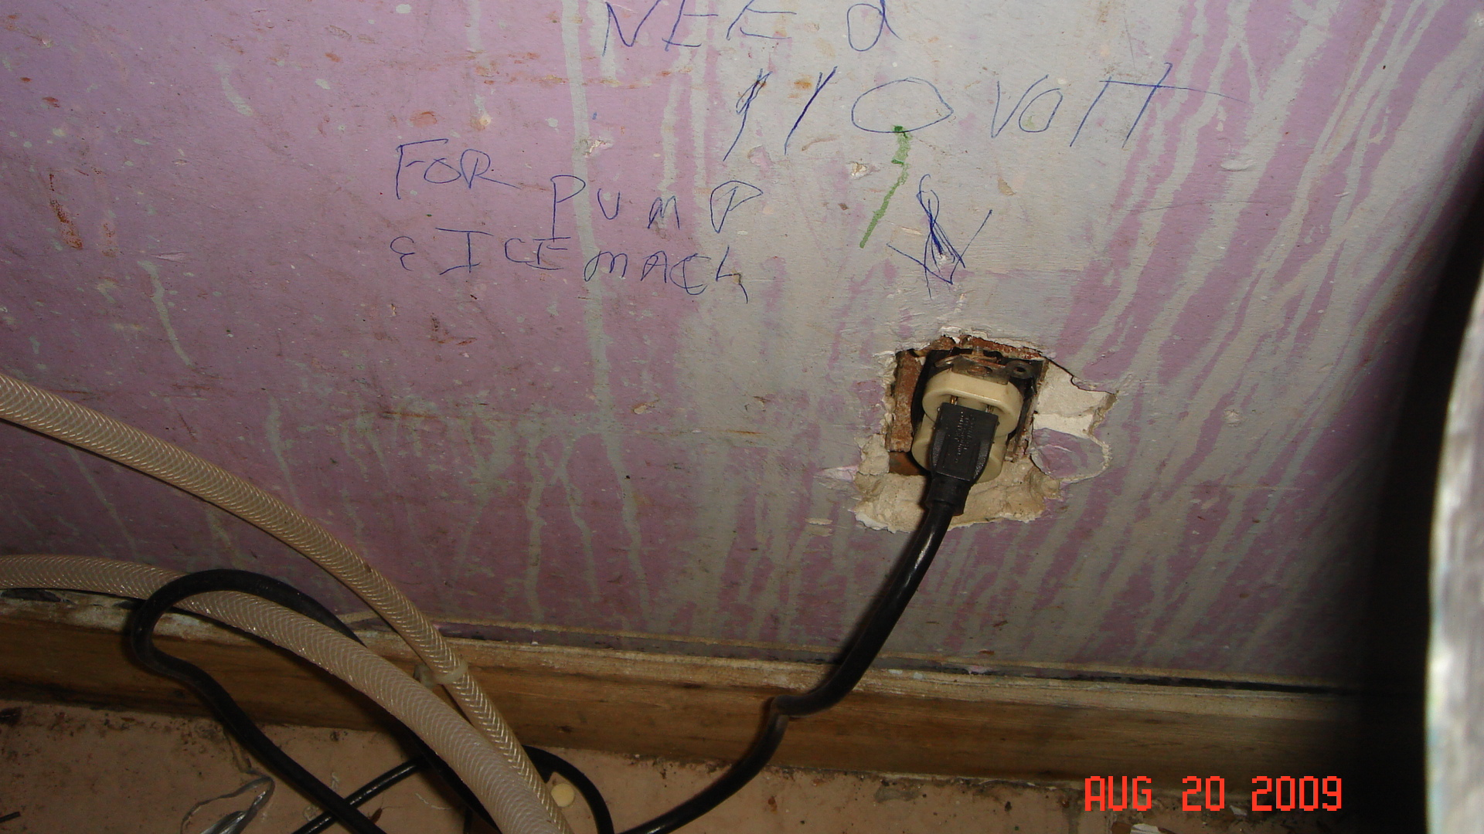
Notes:
Good example of bootleg wiring and often may be accompanied by theft of electricity via electricity diversion, it’s a felony to tamper with a public utility regulating device (water, gas, electricity, cable)

Slide 37
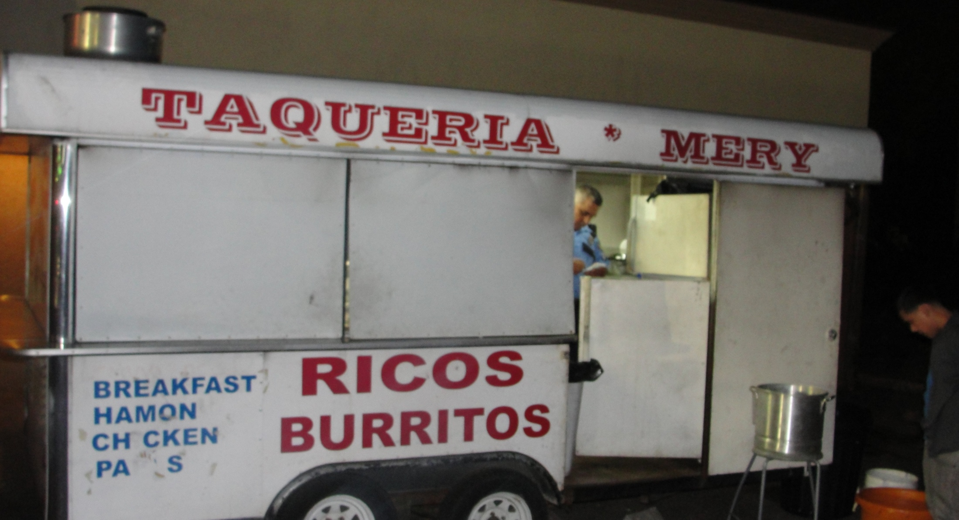
Fresh Tacos Anyone??
Notes:
Grab a taco as you leave the cantina… no food handler’s license, no inspection by health dept. illegal trailer. Often they open only late a night, the health inspectors only work dayshift.

Slide 38
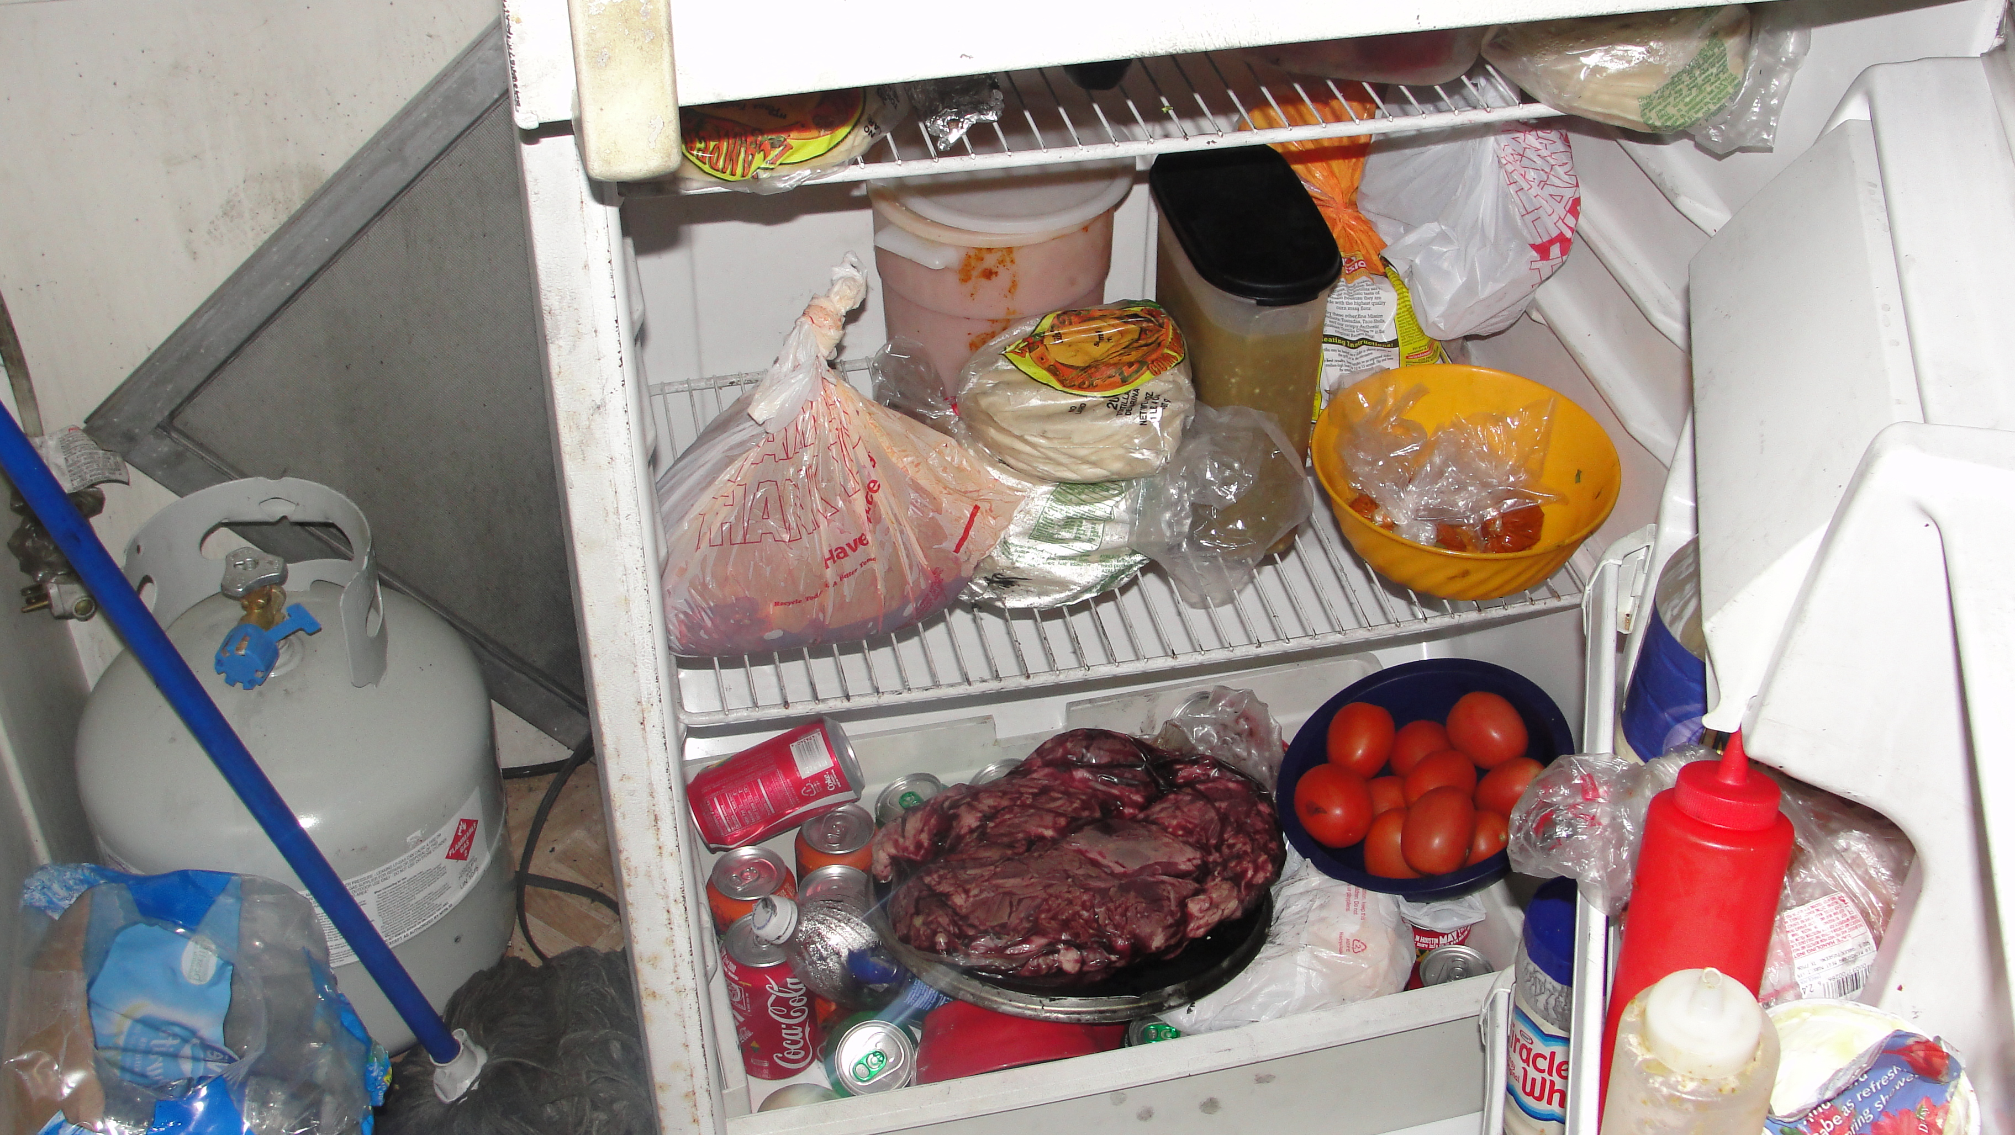
Notes:
Cross contamination, “slime in the ice machine”, no caps on the condiments…

Slide 39
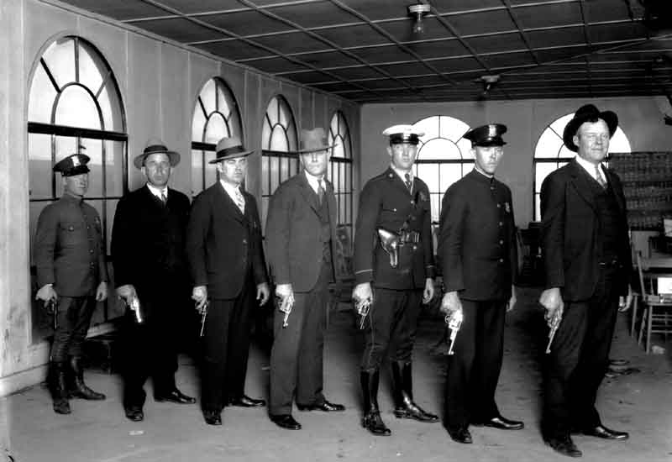










DRT Partnerships

Slide 40
QUESTIONS?

Slide 41
Thank You!!
Sergeant Mike Hill
City-Wide DRT Coordinator
Mike.hill@cityofhouston.net
832.394.1350 (office)
Office 217
7277 Regency Square
Houston, Texas 77036

