Slide 1



2021-2022
City of Houston Benefit Plans
Notes:
Welcome to the City of Houston. During today’s benefits presentation I will hit the high points of your City of Houston Benefits.

Slide 2

Benefit Options
Medical
Dental
Vision
Flexible Spending Accounts
Supplemental Insurance Plans
Basic and Voluntary Life Insurance
Notes:
All full-time and part-time employees who work an average of 30 hours per week or more are eligible to participate in the City of Houston’s benefits plan offerings.
Temp Employees are not eligible for benefits. To find if you are eligible part-time 30 you must check with your supervisor.
The city offers the following benefits:
Medical
Dental
Vision
Flexible Spending Accounts
Supplemental Insurance Plans
Basic and Voluntary Life Insurance

Slide 3

Benefits Information on Demand
Visit CityofHoustonBenefits.org for:
Benefits Guide
Detailed plan information
Presentations and benefits education videos
Wellness information
Forms
Notes:
During today’s benefits presentation I will hit the high points of your City of Houston Benefits. For more extensive information visit cityofhoustonbenefits.org for Benefits Guides, detailed plan information, presentations and benefits education videos, wellness information, forms and more.

Slide 4

Enrolling
Enroll using the Employee Self Service Portal at portal.houstontx.gov
Use your user ID (e + employee ID) and an active password
For password resets contact HITS at 832-394-4487
Notes:
As employees, you will enroll using the Employee Self Service portal at portal.houstontx.gov. If you need to reset your ESS password, contact HITS at 832-393-4487

Slide 5
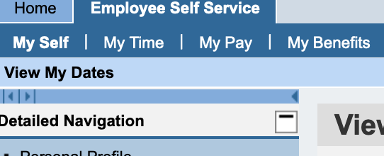
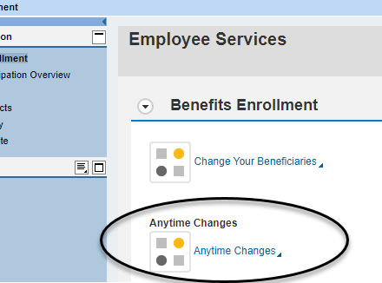
Enrolling
From the ESS tab, choose My Benefits
Under Benefits Enrollment, choose Anytime Changes
30 days to make selections
Benefits are effective on either the 1st or 16th of month following 30 days of hire
Notes:
Once you are logged into ESS, choose My Benefits from the ESS tab at the top of the screen. Under Benefits Enrollment, choose Anytime Changes. This will open the enrollment form. Complete the form within 30 days of your hire date.
Benefits are effective either on the first or sixteenth day of the month following 30 days of hire date

Slide 6

Who is an Eligible Dependent?
Legal spouse
Biological child
Adopted child
Legal custody or guardianship foster child
Court ordered dependent
Stepchild
Biological grandchild
Disabled children age 26 and over
Notes:
Your eligible dependents include: a legal spouse; natural, adopted or stepchildren up to age 26; children up to age 26, over whom you have legal guardianship or legal foster care; grandchildren up to age 26, if they qualify as your dependents for federal income-tax purposes and live with you.
Ex-spouses are not considered eligible dependents, unless a court order has been issued that states they need to be covered on your health plans. Step-grandchildren are not considered eligible for benefits purposes under any circumstance.
Other eligible dependents include disabled dependents over age 26. In order to qualify the dependent must depend on you for more than 50% of financial support, must be classified as disabled and covered on a medical plan before reaching age 26, and approved for coverage after age 26.
If you have a dependent for whom a court order has been issued requiring you to provide healthcare coverage, you must provided the Benefits Division the court order within 31 days of the event.
In all situations, the plan’s eligibility rules and necessary documentation apply.

Slide 7

Required Supporting Documents
Depending on the relationship, required supporting documents can include:
  Birth certificates
  Marriage certificates or Declaration of an Informal Marriage
  Adoption/Guardianship documents
  Social Security Numbers
Notes:
The City of Houston requires that employees submit appropriate documents for all eligible dependents to be covered on health plans. The City requires proof of identity such as a Social Security Number or TIN, and proof of eligibility, such as a birth certificate, marriage certificate or legal adoption paperwork. Please be advised that you will also need to provide all dependent’s Social Security numbers and dates of birth to enroll. The list of required documents is available on the Benefits Division website

Slide 8
Required Supporting Documents
Submit your supporting documents within 30 days from your hire date.
Secure Document Portal: bit.ly/COHBenefitsForm
In-person
  611 Walker, 4th floor
Notes:
If you are covering any dependents, you must submit your supporting documents withing 30 days from your hire date. If you miss this window, your next opportunity will be during Open Enrollment, which occurs in March each year, or if you have a Qualified Life Event.
You can submit supporting documents through the Secure Document Submission Portal at bit.ly/COHBenefitsForm
Or you can bring them in-person to the 611 Walker 4th floor lobby drop box
If both you and your spouse work for the City of Houston, you may be covered as an employee or as a dependent - but not both . Dependents may be enrolled under only one parent or guardian if both parents work for the City of Houston.

Slide 9
Qualifying Life Events
Marriage
Birth
Adoption
Divorce
Loss of coverage
Moving outside of coverage area
Notify Benefits Division within 31 days of Qualifying Life Event
Notes:
Outside of Open Enrollment, the only other time you can make a change is if you experience a qualifying life event.
A qualifying life event s a change in your situation that makes you eligible to enroll or change your health benefits. Some of the most common qualifying life events are marriage, birth or adoption of a child, divorce, loss of other coverage, and moving outside of the coverage area.
You are responsible for notifying the Benefits Division of a qualifying life event within 31 days of occurrence.
If you wait until after 31 days, you lose the ability to enroll or make changes until the next Open Enrollment.

Slide 10



Medical Plans
Administered by
Cigna

Slide 11
Medical Plans
Whether you want more choices or more monthly savings, the City offers three unique medical plan options to meet your individual needs.
All plans include free preventive care services and a four-tier prescription drug plan.
Consumer-Driven Health Plan (CDHP)
Limited Network Plan
Open Access Plan
Notes:
The City of Houston offers three Cigna medical plans for our eligible, active employees: a Consumer Driven Health Plan (or CDHP), a Limited Network Plan (similar to an HMO), and an Open Access Plan (or OAP). Let’s talk about how these plans differ.

Slide 12
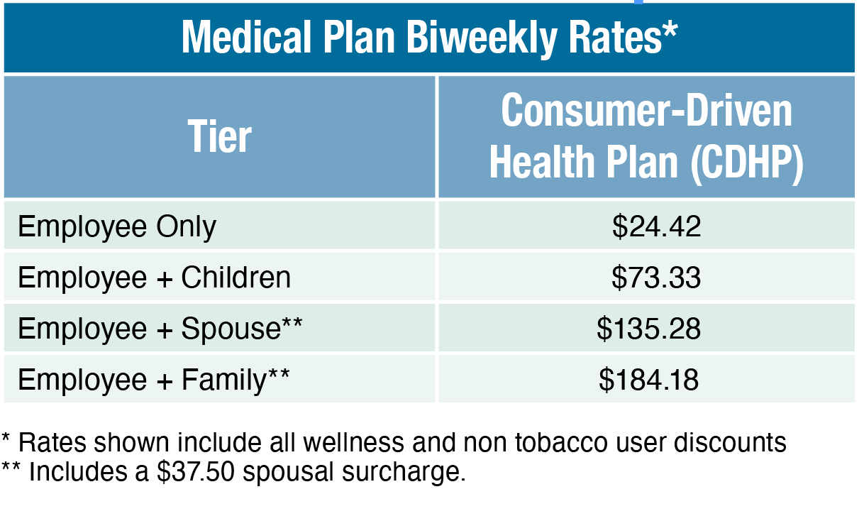
Consumer-Driven Health Plan
Includes a Health Reimbursement Account
Cigna’s national network
20% coinsurance for most in-network services
40% coinsurance for most out-of-network services
Combined medical and pharmacy deductible $1,750/$3,500 in-network
Notes:
The CDHP offers a low paycheck contribution and includes a Health Reimbursement Account to help you lower the cost for services. The City pays for the first $500 for an individual or $1,000 for family from the Health Reimbursement Account which can be used to offset your deductible or coinsurance costs.
Under the CDHP, you have access to all Cigna providers throughout the country, without having to seek referrals to see specialists. There are no copays on this plan, meaning that you will pay 20% the cost of your doctor visits, hospital stays, lab work, x-rays, emergency room visits, and outpatient procedures when you stay in network after you reach your annual deductible. The annual deductible on this plan is $1,750 for an individual and $3,500 for family coverage. Remember that these deductibles are offset by the Health Reimbursement Account.
This plan also includes a four-tier prescription drug plan, which also utilizes the 20% coinsurance.
Please take a moment to review the biweekly rates on the screen. These include discounts for non-tobacco users and participation in the annual Wellness program.

Slide 13
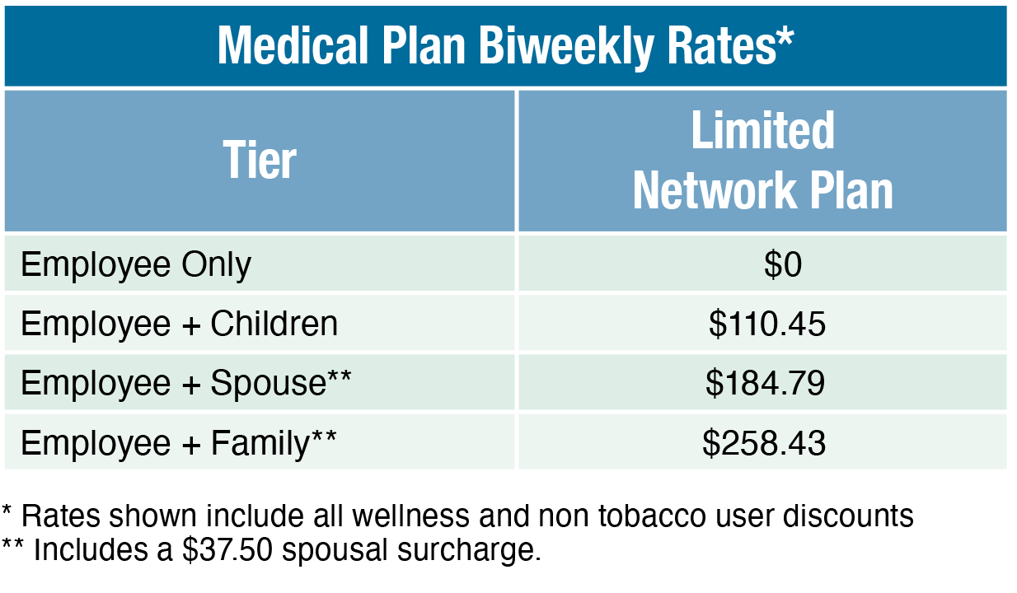
Limited Network Plan
Three provider groups
Medical deductible
Pharmacy deductible
PCP: $35
Specialist $65
Outpatient surgery: $350
Inpatient facility: $600/day
ER: $400
Urgent Care: $65
Notes:
The Limited Network plan allows you to choose from three provider groups: Kelsey Seybold,, Renaissance, and Village Family Practice. This means that you will need to coordinate your care within these networks. In the limited network plan you have a lower deductible and pay less for services. The Limited plan has a $200 annual deductible for individuals, and a $600 annual deductible for family. Additionally, you have set copays for services, like primary care and specialist visits, outpatient surgery, inpatient facilities, ER and Urgent care.
The Limited plan does not offer a Health Reimbursement Account, so the City is not contributing towards the cost of services like the CDHP.
If you choose to enroll in the Village Family Practice or Renaissance network, you must choose a primary care physician, and you will need a referral from your PCP in order to see a specialist. At the time of enrollment, a PCP will be assigned you to based on your zip code. When you receive your insurance card in the mail, please contact Cigna directly to update to a provider of your choice.
If you choose to enroll in the Kelsey Seybold network, you do not need to choose a primary care physician. With Kelsey Seybold, you can visit any Kelsey Seybold office in the Houston area and you do not need a referral to see a specialist with Kelsey.
You and your dependents do not need to be enrolled in the same network, for example you may choose Renaissance or Village Family Practice while your spouse chooses Kelsey Seybold.
Please take a moment to review the biweekly rates on the screen. These include discounts for non-tobacco users and participation in the annual Wellness program.

Slide 14
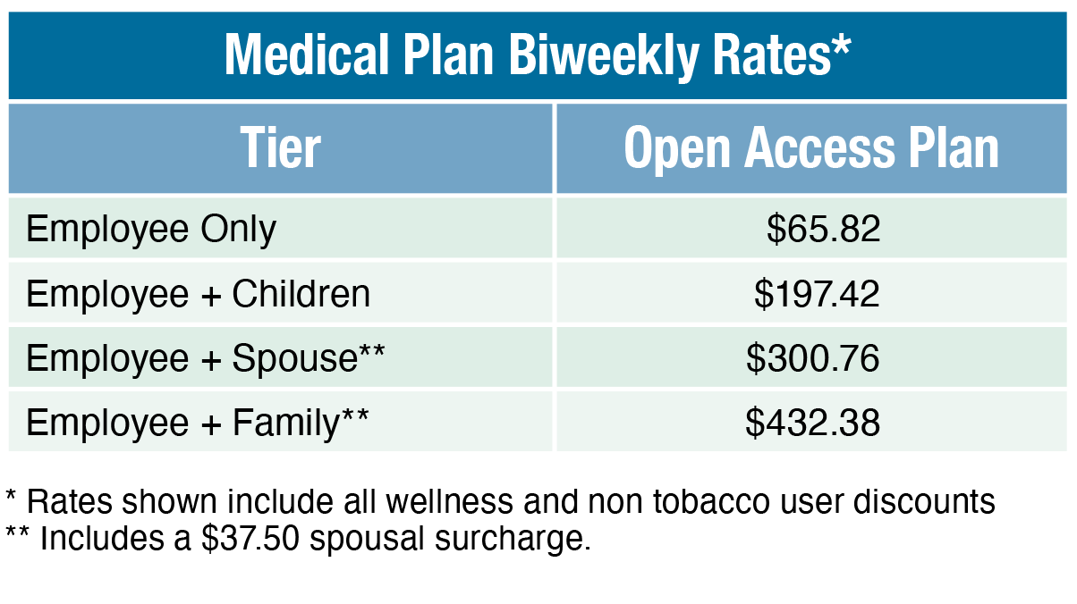
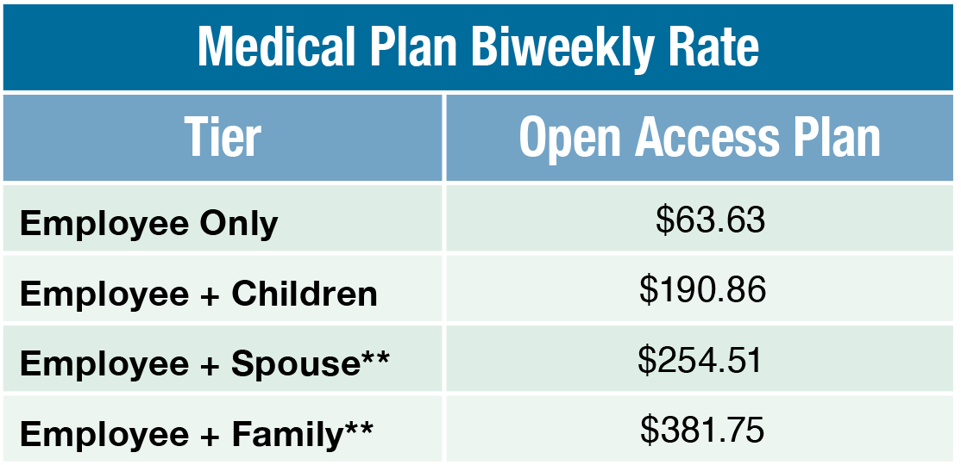
Open Access Plan
Medical deductible
No pharmacy deductible
Cigna’s national network
Outpatient surgery, inpatient
facility and ER: 30% coinsurance
PCP: $40
Specialist: $65/$80 (Non-CCN is $80)
Urgent Care: $75
Notes:
The Open Access Plan, or OAP is the most expensive plan in terms of paycheck amounts, however it gives you greater flexibility to choose your care than the other two plans. The OAP gives you access to Cigna’s national network without a need for referrals to see specialists. The OAP has an annual deductible of $850 for individual and $1,700 for a family. Once you have met this annual deductible, you will pay 30% coinsurance for most services until you reach your maximum out of pocket amount.
You will have a set copay of $40 for primary care visits, and $65 for a Tier 1 specialist or $80 for a non-Tier 1 specialist.
The OAP includes a four-tier prescription plan with no deductible to meet.
Please take a moment to review the biweekly rates on the screen. These include discounts for non-tobacco users and participation in the annual Wellness program.

Slide 15
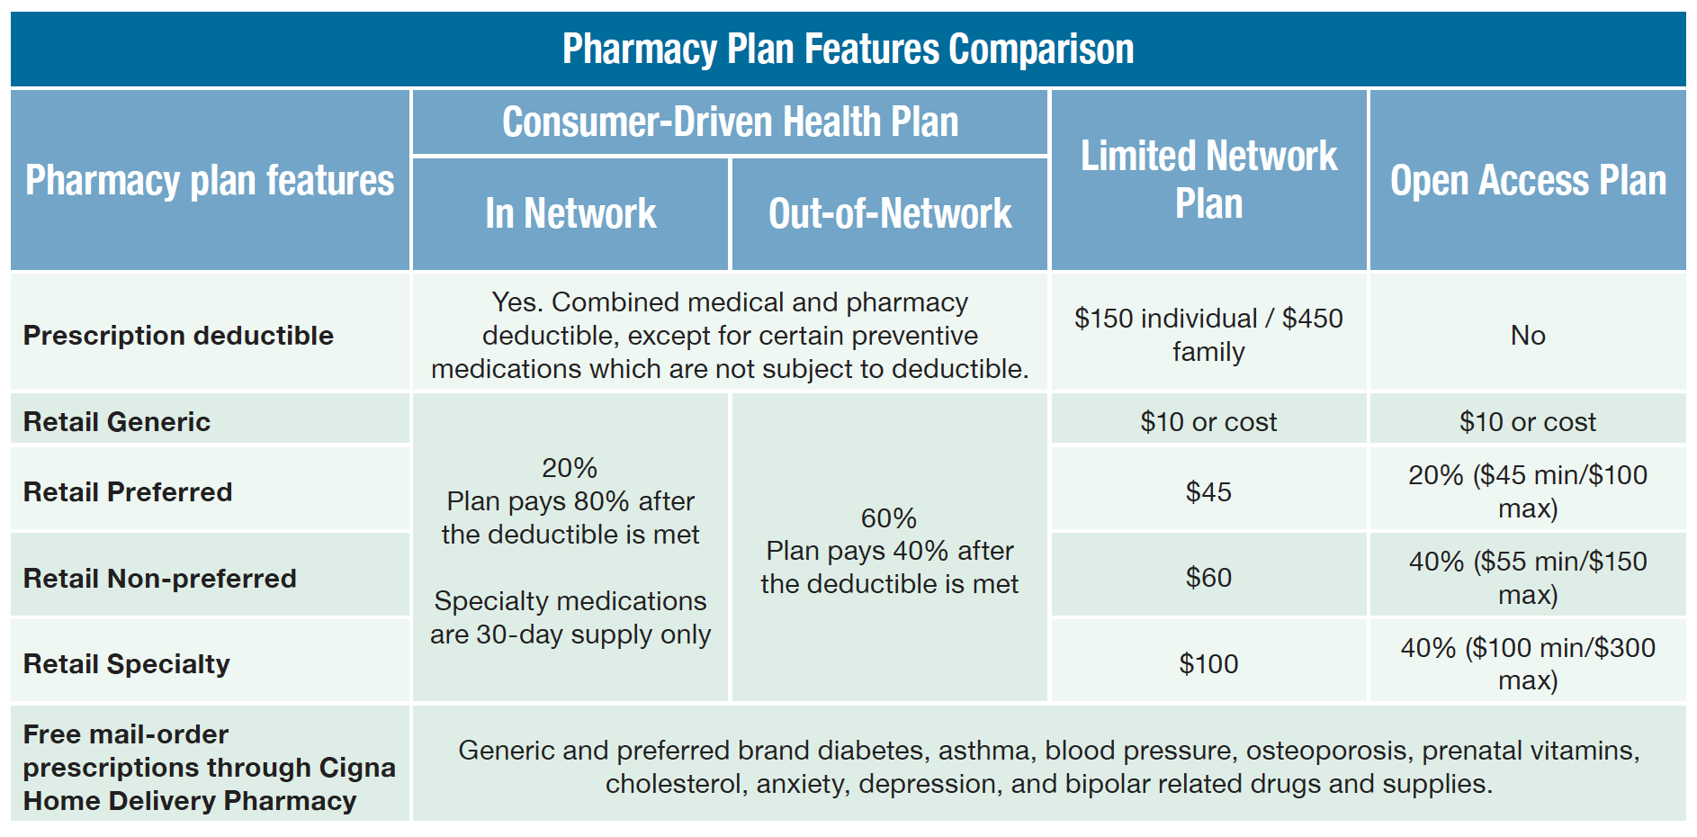
Pharmacy Plan Features
Notes:
The three medical plans have differing copayments and coinsurance amounts for prescription coverage.
The CDHP has a prescription deductible that is combined with your medical deductible of $1,750 for an individual and $3,500 for family. On the CDHP all drug tiers will require you to pay 20% of the cost of the drug.
The Limited plan has a separate deductible from the medical deductible, so this is an additional amount you will need to pay exclusively for prescriptions. The Limited plan offers tiered copay amounts for different classifications.
The OAP does not have a prescription deductible at all, and offers a tiered copay and coinsurance amount for different drug classifications.
Please review the cost for prescription drugs by verifying which tier your prescriptions fall under and carefully consider your options when choosing your medical plan. 90-day prescriptions have a higher copayment or coinsurance than 30-day prescriptions. Specialty drugs in the Limited Network and Open Access plans are only available as 30-day prescriptions.
You can save money on your 90-day prescriptions by choosing Cigna Express Scripts,. You’ll pay just 2.5x your retail copay for a 90-day prescription, which can save several hundred dollars a year depending on your usage.

Slide 16
Participating Pharmacies
Participating Pharmacies: 30-Day
Participating Pharmacies: 90-Day
  CVS/Target
  Kroger
  H-E-B Pharmacy
  Kelsey-Seybold
  Walgreens
  Walmart
  CVS/Target
  Kroger
  Walmart
For a complete list, visit Cigna.com/Rx90network
Notes:
There are over 68,000 retail pharmacies in your network, which include local pharmacies, grocery stores, retail chains and wholesale warehouse stores – all places where you may already shop.
30-day prescriptions can be filled at any retail pharmacy in the plan’s network; including CVS, HEB, Kelsey, Kroger, Walmart and Walgreens.
For 90-day prescriptions, you have the option to use a 90-day retail pharmacy in the plan’s network: including CVS/Target, Kroger, Walmart, or you can use Cigna Express Scripts.
Visit MyCigna.com for a complete list of in-network pharmacies. Pharmacies in which you can fill a 90-day prescription will be identified with 90 symbol.

Slide 17
Free Medications
Cigna Express Scripts offers three-month supply of these medications delivered to your home for $0 copayment:
    Generic and brand name asthma medications
    Generic cardiovascular/high blood pressure medications
    Generic cholesterol medications
    Generic diabetic medications
    Preferred-brand diabetic test strips
    Brand name insulin
    Blood glucose meters (for members not enrolled in Medicare)
Call Cigna Express Scripts at 1-800-835-3784 to get started!
Notes:
Cigna has partnered with Cigna Express Scripts to offer savings on many generic and name brand drugs through mail order. Signing up for Cigna Express Scripts is easy and convenient, with your prescriptions shipping to your home for free!
Covered medications include: generic and brand name asthma medications, generic cardiovascular and high blood pressure medications, generic cholesterol medications, generic diabetic medications, preferred brand diabetic test strips, and brand name insulin. Additionally, if you are a member that is not enrolled in Medicare, you are eligible for free diabetic blood glucose meters.
Call Cigna Express Scripts at 1-800-835-3784 to get started.

Slide 18



Dental Plans
Administered by
Cigna

Slide 19
Dental Plans
Dental wellness is an important component in your overall health. The City offers two dental plans.
Cigna Dental Care® (DHMO) Plan
Total Cigna DPPO plan
Notes:
Cigna® is your dental carrier.
The City of Houston is excited to offer two dental plans for eligible employees. You have the option to choose between the Cigna Dental Care® (DHMO) plan and Total Cigna DPPO plan.

Slide 20
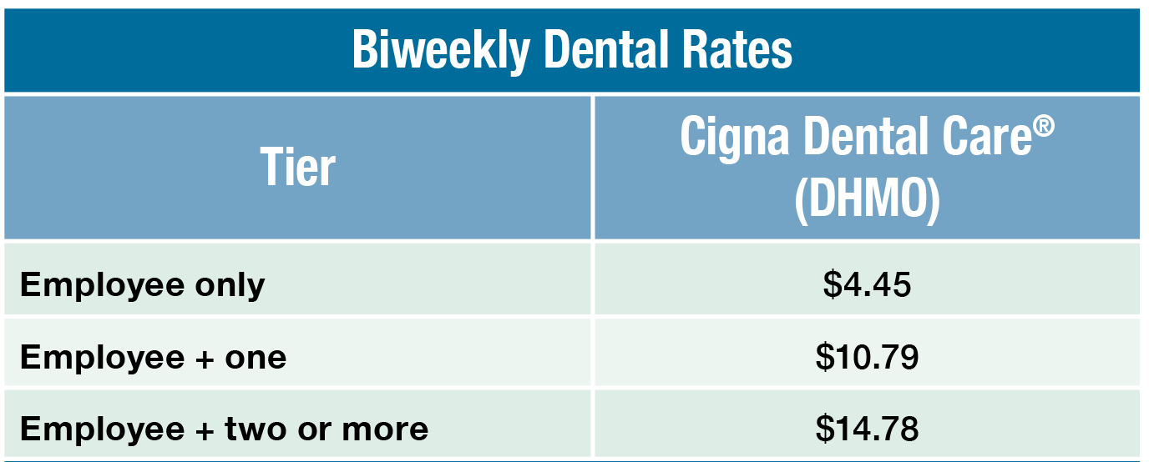
Cigna Dental Care® (DHMO) Plan Facts
No deductibles
No dollar maximums
General dentist manages all dental needs and refers you to specialist
Throughout the U.S., except for 13 states
Benefits start May 1st
No claim forms
Notes:
The Cigna Dental Care DHMO plan is a cost effective plan that has fixed copays for dental services, with no deductible or annual maximums on services. You will need to select a primary care dentist, and will need a referral to see specialists.
The service area includes all of the United States, except for 13 states
Benefits start May 1st - There is no waiting period.
You will not have to submit claim forms on this plan, unless you choose to use services out of the network. There is no charge for preventive services on this plan, and fixed copays for basic and major services.
If you enroll in this plan, Cigna Dental will automatically assign a primary care dentist based on your zip code. Once you receive your dental ID card, you may contact Cigna Dental to change to an approved provider of your choice.
For more plan information, refer to cityofhoustonbenefits.org

Slide 21
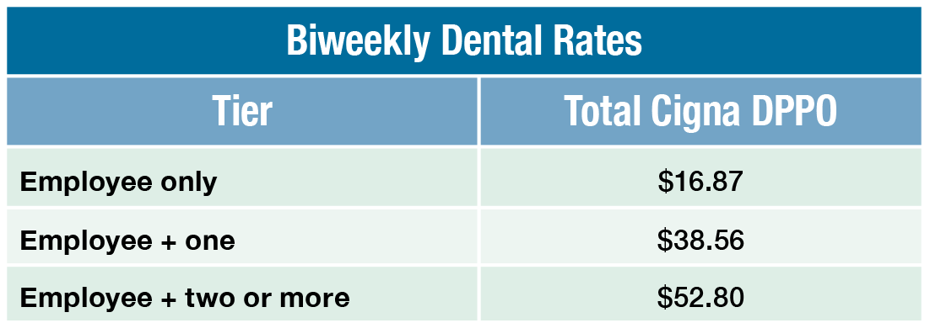
Total Cigna DPPO Plan Facts
Freedom to visit any licensed dentist or specialist
No specialty referrals required
Covers eligible dental expenses after waiting periods and deductibles
Based on coinsurance levels with assigned percentage of costs
Notes:
The Total Cigna DPPO Plan gives you the freedom to visit any licensed dentist or specialist. No specialty referrals required . The plan will cover eligible dental expenses after you satisfy any applicable waiting periods and meet any deductibles. The annual deductible is $50 per individual and $150 per family. The annual maximum benefit for Class I, II, & III expenses is $2,000.
The plan is based on coinsurance levels that determine the percentage of costs covered by the plan for different types of services. For example, Class 1 expenses are preventative services like cleanings and certain x-rays and are covered at 100% by the plan
Class II expenses are basic services like extractions and root canals and are covered by the plan at 80% and class III expenses are major services like bridgework and crowns and are covered at 50%.

Slide 22



Vision Plan
Administered by Superior Vision

Slide 23
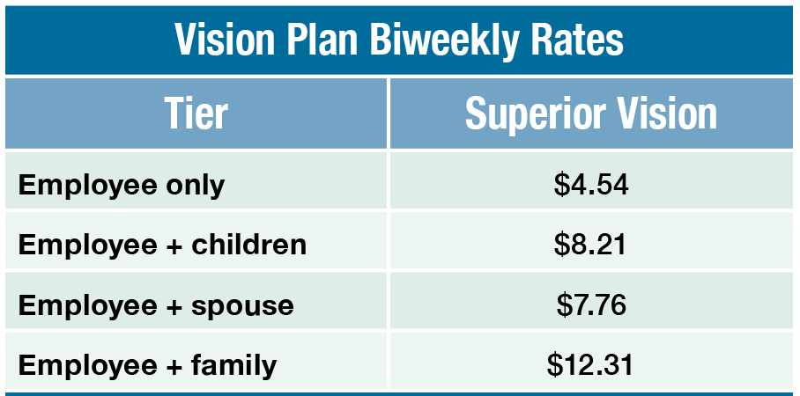
Vision Plan
No deductibles
$20 annual exam copayment
$25 copayment for glasses or contact lenses
$150 allowance for glasses or contact lenses
$300 credit toward Lasik
Notes:
Did you know that eye health is an important component of your overall health? Eye exams can detect many chronic issues, including hypertension, autoimmune disorders, cancer, and thyroid disease.
With the vision plan, there are no annual deductibles, just simple copays when you use the services. You will pay $20 for your annual routine eye exam, and $25 for your glasses or contact lenses. The $25 eyewear benefit includes a $150 allowance toward your glasses or contacts, including single vision, bifocal, trifocal, lenticular, progressives, high-index and polycarbonate lenses. Additionally, if you are thinking about laser eye surgery, the vision plan offers a one-time $300 credit toward Lasik.

Slide 24

Vision Plan
Available providers
  Eyemasters/Visionworks
  Target Optical
  Sam’s Club
  TSO
  Today’s Vision
  Eye Care Centers of America
  Sears Optical
  Walmart
  Lens Crafters
  Pearle Vision
  Vision Source
  Plus, over 1,000 more providers
For a complete list, visit superiorvision.com
Notes:
Superior Vision offers many providers to visit for your eyecare needs, including Eyemasters, Vision Works, Target, Sam’s Club, Today’s Vision, Walmart, Vision Source and many others. To see a complete list of providers in the network, visit www.superiorvision.com.

Slide 25



Flexible Spending Accounts
Administered by
TASC

Slide 26

Flexible Spending Accounts
Healthcare Flexible Spending Account
Dependent Care Reimbursement Account
Total Administrative Services Corporation (TASC)
HFSA is a pre-tax benefit to be used for out-of-pocket qualified healthcare expenses
DCRP is a pre-tax benefit to be used for qualified dependent care expenses
Notes:
The city of Houston offers two options for flexible spending accounts: The Healthcare Flexible Spending Account (or HFSA) for health-related expenses and the Dependent Care Reimbursement Plan (or DCRP) for dependent care expenses.
The provider is Total Administrative Services Corporation (TASC).
As a new hire, you can sign up for both the HFSA and DCRP if you sign up within 30 days of hire.
The plan year for the HFSA is May - April, and the DCRP is Jan - Dec.
The Healthcare Flexible Spending Account (HFSA) allows you to stretch your budget further. The HFSA is a voluntary pre-tax benefit plan that allows you to set aside money from your paycheck to be used to pay the out-of-pocket medical, prescription, dental and vision expenses that you and your eligible dependents incur.
The Dependent Care Reimbursement plan is a pre-tax benefit account that can be used to pay for dependent care services like preschool, summer day camp, before or after-school programs, and child or elder daycare services.

Slide 27

How Does the HFSA Work?
Select a yearly amount keeping in mind:
  Your healthcare costs from the previous year
  Contributions are divided into the number of remaining pay-periods in the plan year.
  $500 rollover into next plan year
You will receive a TASC Mastercard.
Use it like a debit card at your doctor’s office, pharmacy and more
Notes:
You’ll select an annual amount to contribute. As a new hire, this amount will be divided among the remaining pay periods in the plan year. The closer you are to the plan year end on April 30, the less pay periods there are to divide the total amount by. Your bi-weekly amount will be calculated in ESS. Be sure to review this amount before submitting your election.
The minimum annual amount you can contribute to the plan is $240 and the maximum is $2,550.
There is a $500 rollover into the next plan year, but any amount over that will be forfeited.
After you enroll, you will receive a TASC Mastercard in the mail. Use it like a debit card at your doctor’s office, pharmacy and more to pay for qualified expenses.
You have 90 days after the plan year ends on April 30 to file claims with TASC for any expenses that you weren’t able to use the TASC card to pay for.

Slide 28

Examples of HFSA Eligible Expenses
Co-payments, co-insurance and deductibles for medical, dental and vision services
Chiropractor
Eyeglasses, reading glasses, contact lenses and contact lens solution
LASIK
Bandages and related items
First aid kits
Hearing aids and batteries
Medical equipment
Lab fees and diagnostic services
Hospital services and fees
Notes:
In addition to copays, coinsurance, and deductibles for medical, dental and vision services, you can also use your HFSA for chiropractor visits, to pay for eyeglasses and contact lenses, LASIK surgery, bandages, first aid kits, hearing aids, medical equipment, lab fees, diagnostic services and hospital services and fees.
For more information about the HFSA, vist cityofhoustonbenefits.org.

Slide 29
DCRP Highlights
Dependent care expenses must be work-related
Expenses cannot exceed $5,000
Expenses must be for one or more qualifying person
Qualifying person:
  Child under 14
  Spouse physically or mentally unable to care for themselves
  Dependent physically or mentally unable to care for themselves for whom an exemption can be claimed
Notes:
The dependent care expenses must be work-related. The care must be necessary for you or your spouse to work, to look for work, or to attend school full-time
The dependent care expenses provided during a calendar year cannot exceed $5,000
You’ll select an annual amount to contribute. As a new hire, this amount will be divided among the remaining pay periods in the plan year. The closer you are to the plan year end on Dec 30, the less pay periods there are to divide the total amount by. Your bi-weekly amount will be calculated in ESS. Be sure to review this amount before submitting your election.
Dependent care expenses must be for the care of one or more qualifying persons.
A “Qualifying Person” is defined as one of the following:
A dependent child who was under age 14 (per the 2021 Appropriations Act) when care was provided and for whom a tax exemption can be claimed.
A spouse who was physically or mentally unable to care for him/herself and lived with you for more than half the year.
A dependent who was physically or mentally unable to care for him/herself and for whom an exemption can be claimed, and lived with you for more than half the year.

Slide 30
Examples of Eligible Expenses for DCRP
Fees for licensed day care or adult care facilities
Before and after school care programs for dependents under age 14
Amounts paid for services (including babysitters or nursery school) provided in or outside of your home
Nanny expenses attributed to dependent care
Nursery school (preschool) fees
Summer Day Camp – primary purpose must be custodial care and not educational in nature
Notes:
Some examples of of eligible expenses for Dependent Care Reimbursement are:
Fees for licensed day care or adult care facilities
Before and after school care programs for dependents under age 14
Amounts paid for services (including babysitters or nursery school) provided in or outside of your home
Nanny expenses attributed to dependent care
Nursery school (preschool) fees
Summer Day Camp – primary purpose must be custodial care and not educational in nature

Slide 31



Life Insurance
Administered by
Dearborn National

Slide 32

Basic Life Insurance
Basic Life Insurance at one times your base salary at no cost
Spouse is eligible for a $2,000 life insurance benefit
Dependent children are eligible for a $1,000 life insurance benefit
Notes:
The City of Houston provides a basic life insurance policy for each eligible employee that is equal to your base annual salary, at no cost to the employee. You do not need to do anything to qualify for the basic life insurance policy – it is automatically provided by the City.
Please be sure to add your Beneficiaries in ESS. Your spouse is eligible for a $2,000 basic life insurance benefit, and dependent children for $1,000 after you enroll them in coverage using ESS.

Slide 33
Voluntary Life Insurance
As a new employee:
  Up to 3x salary: no Evidence of Insurability
  4x salary: must submit Evidence of Insurability
Spouse: up to half your
salary $50,000 max
Child(ren): $10,000 max
Premiums are based on age, salary and coverage options
Rates are available on the Employee Self Service portal
If you are electing/increasing voluntary life insurance, you must complete an Evidence of Insurability Form (EOI) to be approved
Notes:
You have the option to purchase voluntary life insurance for yourself, up to four times your annual base salary. If you are a new employee, you must enroll within 30 days of your hire date, and are guaranteed issued up to three times your annual base salary. Guaranteed issue means that you do not have to answer any medical questions or submit an Evidence of Insurability form to get the coverage. If you are electing four times your base salary you will need to submit an Evidence of Insurability form to Dearborn for approval.
You may also purchase additional life insurance on your dependents. Your spouse can carry up to half your annual salary, up to $50,000. Additionally you can cover your children for $10,000.
Premiums are calculated based on age, salary, and coverage amount chosen, so you can review the rates when you log into ESS to select your benefits.
The voluntary life insurance is a post-tax benefit, which means you can elect, increase, decrease or cancel your coverage at any time. However, if you are electing or increasing your life insurance coverage after your first 30 days of hire, you will need to submit Evidence of Insurability to Dearborn for approval.

Slide 34
Life Insurance: Things to Consider
A life insurance benefit will not be paid to a minor without legal financial guardianship documents
Update beneficiaries if you encounter a life event change such as marriage, death, divorce or birth
Notes:
Life insurance is not always so simple. Life insurance benefits cannot be paid to anyone under the age of 18 without legal financial guardianship documents on file with the courts. If you are interested in naming someone under the age of 18 as your beneficiary, you must have proper legal documents drafted that allows them access to the money. Otherwise the funds will go into a trust until they reach age 18.
If you experience any major life event changes, such as marriage, divorce, birth of a child, or death of a loved one, we strongly encourage you to update your beneficiaries with the Benefits Division. You can update your beneficiaries at any time.
When you list your beneficiaries, remember that primary beneficiaries are those that will absolutely receive the amount listed. Contingent beneficiaries will only receive life insurance funds if the primary beneficiary has also passed away. If you have elected life insurance for your dependents, you are the only beneficiary on those plans.

Slide 35



Supplemental Insurance
Administered by
Continental American Insurance Co.

Slide 36
Supplemental Insurance Plans
The City offers three supplemental insurance plans
Provided by Continental American Insurance Company
Group Hospital Indemnity
Group Critical Illness with Cancer
Group Accident Insurance
Notes:
The City of Houston’s Supplemental Insurance offerings are provided by Continental American Insurance Company and include Group Hospital Indemnity, Group Critical Illness with Cancer and Group Accident Insurance. They will help protect you and your family against unexpected costs due to medical conditions and hospitalization. Individual and family supplemental coverage may be a good fit for some employees who want extra financial protection.

Slide 37

Hospital Indemnity Plan
Includes additional $100 a day ICU benefit for 30 days
Plan pays a one-time hospital admission benefit of $500
$150 for up to 30 days for hospital confinement
$125 for out-patient surgery
$50 health screening benefit
Notes:
The hospital indemnity plan helps cover the costs associated with hospital visits, and surgical procedures. This plan reimburses you after you file a claim, which can help lower the out of pocket expenses associated with unexpected medical conditions and hospitalizations.
The plan includes a $100 per day benefit for ICU stays up to 30 days, a one-time hospital admission benefit of $500, $150 a day benefit for hospital room confinement up to 30 days, a $125 benefit for outpatient surgery, and a $50 benefit for health screenings. This is not an all inclusive list and some exclusions or limitations can apply. For more information can be found on the Benefits Division website, www.cityofhoustonbenefits.org.

Slide 38
Group Critical Illness with Cancer
Up to a $20,000 lump sum is paid directly to you upon diagnosis.
Covers cancer, heart attack, stroke, coma, major organ transplant, kidney failure, burns, etc.
Different illness reoccurrence benefit payable at 100% if at least six months apart
Same illness reoccurrence benefits payable at 100% if at least six months apart (12 months for cancer)
No lifetime limit on payout
$75 health screening benefit
Notes:
The group critical illness plan pays a lump sum benefit if you are diagnosed with an approved major occurrence including cancer diagnoses.
You can receive up to a $20,000 lump sum payment paid directly to you upon diagnosis of cancer, heart attack, stroke, coma, major organ transplant, kidney failure, burns and more.
Additionally, you can receive lump sum for reoccurrence benefits, so long as they are six or twelve months from the original occurrence.
This is not an exhaustive list of all covered occurrences and some exclusions or limitations can apply. Please refer to the plan documents on the Benefits Division website for more details.

Slide 39
Group Accident Insurance
Helps cover the cost of expenses due to an accident such as: ambulance rides, emergency room visits, surgery and anesthesia, prescriptions, major diagnostic testing and burns
Benefits are paid directly to you, unless otherwise assigned.
Coverage is guaranteed-issue (which means you may qualify for coverage without having to answer health questions).
Benefits are paid regardless of any other medical insurance.
Notes:
Helps cover the cost of expenses due to an accident such as: ambulance rides, emergency room visits, surgery and anesthesia, prescriptions, major diagnostic testing and burns
Benefits are paid directly to you, unless otherwise assigned.
Coverage is guaranteed-issue (which means you may qualify for coverage without having to answer health questions).
Benefits are paid regardless of any other medical insurance.

Slide 40

Supplemental Insurance Enrollment
Continental American Insurance Company (CAIC)
866-849-0011 or 832-639-4453
Enroll on-line at www.wecareworks.com/wecare
  Case ID: C136
  User ID: First Initial of First Name + First Initial of Last Name + Employee ID
  Password: Houston21 (Case Sensitive)
Notes:
The supplemental plans are not eligible for enrollment through ESS. To enroll, you must either call Continental American Insurance Company at the numbers listed above, or visit their website at www.wecareworks.com/wecare and use the login information provided.

Slide 41



2021-2022 Wellness Program
Administered by City of Houston & Cigna

Slide 42

Wellness in Three Easy Steps
Annual Exam
    Deadline: Jan. 31, 2022
    Earn 10%
Health Assessment
    Deadline: March 11, 2022
    Earn 10%
Wellness Engagement
    Deadline: March 11, 2022
    Earn 80%
For more information houstonwellnessconnection.org
Notes:
Employees, covered spouses, and retirees enrolled in a Cigna medical plan are eligible to participate in the wellness program and earn a medical rate discount for their 2022-2023 medical benefits.
1. Annual Exam
Visit your physician for your annual physical exam by January 31, 2022, to earn 10%.
Obtain your biometric measurements from your annual preventive exam. Your biometric measurements must be labs obtained from February 1, 2021, or later.
You need up-to-date measurements for your blood pressure, total and HDL cholesterol, height, weight, and waist circumference.
2. Health Assessment
Use your up-to-date measurements to complete the online Health Assessment on
myCigna.com between May 1, 2021–March 11, 2022, to earn 10%.
3. Wellness Engagement
Complete one of the five wellness engagement options between March 15, 2021–March 11, 2022, to earn 80%.
Complete all Three Steps to Earn Your Discount
Earn 100% credit by completing all three steps.
For more information about the Wellness program, visit houstonwellnessconnection.org.
If your benefits become effective on or after September 1, 2021, you are exempt from taking the online health assessment and will be eligible for the annual discounted rates automatically.

Slide 43



Employee Assistance
Administered by
City of Houston EAP & Guidance Resources

Slide 44

Employee Assistance Program Overview
Professional counseling
Confidential and free
For employees and household family members
Up to six free visits per issue
Multi-lingual access 24 hours a day, seven days a week (Telephonic)
Work/Life Services
Online Resource Services
Notes:
The City of Houston’s EAP offers confidential counseling that helps to address stress, relationship, and other personal issues you and your family may face. Our team is staffed by qualified clinicians who will listen to your concerns and can refer you to in-person counseling and other resources to help with anxiety, depression, marital conflicts, problems with family, job pressures, grief and loss, and substance abuse. Additionally, our internal EAP offers several educational seminars throughout the year including anger management courses, stress management, and more.
Through, Guidance Resources, EAP can assist with Financial Information and Resources, Work-Life Solutions, Legal Support and Resources and more.

Slide 45

Accessing EAP
832-393-6510
855-378-7485
TTY: 711
guidanceresources.org
WEB ID: HOUSTONEAP
employeeassistanceprogram@houstontx.gov
Notes:
You can contact the City of Houston internal EAP at 832-393-6510 or Guidance Resources at 855-378-7485. You can also email the EAP or visit the Guidance Resources website for more information.

Slide 46

Death Termination Pay Form
Please complete the form legibly and have it notarized by a notary public that is convenient for you. The Human Resources Department has several notaries available at 611 Walker, 4th Floor.
Notes:
The death termination pay form is separate from life insurance. This form allows you to elect a beneficiary that will receive any pay, which you would have otherwise received, like wages, vacation accruals, sick time, and PTO, that is owed upon your death as an active employee. Make sure that you do not confuse the two forms – the death termination form is your pay, and life insurance is a separate benefit.
You must complete this form. Please note that it also must be notarized. You can visit a notary public that is convenient to you. The Benefits Division has several notaries available at 611 Walker on the 4th floor.

Slide 47
Contact Information
Human Resources Benefits Division
benefits@houstontx.gov
832-393-6000
cityofhoustonbenefits.org
Notes:
If you ever need to reach the Benefits Division, we are conveniently located on the 4th floor of 611 Walker. You can also reach us by emailing benefits@houstontx.gov, calling 832-393-6000. You can also view more benefits information on our website, www.cityofhoustonbenefits.org.

Slide 48



Questions

