Slide 2
Kingwood town Hall
October 11, 2016

Slide 3
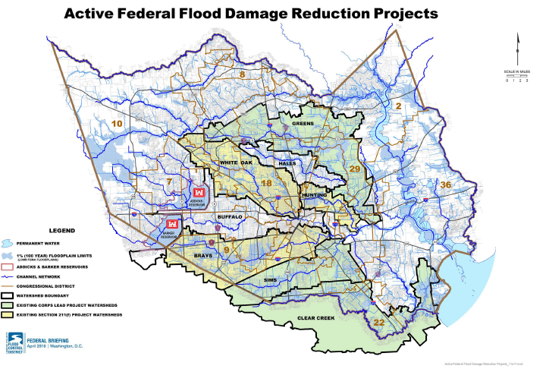

Slide 4
Agency Mission
(Distinct Roles)
FLOOD CONTROL DRAINAGE
(bayou to bay) (rooftop to bayou)

Slide 5
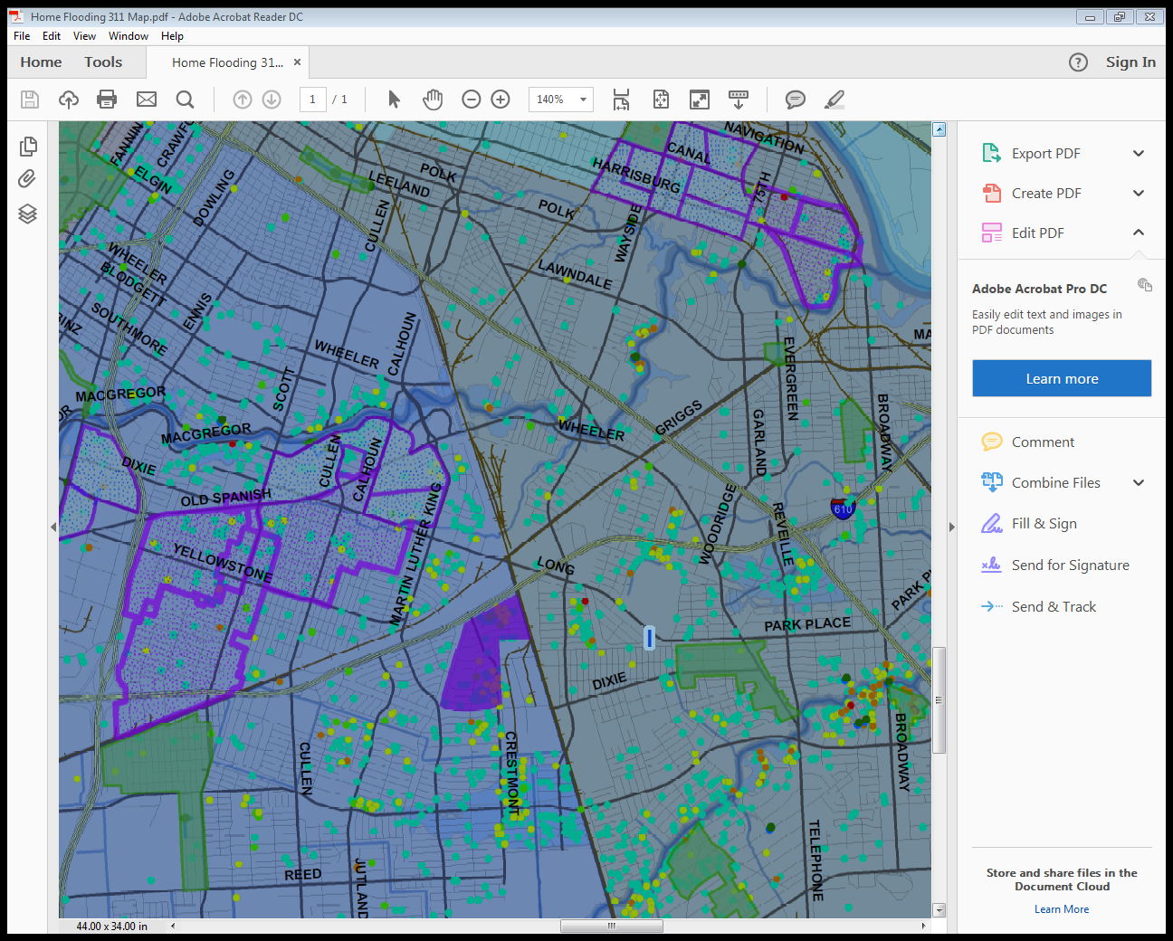
Structural Flooding

Slide 6
Public Demands
Drainage and Flood Control
Common Goal, Common Taxpayer,
Common Sense
“KEEP THE WATER OUT OF MY HOME”

Slide 7
Working Together
Ongoing Federal Flood Damage Reduction Project
Brays Bayou
Hunting Bayou
White Oak Bayou
Goal: Help expedite project completion

Slide 8
Working Together
Current Financial Arrangement
HCFCD----------50/50----------Corps
Proposed
HCFCD----------50/50----------Corps
|
COH --- (TWDB)
Federal, State, County & City Participation

Slide 9
Core Mission - Drainage
Rebuild Houston Enterprise Fund
CIP Maintenance/Upgrade
(SWAT)
(Storm Water Action Team)

Slide 10
SWAT Team Composition

Slide 11
Storm Water Action Team
Improvements: Ditch Widening
Driveway Culvert Replacement
Inlet Replacement
Side Lot Swales
Sewer Line Replacements
Funding: $$
Issues: De minimis Storage
Department Capabilities
Policy Changes

Slide 12
Near-Term Initiatives
Early Warning Systems
City-Wide Detention Plan
Task Force
Rebuild Transition Recommendations
Beyond the Federal Projects

Slide 13
Long-Term Initiatives
Other Federal Projects
Public Trust
Design Criteria
Gray to Green

