Slide 1
San Jacinto Regional Watershed Master Drainage Plan
October 17, 2019

Slide 2
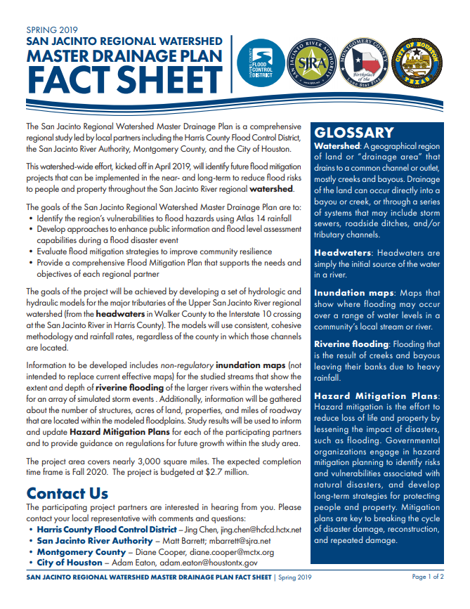
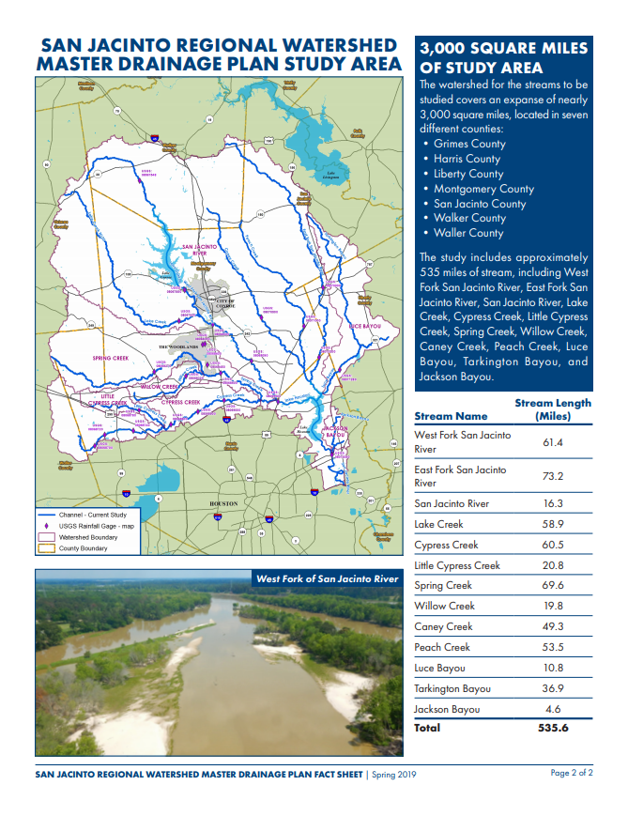
s
a
n
j
a
c
s
t
u
d
y
.
o
r
g

Slide 3
Goals

Slide 4
Goals
Process

Slide 5
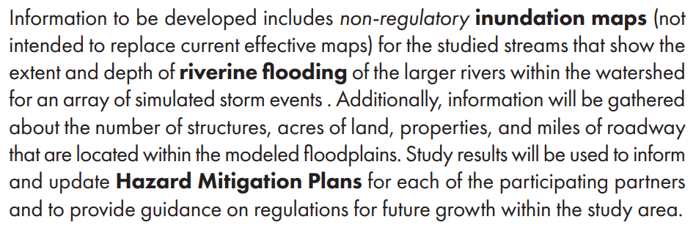
Goals
Process
Information Gained

Slide 6
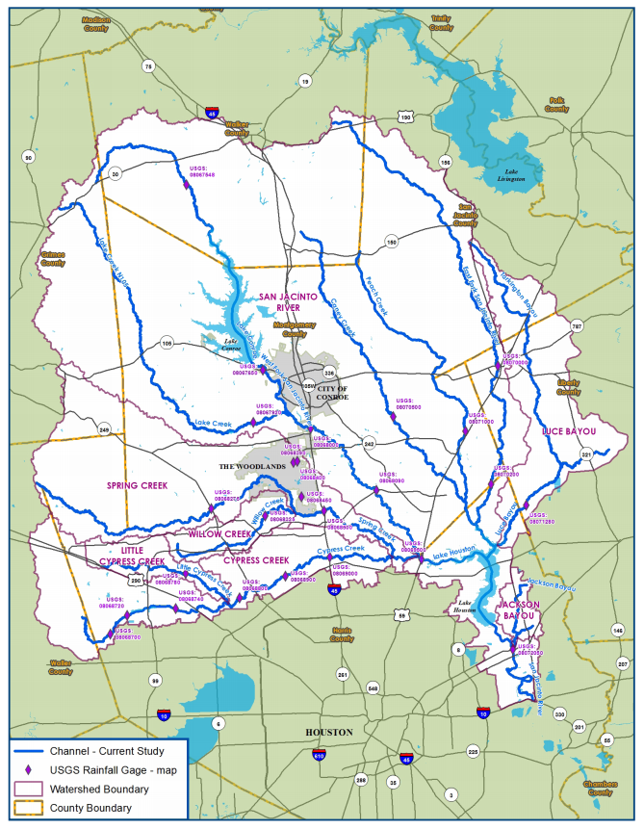
Study Area

Slide 7
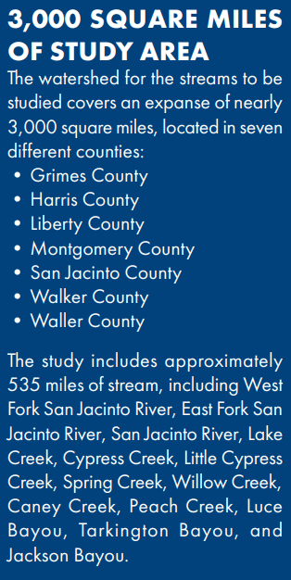
Study Area

Slide 8
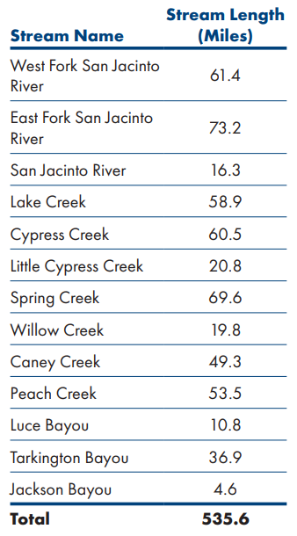
Study Area

Slide 9
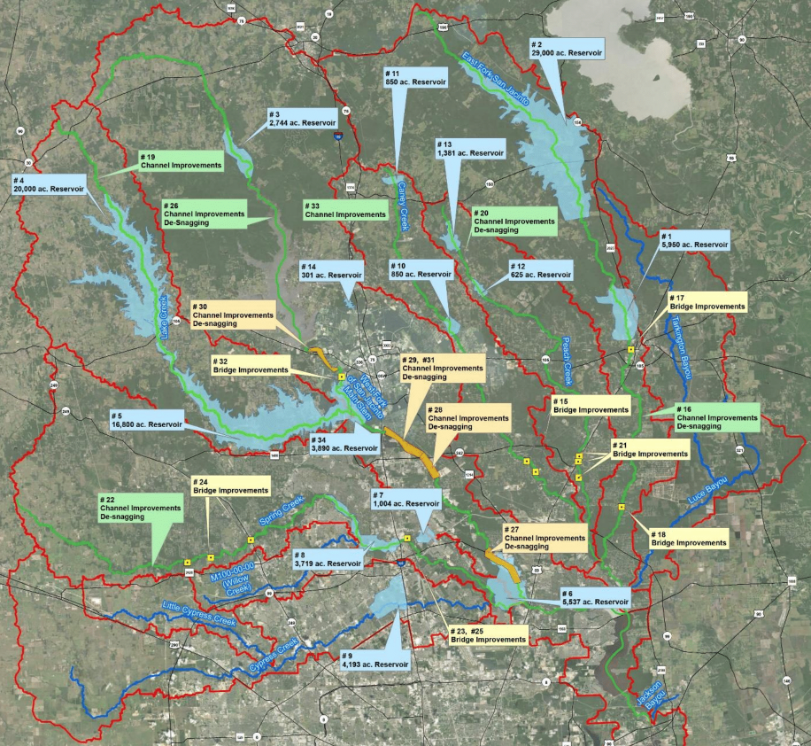
Completed Major Activities
Reviewed and collected data on existing conditions / developed existing conditions model(s)
Held workshop to review previously identified alternatives

Slide 10
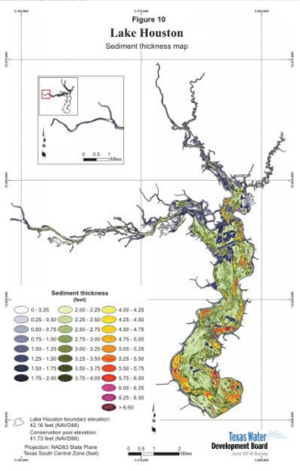
Activities in Progress
Evaluating historical storm events to calibrate model(s)
Developing mitigation alternatives
Working to develop plan for sedimentation and vegetation

Slide 11
Looking Ahead
(Anticipated Completion Dates)
Vegetation and sediment control analysis – January 2020
Alternatives analysis (including H&H) – March 2020
Project completion – Fall 2020

Slide 12
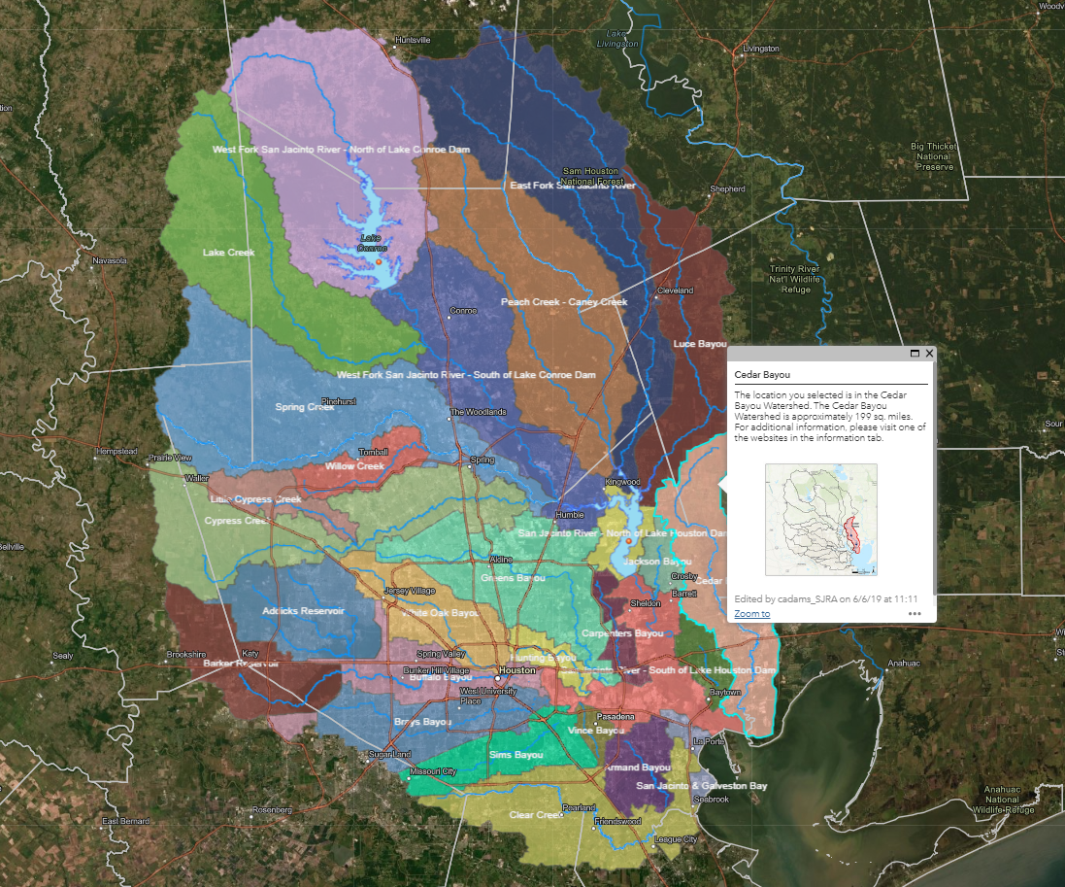
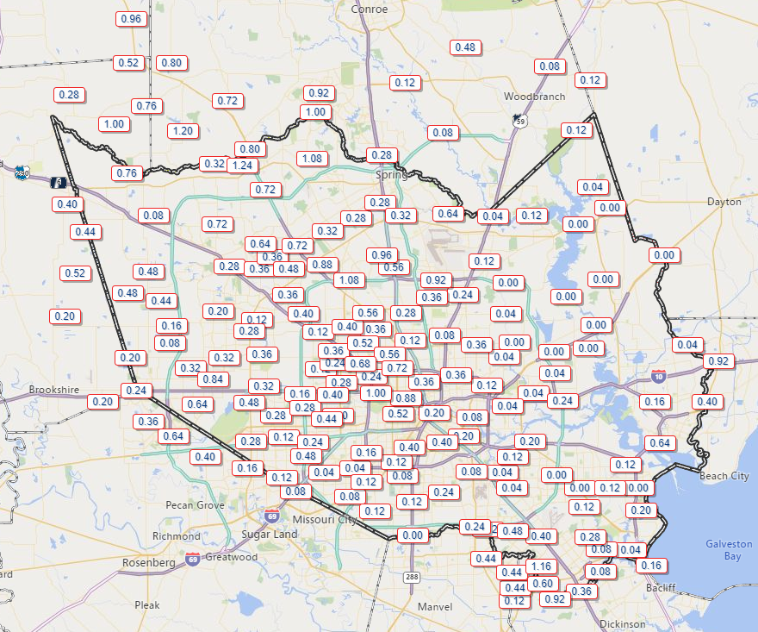
Resources
SanJacStudy.org
KnowYourWatershed.com
www.sjra.net
HarrisCountyFWS.org

Slide 13
Study Partners
Project Budget = $2.7 million

