Slide 1
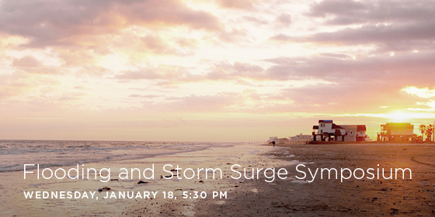






Slide 2
Coastal Spine: Interim Design Report

Slide 3
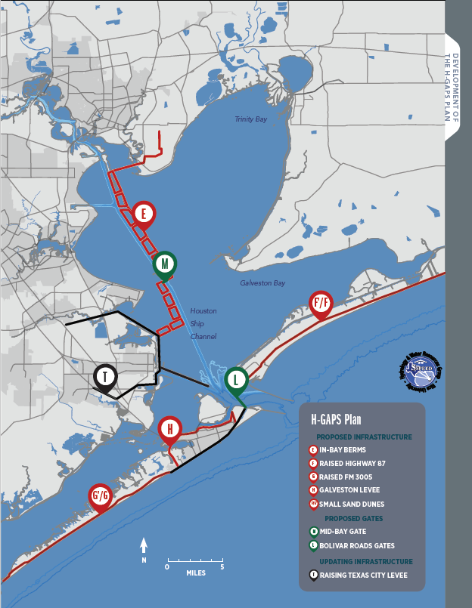
HGAPS Plan
“Multiple Lines of Defense”
Coastal Spine (F, L, 1, G)
Land Barriers (F, 1, G)
Bolivar Roads Navigation and Environmental Gates (L)
In-Bay System (E, M, T, H)
In-bay berm system with small- craft gates (E)
HSC Navigation Gate (M)
Backside Levee (H)
Note: Existing Structures (1 & T)
Notes:
The Mid-Bay Gate Strategy entails a storm surge gate across the HSC over Galveston Bay, connecting the east and west sides of the sea barrier that spans 740 ft and protects to a depth of approximately 60 ft and a height of 25 ft. The remaining elements for cost estimates are similar to the Upper-Bay Gate Strategy. The eastern portion involves levee protection extending from Atksinson Island over to Mosquito Knoll southeast of Atlantic Pipeline to FM- 1405 and then around the south and east side of Lone Star Energy Fabrication. The bay portion of the strategy consists of dredge disposal containment areas stretching from Atkinson Island running south along the east side of the HSC to the Trinty River Cut. An HSC opening remains over the navigable portion of the HSC near the middle bay portion, but the dredged disposals continue west of this opening and running south to Dollar Reef until final tie-in with the Texas City Levee. Roadway elevation including FM-3005 (from seawall to San Luis Pass) and SH-87 (from seawall to High Island).

Slide 4
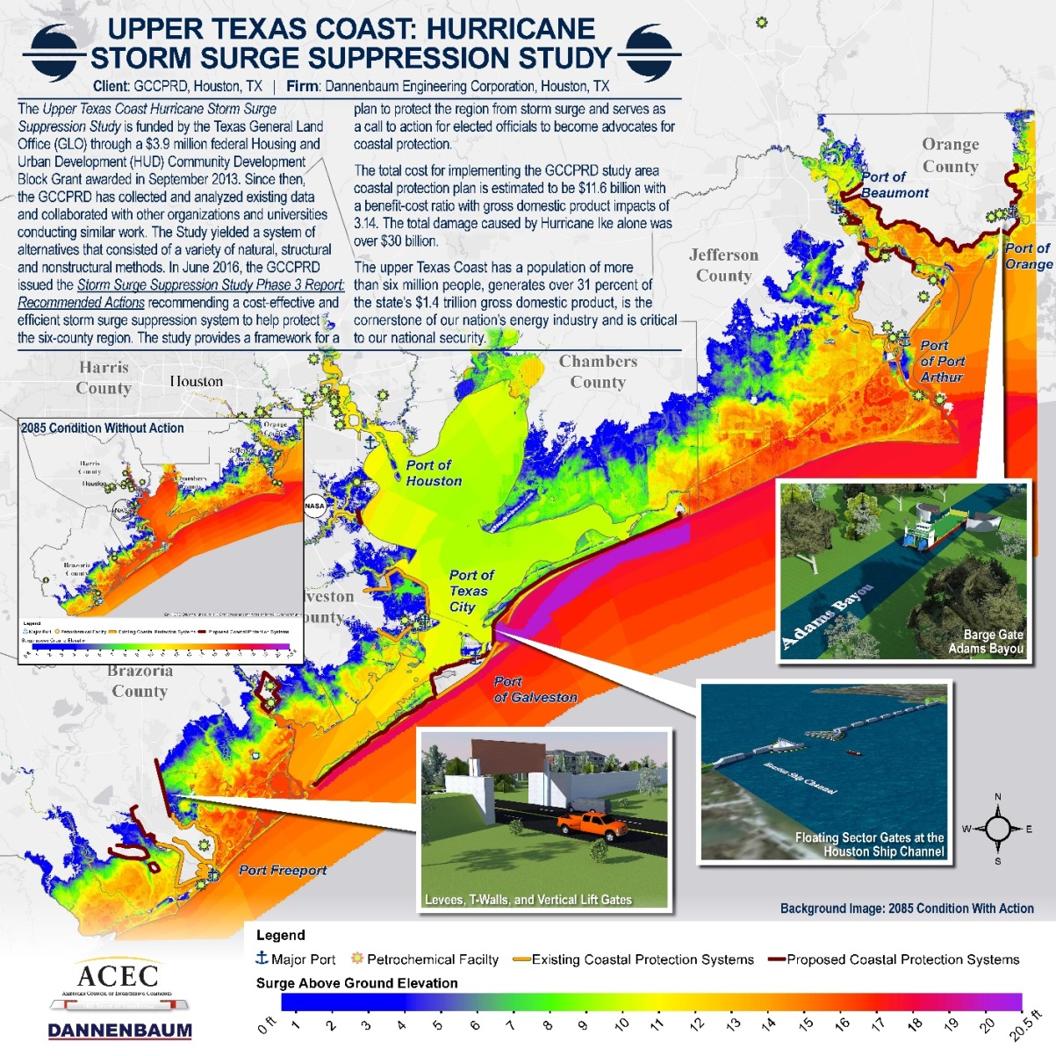
GCCPRD Recommended Plan

