Slide 1







Slide 2
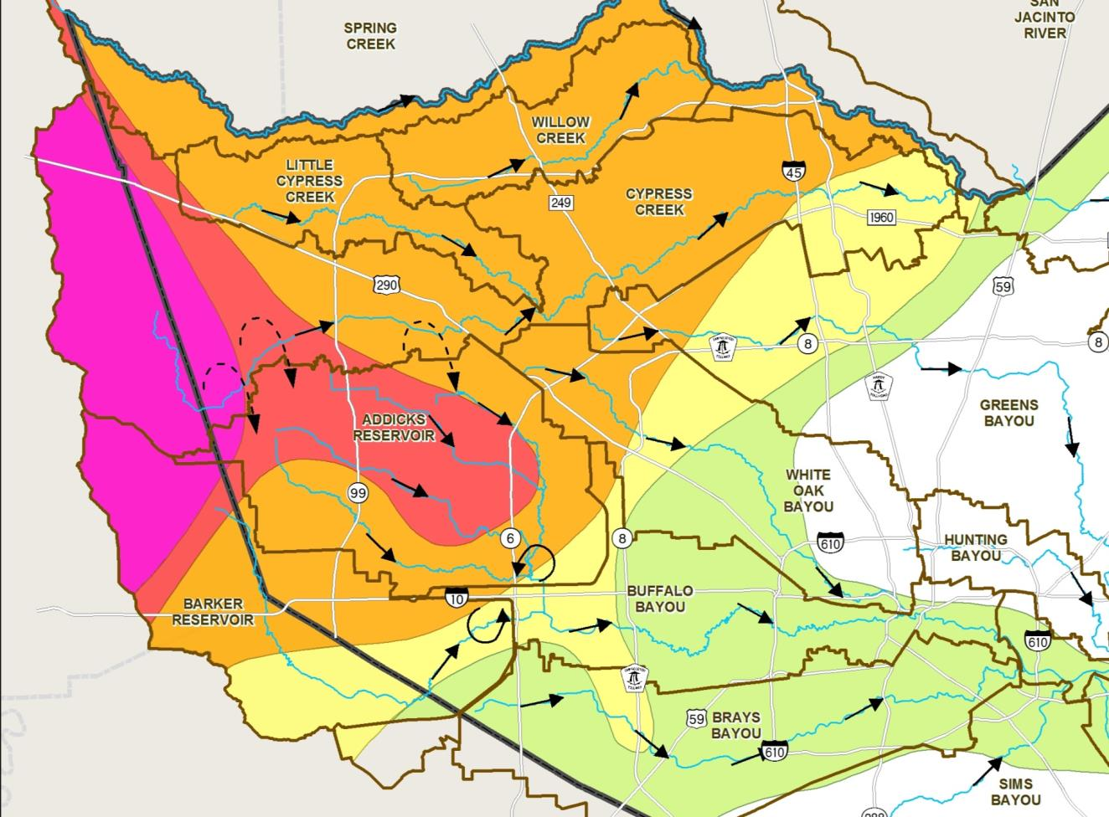
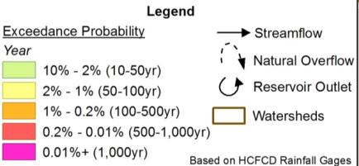
April 17-18, 2016 Flood

Slide 3
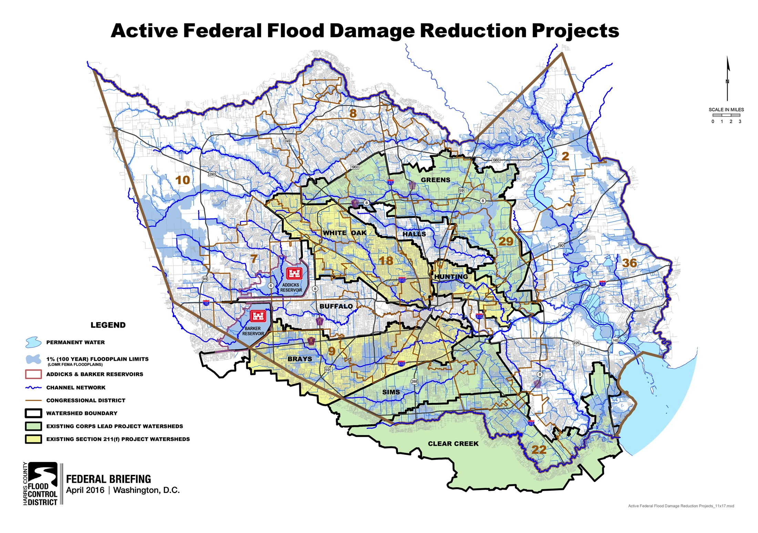

Slide 4
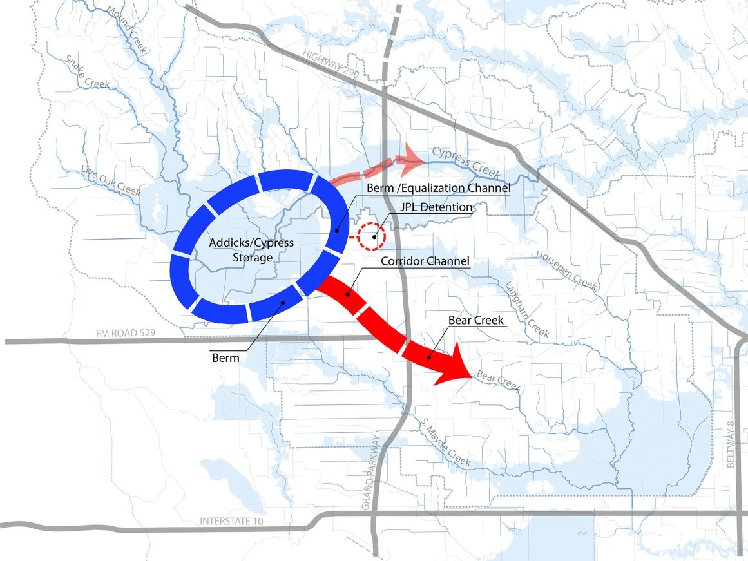
Cypress Creek Overflow Management Plan: Plan 5

