Slide 1
Donation Boxes – Proposed Ordinance Stakeholder Meeting
December 17, 2020

Slide 2
Background
Vice Mayor Pro Tem Castex-Tatum has received complaints about Donation Boxes located in District K.
Based on those complaints, the staff did a high level survey of some of the boxes in District K.
Findings from Survey
The donation boxes were not authorized by the property owners nor corporations
The property owners nor corporations are receiving monies for property rental and want the boxes removed
The donation box owners will not remove the boxes, leaving the property owners responsible for removal
Debris and clutter collect around the donation boxes that do not fit in the box. Items that are not being collected such as furniture are left at the boxes.
Based on a windshield survey by HPD, there are approximately 285 donation boxes in the City

Slide 3
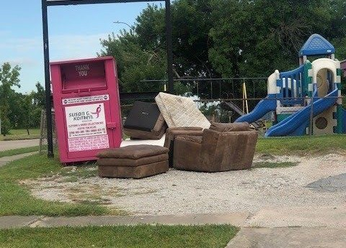
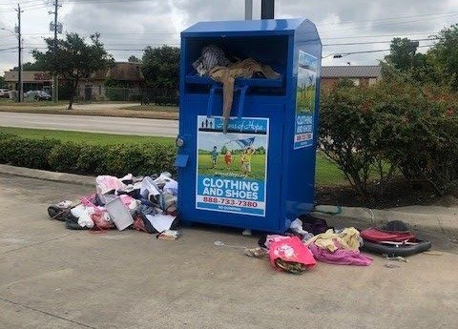
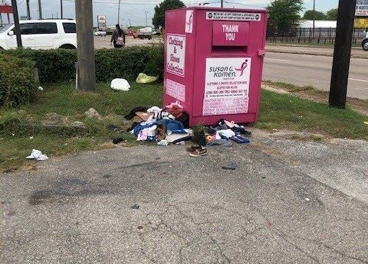
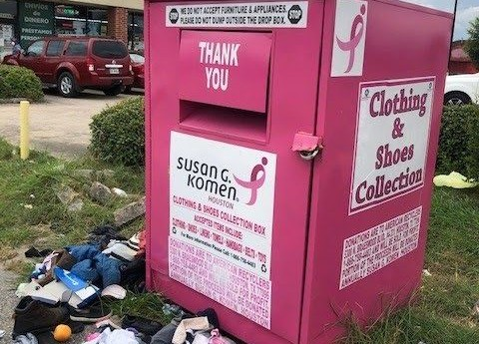
Background
Pictures of some of the Donation Boxes that have been found in District K

Slide 4
Background
As a result of the survey, VMPT asked Administration & Regulatory Affairs, City Attorney’s Office, Solid Waste Department and Houston Public Works to work on regulations for Donation Boxes in the City of Houston
Definition of a Donation Box means any public donations receptacle intended for use as a collection point for clothing or household goods donated by the public

Slide 5
Donation Box New Requirements
General Requirements - All donation boxes in the city must comply with following requirements:
Current contact information for the operator of the donation box must always be displayed on a donation box.
Valid decal/permit must be posted on the donation box and visible from the right-of-way at all times.
No donation box may be placed in the city’s right-of-way.
At least one parking space must be provided for use of persons accessing the proposed donation box. The donation box must not block any parking space required under this Code or any other law.
No donation box shall be permitted within the row of parking adjacent to the right-of-way unless an existing landscape buffer is present and in good condition. If there is no landscape buffer, a donation box shall not be placed less than [40 feet] from the adjacent right-of-way.

Slide 6
Donation Box New Requirements
General Requirements (cont’d)
No donation box shall be permitted in a required landscape buffer or building setback, drainage easement, floodplain, driveway, utility easement or fire lane.
No donation box shall be permitted in a visibility triangle described in section 42-161 of this Code.
No donation box may exceed 120 cubic feet in volume or have a footprint that exceeds 50 square feet
No more than one donation box may be placed within 500 yards of another.
No donation box may constitute a hazard for drivers on nearby roadways.
A donation box shall not impede traffic nor visually impair any motor vehicle operation within a parking lot, driveway or street.

Slide 7
Donation Box New Requirements
General Requirements (cont’d) –
A donation box must be made of metal to reduce the possibility of arson, and degradation resulting from exposure to the elements.
Each donation box must be covered by a bond with an operator principal and a corporate bonding company licensed to do business in the state, a surety in the amount of $10,000 to cover the costs of abatement, damage to any city property, or remediation by the city caused directly or indirectly by the operation or maintenance of the donation box.
Each donation box shall comply with all applicable state and federal laws, including but not limited to section 17.922 of the Texas Business and Commerce Code.

Slide 8
Required Permits
Permit Required
A permit will be required for each donation box placed within the City
There will be a decal provided for each permitted donation box
The decal will be placed on each permitted donation box in service
The company who owns and manages the donation boxes will
obtain the permit for each box from Administration & Regulatory
Affairs
Cost of Permit Decal – To Be Determined

Slide 9
Placement or Maintenance of Donation Box
Unlawful Placement or Maintenance of Donation Box –
It shall be unlawful for any person to place or maintain, or allow to be placed or maintained unless done in accordance with a valid permit
Unlawful to Allow Unpermitted Donation Box on Real Property –
It shall be unlawful for any person that owns, leases, is in control of, or possesses real property within the city to authorize or allow any donation box to be placed on or remain on real property unless done with a valid permit.
Penalty for Operating an Unpermitted Donation Box or Unlawful Placement or Maintenance of Donation Box
A violation of these items or any other requirements is guilty of a misdemeanor punishable by a fine of $500

Slide 10
Requirement to Keep Donation Boxes Clean
A donation box shall not be used for solicitation or collection of anything other than clothing and household items. All donated materials must fit into and be placed inside the donation box. The collection or storage of any materials outside the container is strictly prohibited.
Owners shall be responsible for preventing overflow of the donation box and littering. Owners shall keep the real property within 25 feet of the donation box free of trash, debris, donations, clothes, furniture and any other materials related to or resulting from the operation of the donation box. Failure to do so shall constitute ground for revocation of a permit
Each donation box shall clearly indicate in written letters at least one-half inch in height, that all donations must fit into and be placed within the donation box. Failure to provide such indication shall constitute ground for revocation of a permit.

Slide 11
City Abatement of Donation Box
If an owner fails to timely abate a violation of the regulations, then the city shall be authorized to carry out the abatement, to assess its expenses including applicable overhead related to the abatement and place a lien on the donation box or any real property on which the donation box was unlawfully placed.
If determined by the city that any violation is likely to have an immediate adverse effect upon the public health or safety, then the city may order such violation to be summarily abated and lien for the city expenses related to the abatement shall be assessed.
Any donation box placed or maintained on real property without the consent of the real-property owner shall be subject to immediate impoundment by the City. Any donation box impounded by the City shall be released to the operator upon payment of all applicable impoundment and storage fees.

Slide 12
Questions?
Follow Up Questions:
Email: ARARegulatoryPermitting@houstontx.gov
Phone: Kathryn Bruning, 832-394-9414

