Slide 1
Community Update
Fall 2019

Slide 2
CONTENTS
1 | Project background
2 | Progress to date
3 | What’s next
4 | What we have heard
5 | Questions

Slide 3
Project Background

Slide 4
MAXIMUM GROUNDWATER USE
70%
30%
% of ground water
20%
Current
2025
2035
this requirement pertains to the Area 3 of the Harris Galveston Subsidence District and Area A of the Fort Bend Subsidence District

Slide 5
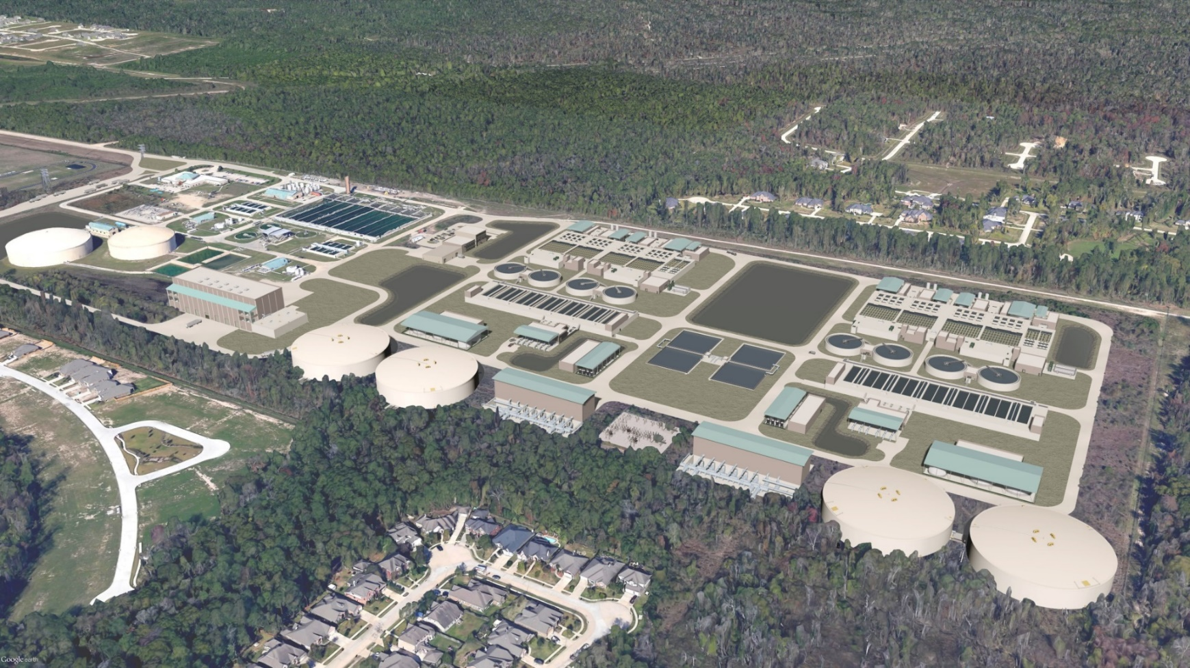
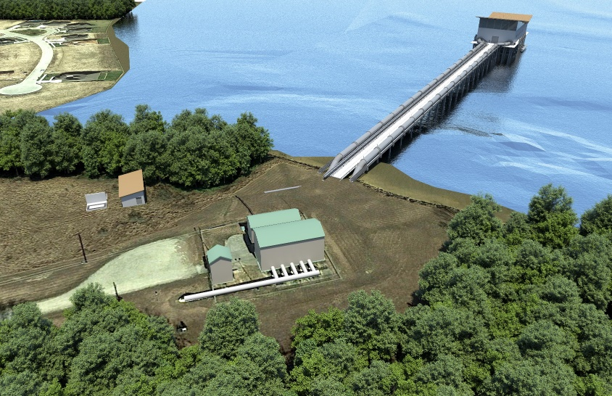
NORTHEAST WATER PURIFICATION PLANT
Existing Facilities
New Facilities*
Intake Pump Station
Raw Water Pipelines*
Treatment Facilities
* new facilities shown are renderings of the completed project

Slide 6
Progress to Date

Slide 7
Estimated Pipe Construction Timeline
Lake Houston
May 2019 – Jan 2020
Mar 2019 – Jan 2020
Pipe Work Complete
Apr 2019 – Nov 2019
Pipe Work Complete
Pipe Work Complete

Slide 8
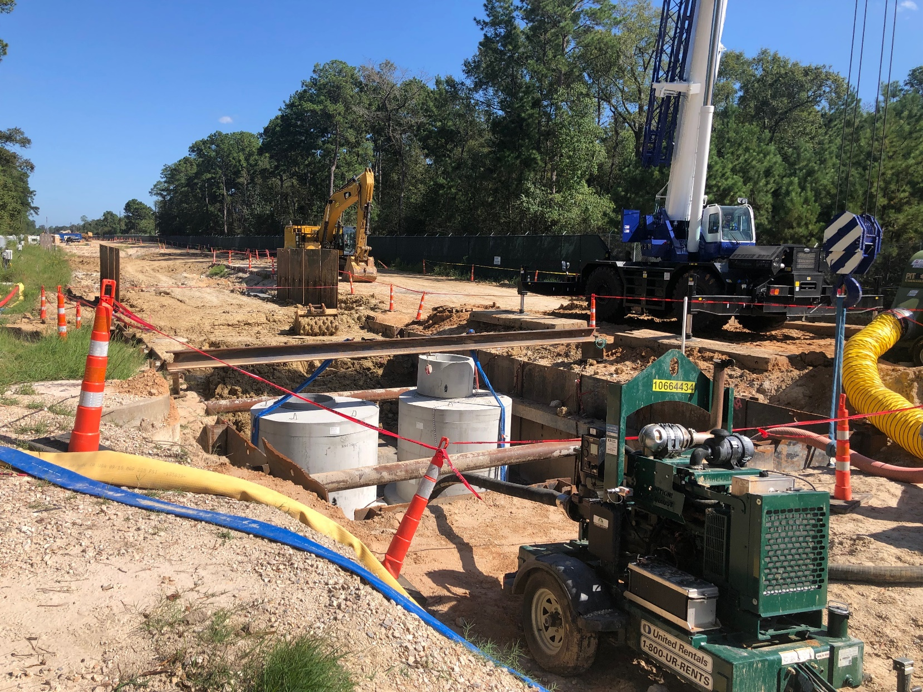
Pipe Installation in the West Corridor

Slide 9
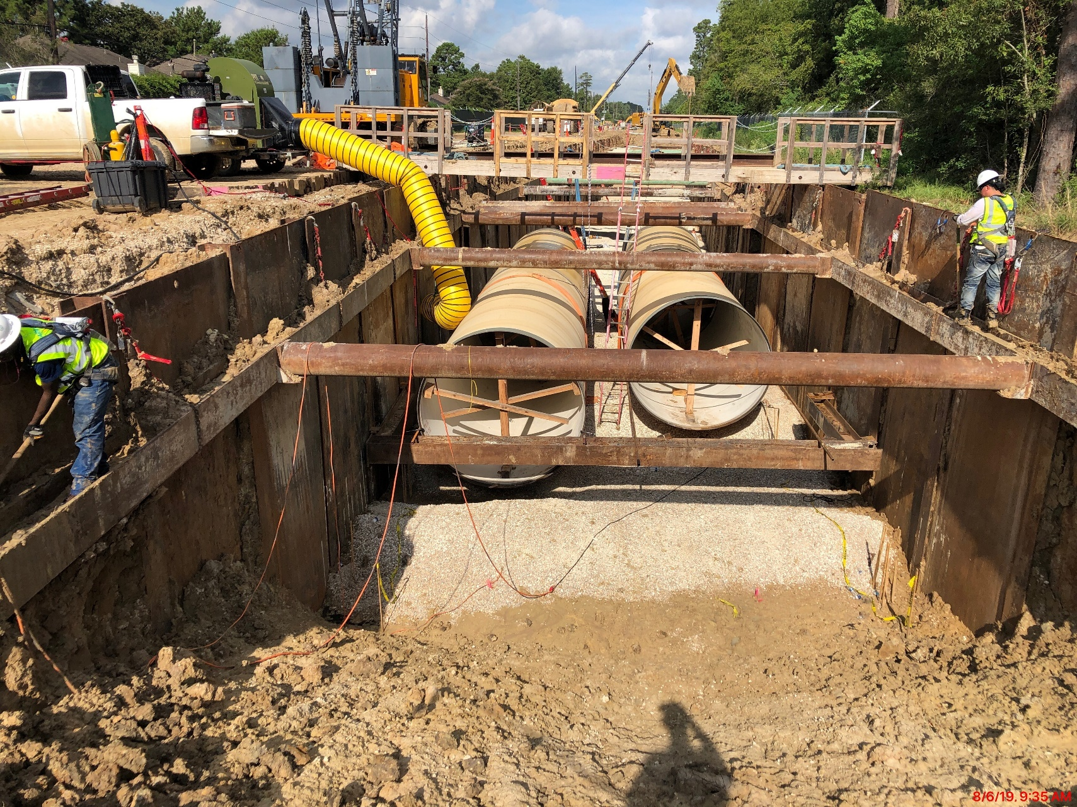
Pipe Installation in the East Corridor

Slide 10
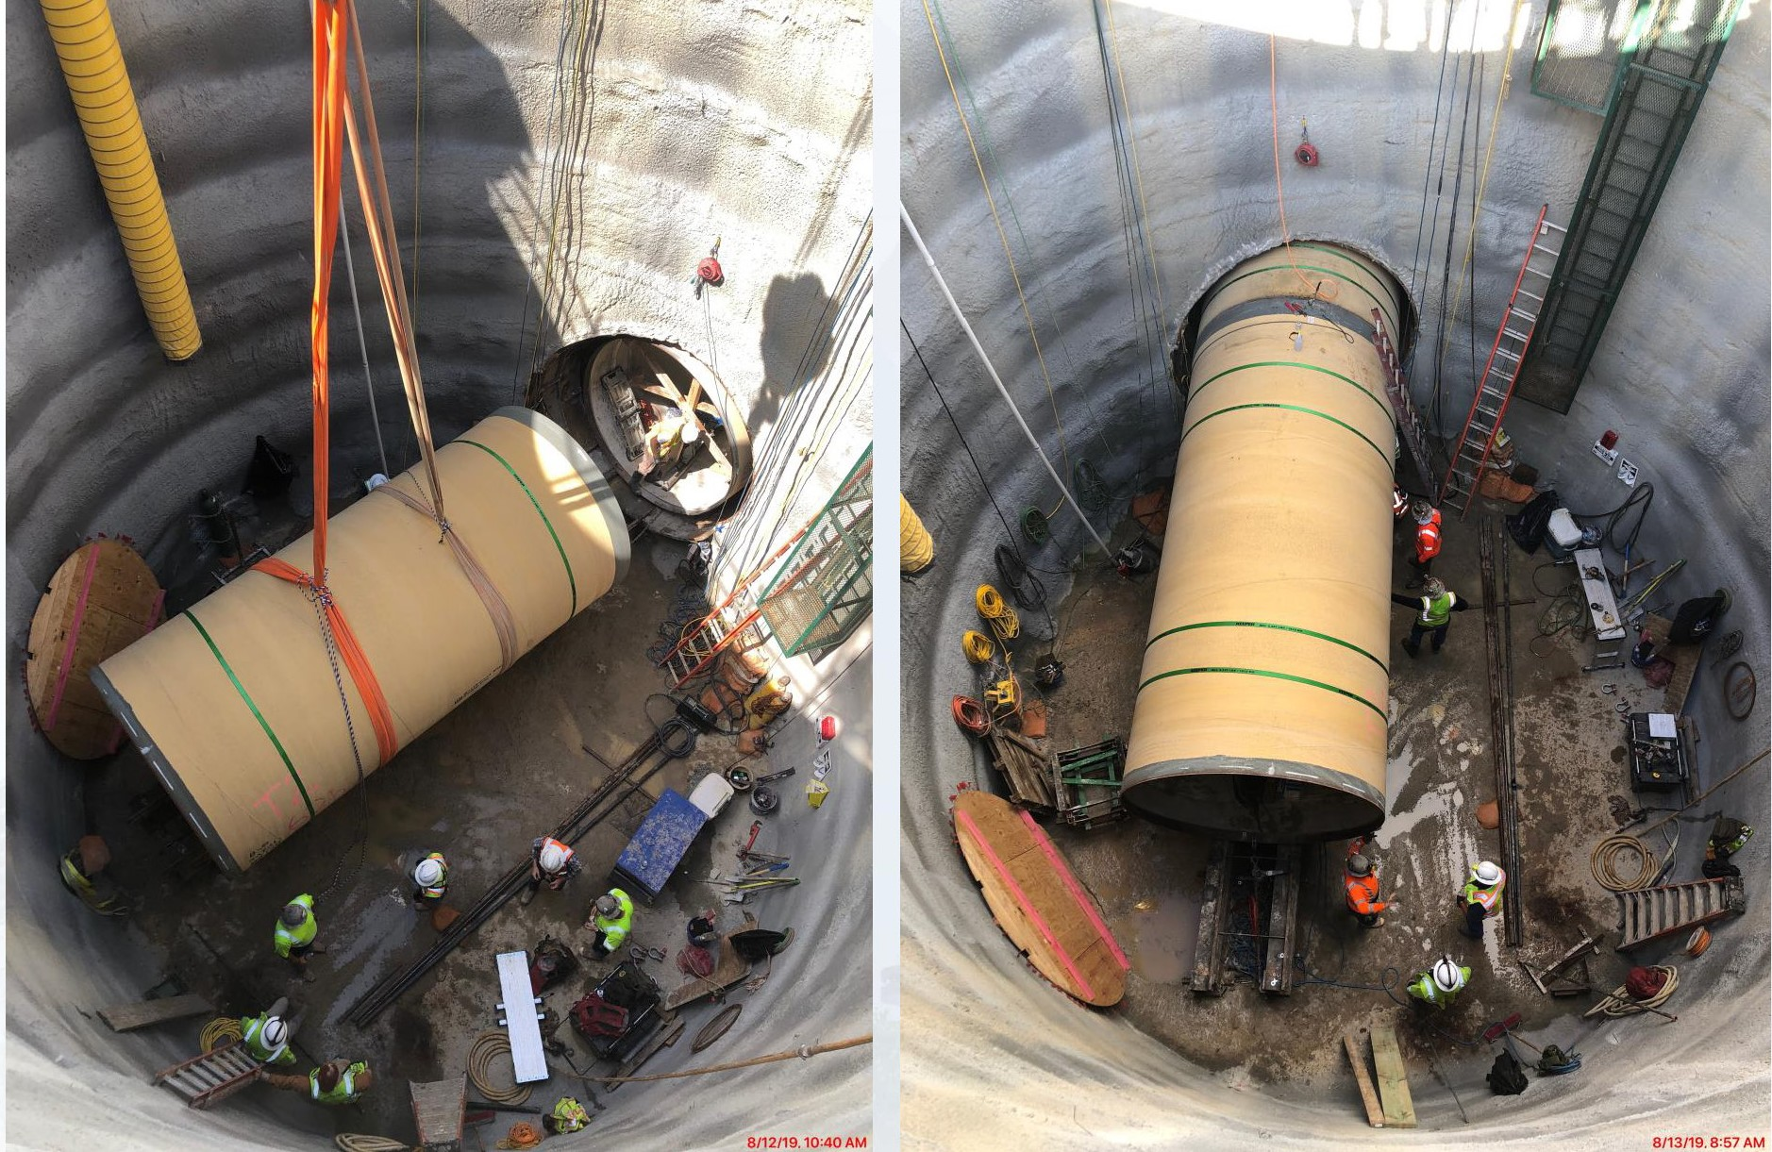
Pipeline in Tunnel under Lake Houston Parkway

Slide 11
Work on Intake Pump Station

Slide 12
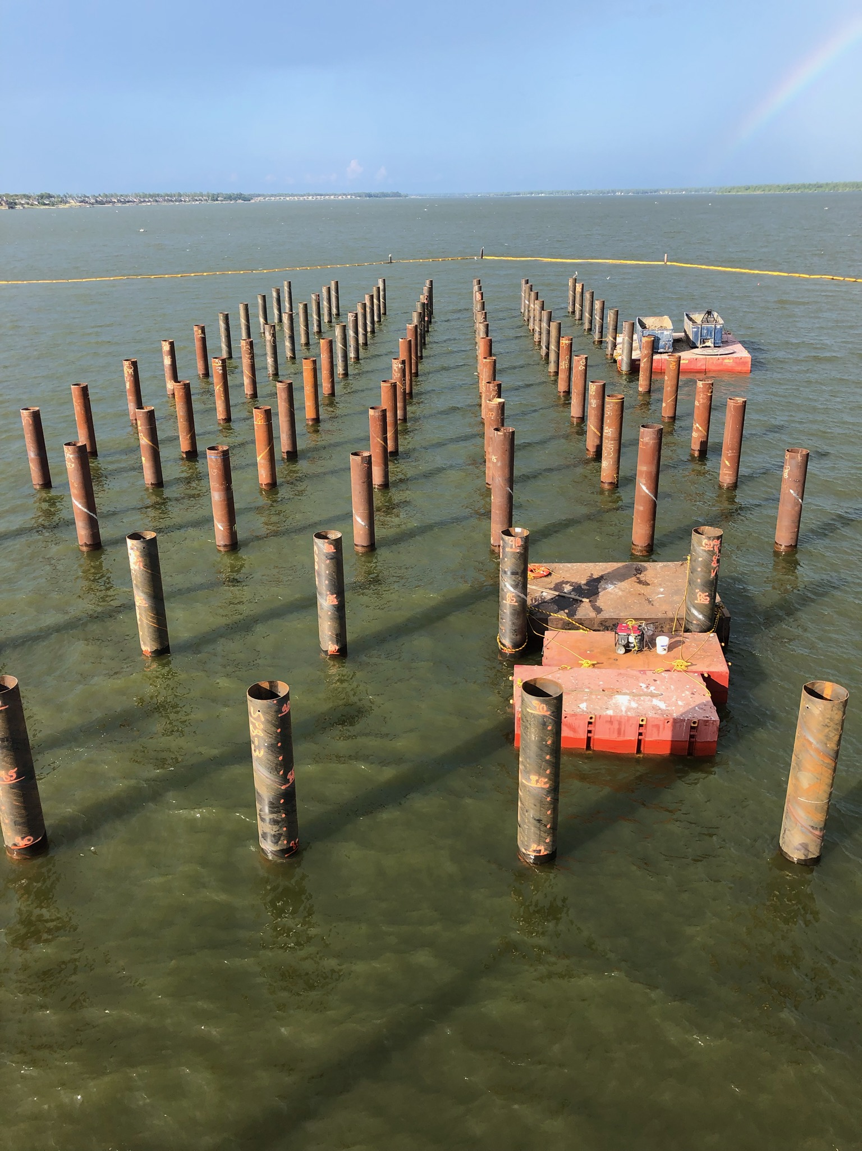
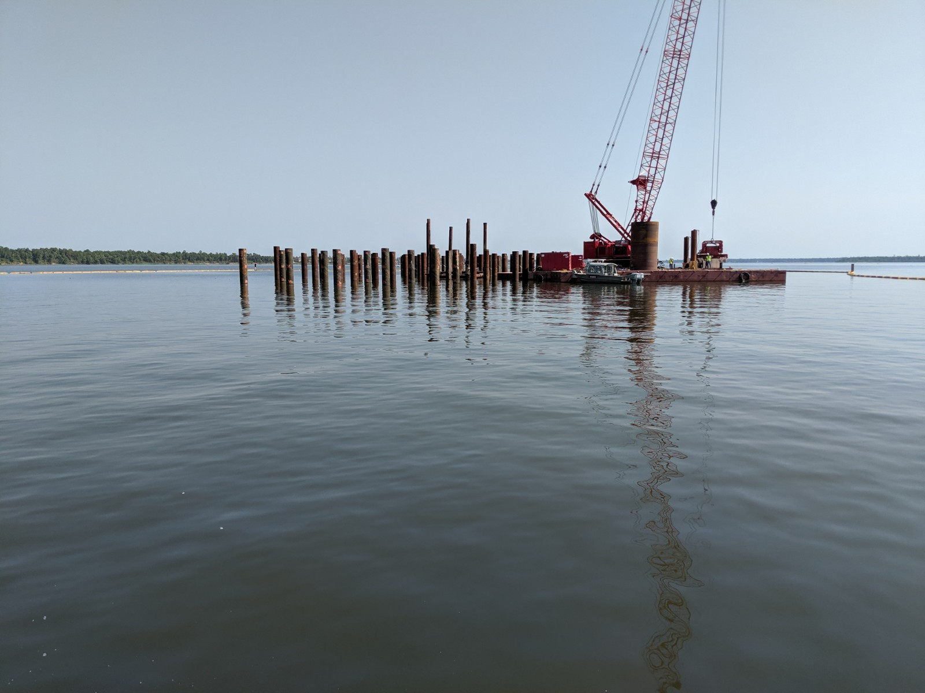
Lake Houston Intake Pump Station

Slide 13
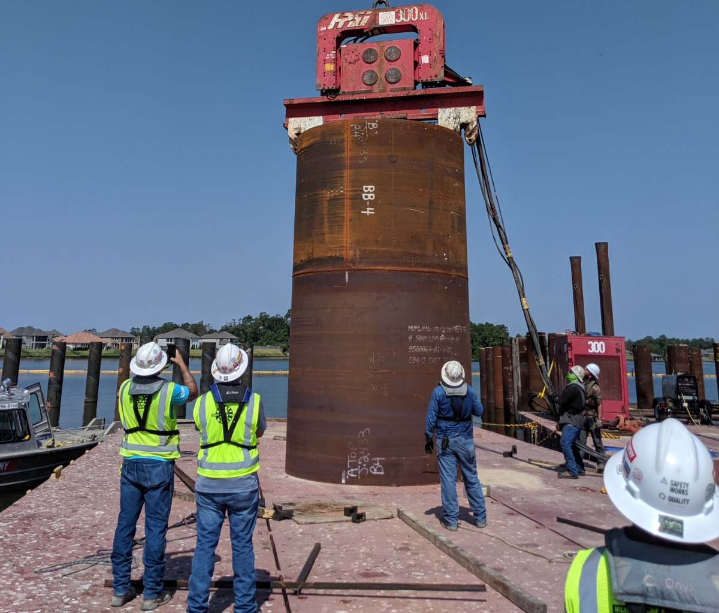
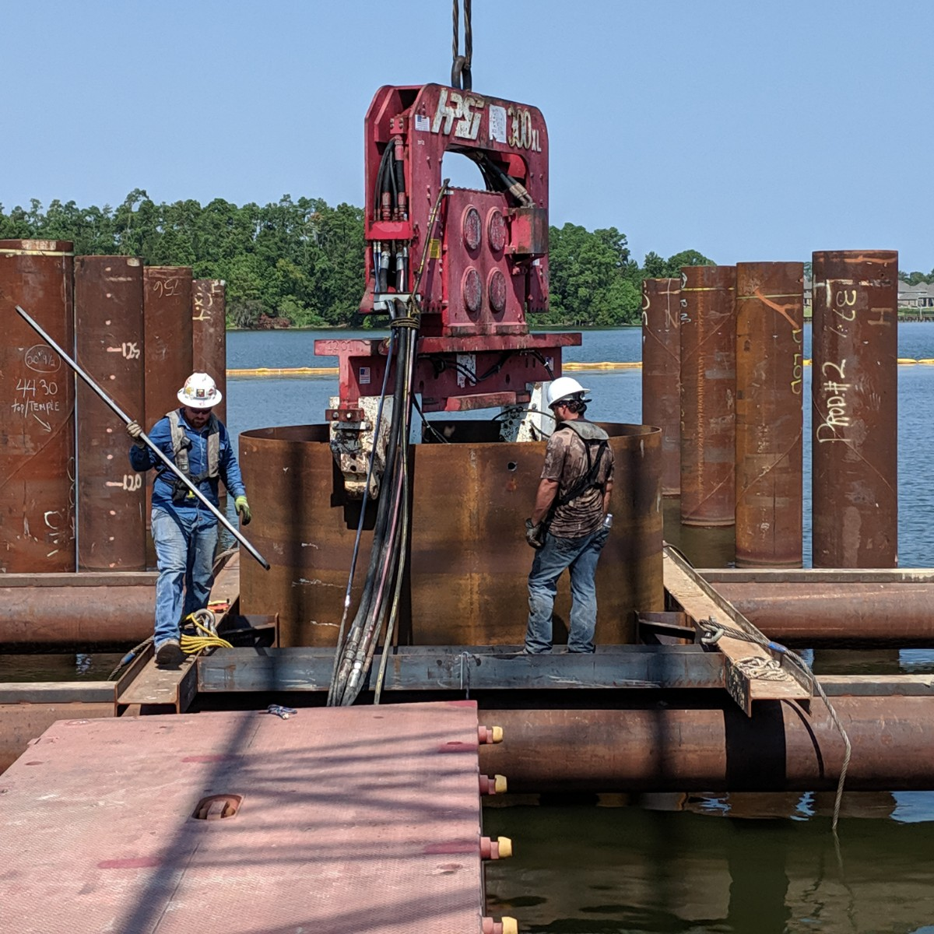
Driving of Pump Can Steel Casings

Slide 14
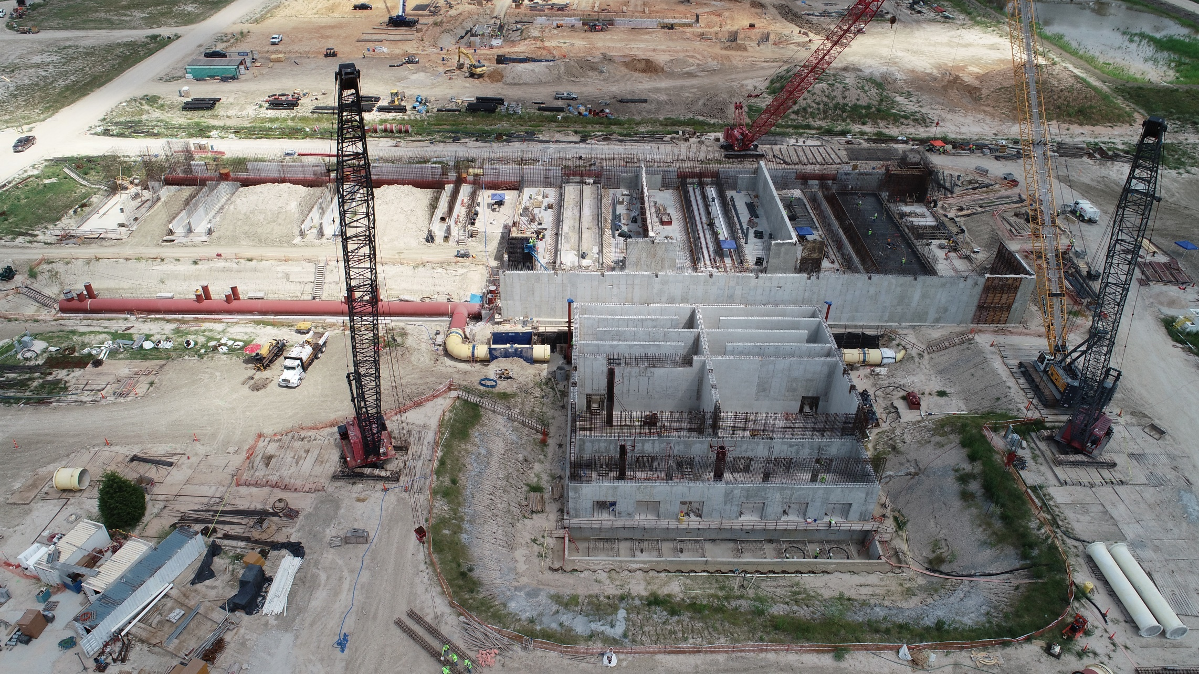
Plant Site Construction

Slide 15
What’s Next

Slide 16
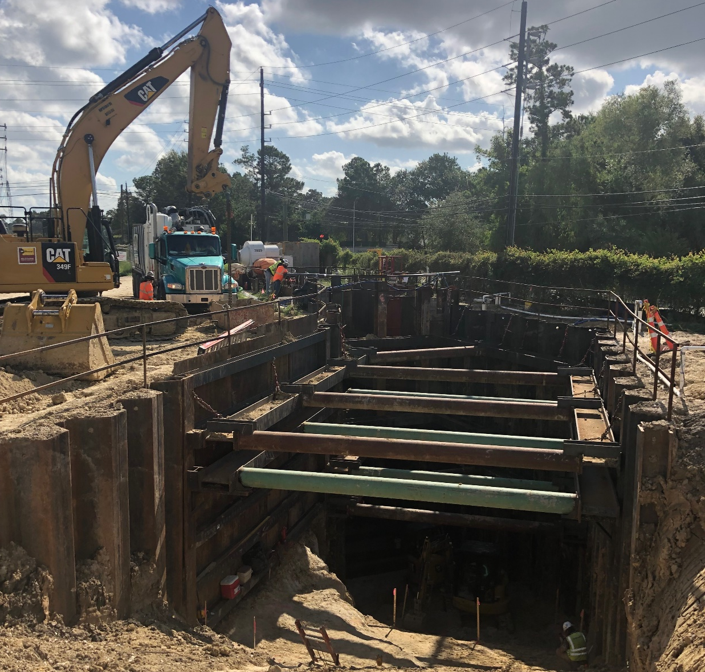
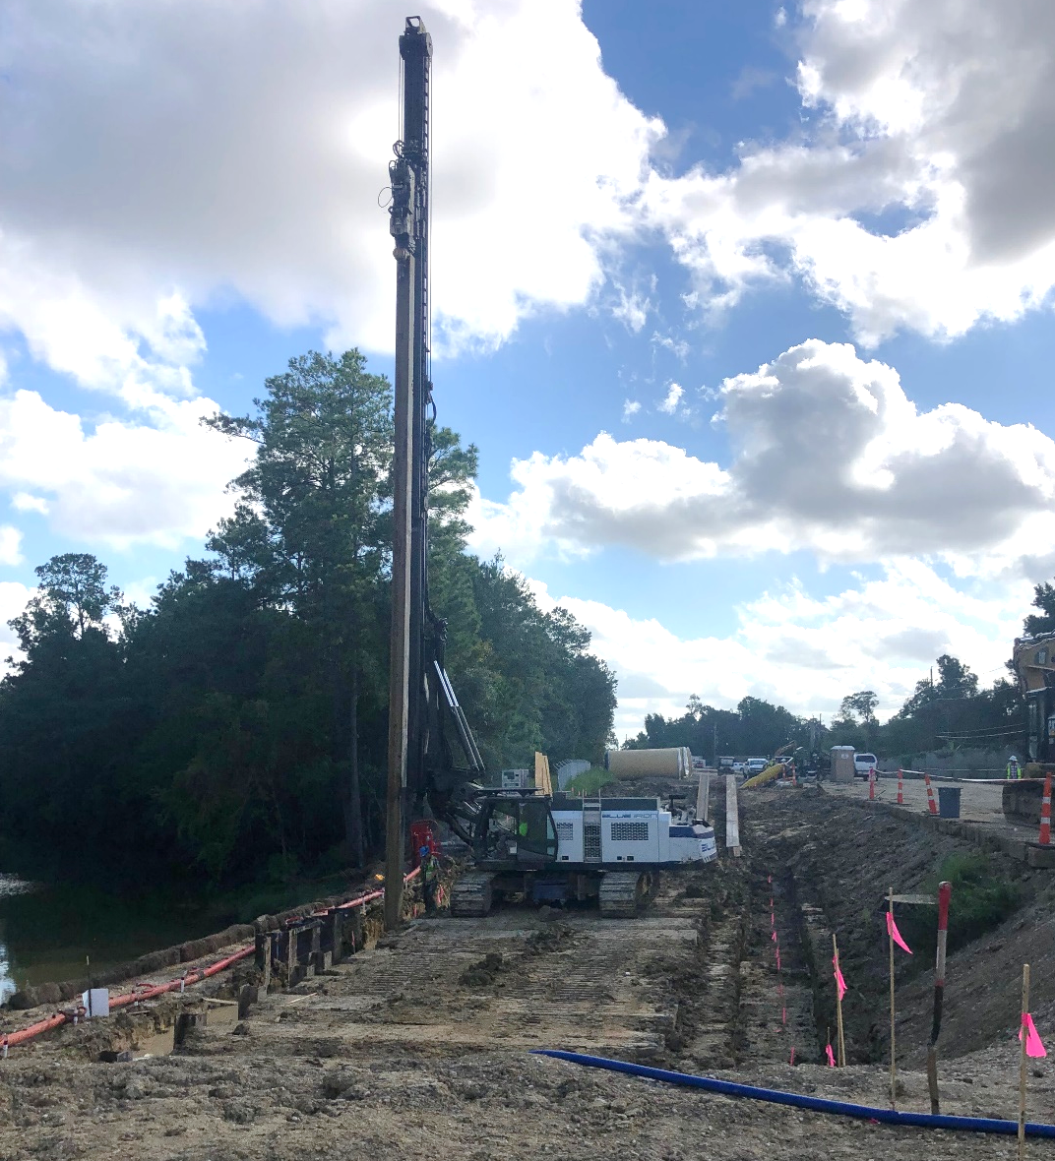
Raw Water Pipeline Installation

Slide 17
Intake Pump Station
Notes:
1

Slide 18
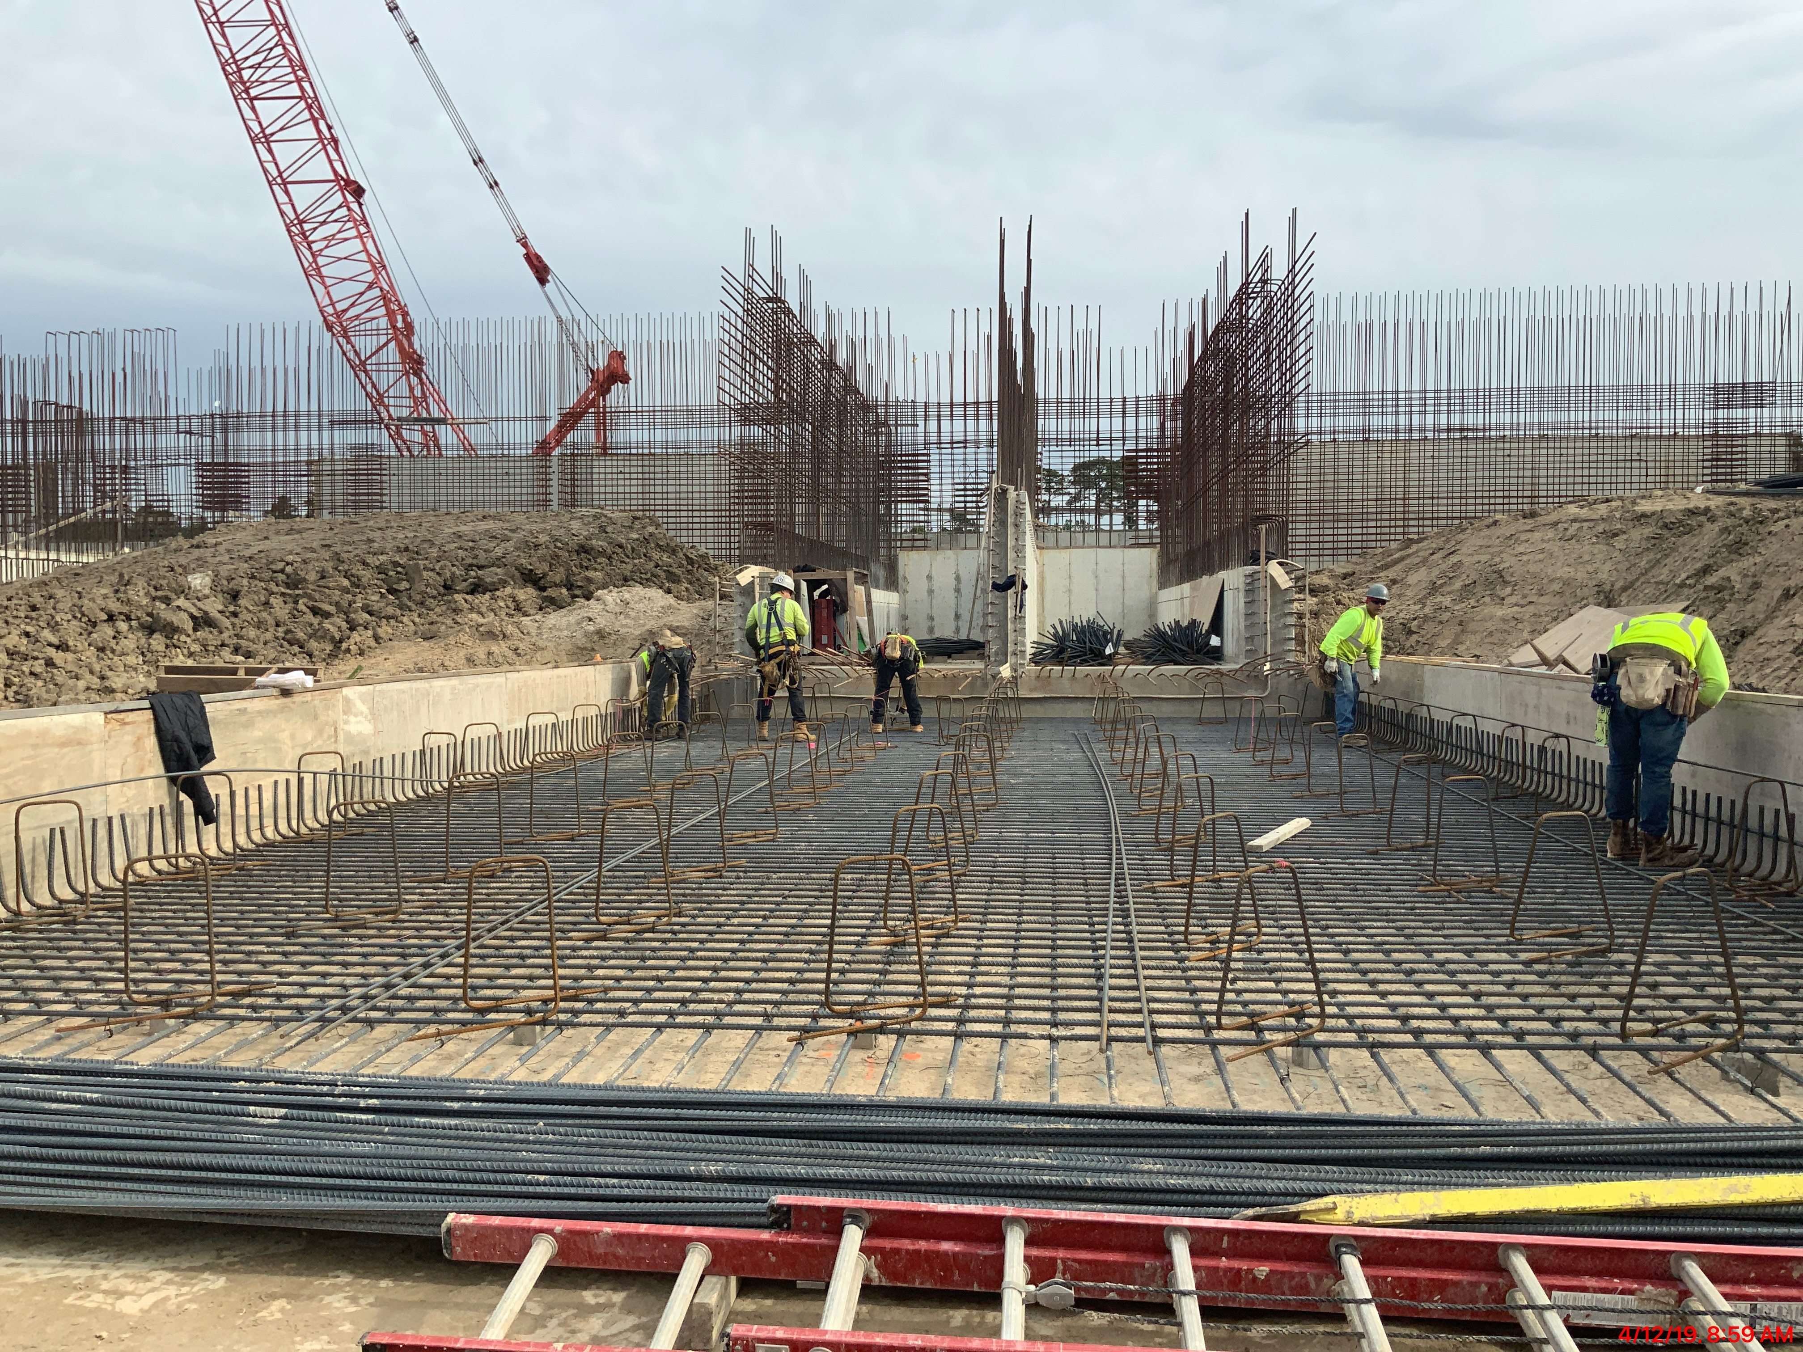
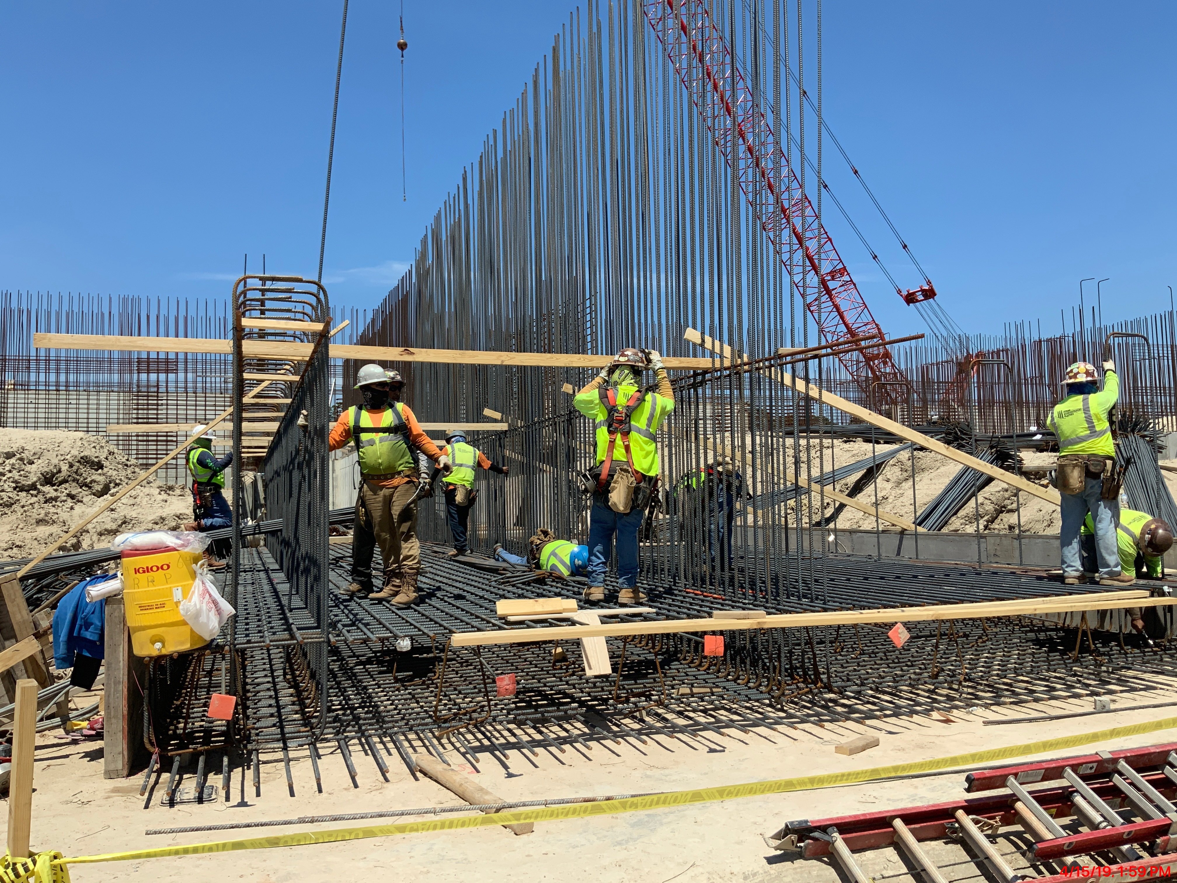
Construction at Plant

Slide 19
Next Steps
WHAT? | WHEN?
Pipeline Installed West to East | March 2018 - January 2020
Intake Pump Station at Lake Houston | February 2019 – 2022
Ductbank Installation and Road Restoration | February 2020 – March 2021
Plant Construction Site | Ongoing – 2025
Beautification (trees, intake pump station) | March 2021 – 2022

Slide 20
What you can expect during construction
Traffic on W. Lake Houston Parkway : delays Monday – Saturday, 9AM – 4PM
Noise from Pile Driving : hammering sounds as piles are driven into the lakebed
Noise from Plant Construction : heavy equipment, traffic, workers, etc.
Heavy Equipment : noise, vibration & dust from heavy equipment
Construction hours : Monday - Saturday, 7AM – 7PM
Holiday Schedule : Thanksgiving Day + Friday After, Christmas, New Years Day

Slide 21
What we have Heard

Slide 22
Our Good Neighbor Policy
In response to your calls, we have adopted a Good Neighbor Policy which gets reviewed at our weekly meetings. That policy includes:
No work before 7AM or after 7PM
Be mindful of how closely you are working to people’s homes
Reduce backing up equipment as much as possible
No foul language
Our goal is be good neighbors.

Slide 23
Just in case…..
If you are concerned about the proximity of the construction to your home please take photos before and after construction so you can show any damage that you may think was caused by the contractors working in your area.
If you choose to file a claim for damages we will need to get a form W9 from you if a payment is forthcoming.

Slide 24
Contact us
GreaterHoustonWater.com
281-520-3777
newppexpansion@gmail.com
Please contact us at this email and phone number for faster response
Public meetings will be held each quarter.
If you would like a tour of the site please contact us.

