Slide 1


Houston Fire Department
Public Safety Committee Meeting
Rodney West
Interim Fire Chief

Slide 2
Objectives
Overview of A-1 Custom Packing Fire on May 5, 2016
Life Safety Bureau Audit Plan
Digital Sandbox Restart

Slide 3
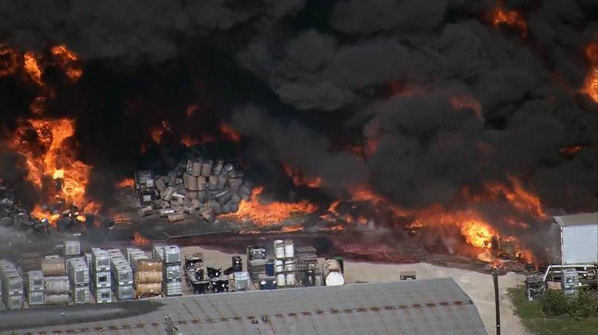
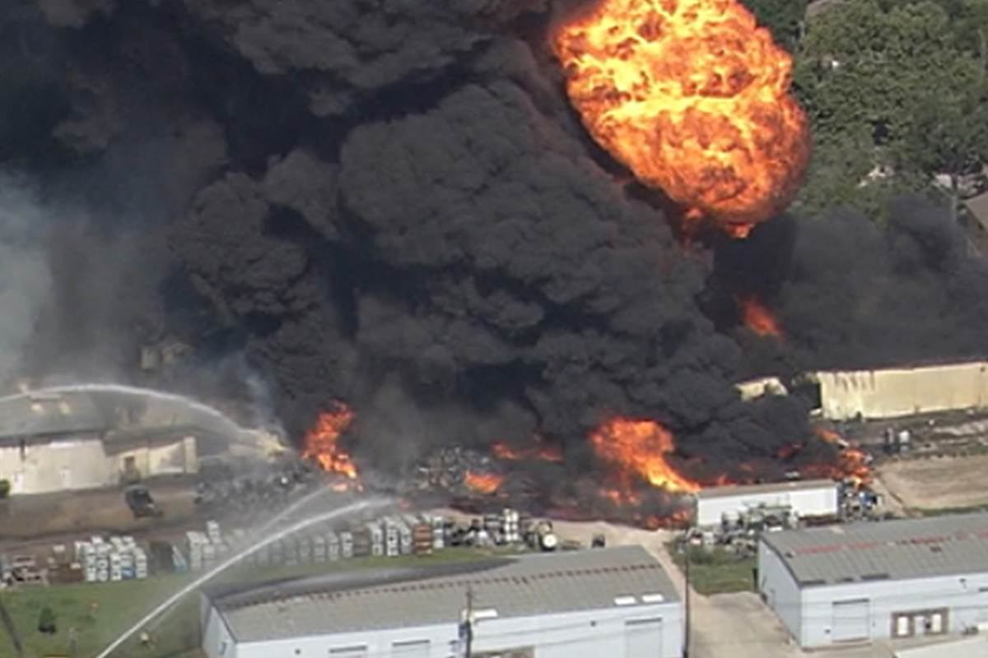
A-1 Custom Packing Fire
HFD responded to a reported house fire in the vicinity of 1710 Laverne at 09:45
Prior to arrival there were reports of a 2nd house on fire and multiple reports coming into the Emergency Operations Center (OEC)
The first companies arrived on the scene at 09:53 and within three minutes requested an increased alarm level

Slide 4
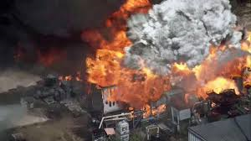
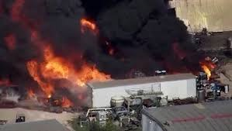
A-1 Custom Packing Fire
HFD was able to keep the fire from spreading to any other residential property however we were not able to stop the spread to the warehouse in the rear of the original location
By 10:14 the alarm level was raised to 411 and at 10:38 shelter in place was issued
The fire was declared under control at 13:58
Due to the chemicals and amount of fire HFD used a combination of a 3% AFFF foam and water to extinguish the fire

Slide 5
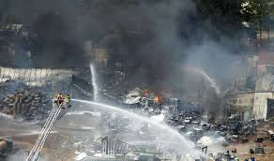
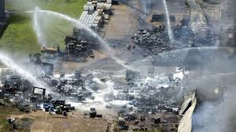
A-1 Custom Packing Fire
Coordinated control of hot-spots and runoff continued through the night and on to the next day
The Chemicals involved were mostly hydrocarbons and pesticides.
The location of the origin is at 1710 Laverne
The investigation into the cause and origin of this fire is ongoing.
Fire Under Control

Slide 6
Other Agencies and Departments Involved
Harris County HAZMAT
Harris County Pollution Control
Texas Parks and Wild Life
Texas Commission on Environmental Quality
Environmental Protection Agency
SET Environmental Services
PWE
Houston Health Department
Office of Emergency Management

Slide 7
A-1 Custom Packaging Fire and Spill Response
Warehouse Facility Progress
  TCEQ is the lead for enforcement activities against the Potential Responsible Parties PRPs.
  UC is documenting the potential for any release events and presenting request to the PRP for improvements in their rainfall runoff containment.
U.S. Environmental Protection Agency
  Press Office: 214.665.2200
Texas Commission on Environmental Quality
  Press Office: 512.239.5000
City of Houston Public Information
  311
Direct Media or Public Information Requests

Slide 8
Life Safety Hazardous Material Team Plan
There have been 777 locations identified that have H-Occupancy permits issued per the Hazardous Material Enterprise Ordinance restrictions
Through PWE there were over 2400 H-Occupancy permits identified that need to be assessed for; 1) the necessity of the H-Occupancy permit and 2) Compliance with the HAZMAT Enterprise ordinance
Extra resources from the General Occupancy inspection team will be tasked to access the facilities that were not Identified by HFD (approximately 1700)

Slide 9
Life Safety Hazardous Material Team Plan Questions
Where are we today?
How effective are we in our current state?
What opportunities exist for improving public safety and minimizing Homeland Security exposure
Evaluation of our current resources, human and technology wise
Timeframe for completion of the audit

Slide 10
Life Safety Currently known Universe

Slide 11
Life Safety Team FTE Count
Fire Marshal
16 Senior Inspectors
102 Inspectors
2 Deputy Chiefs
7 Chief Inspectors

Slide 12
Digital Sandbox
Platform that replaces paper records of Tactical Evaluation and Assessment Plans (TEAP)
Allows stations to enter the information obtained from evaluating and assessing the businesses in their immediate response area and making it available to the entire department

Slide 13
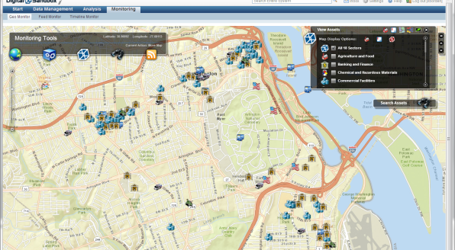
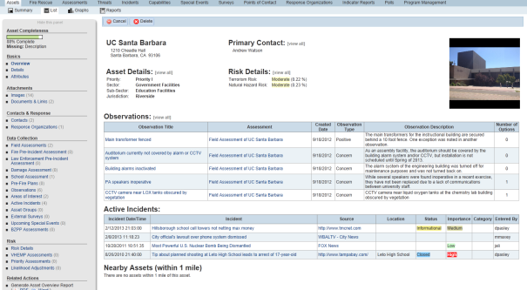
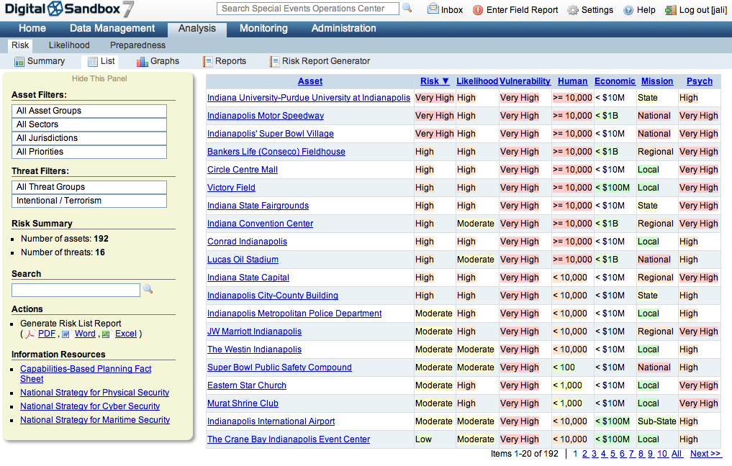
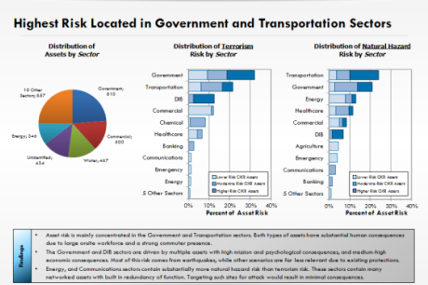
The DS7 Fire Module
Collect and manage, in one place, comprehensive data on all critical infrastructure and priority assets
Create or update assessments, fire pre-plans, safety inspections using mobile assessment tools
Filter data by jurisdiction, district, public/ private/charter, etc. to analyze risk from all hazards
Report incidents and threats
Share data among all stakeholders including law enforcement/ public safety communities
Access critical infrastructure data and fire plans real-time in the field

Slide 14
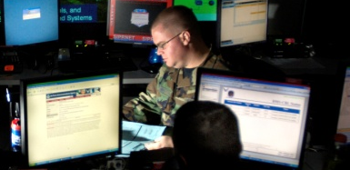


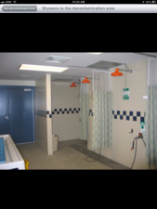
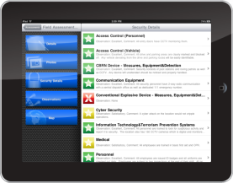


Share data with public safety systems during crises
Electronic Tear Sheets
Command Centers/EOCs
Mobile Data Terminals
External Systems
Field Devices

