Slide 1
MBK Houston Initiative
Social Justice Learning Institute
Urban Scholars
Government Operations Committee
Presented by:
Director Stephen L. Williams, M.Ed., MPA
Assistant Director Patricia Watson, MBA
Tuesday, April 16, 2024

Slide 2
EXECUTIVE SUMMARY

Slide 3
MBK HOUSTON
Since 2014, has participated in the national My Brother’s Keeper initiative and has been working in partnership with community to improve opportunities and reduce barriers for success for boys and young men of color by taking collective action across 6 MBK milestones
Data reveal that boys and young men of color experience underemployment, criminal justice involvement and lack of academic achievement at a disparate rate
The Social Justice Learning Institute’s Urban Scholars program addresses Milestone 3 which is graduating from high school ready for college and career and Milestone 4, completing post secondary education or training

Slide 4
HHD, MBK HOUSTON and URBAN SCHOLARS
One of HHD’s initial strategies for MBK was to leverage HHD resources with other agencies willing to contribute because MBK was not funded by federal, state or local resources, others than those contributed by HHD from it’s 1115 Waiver Special Fund.
As an accredited health department, HHD seeks to implement programs and services with strong evidence for success
The collaboration with the Social Justice Learning Institute (SJLI) to implement Urban Scholars in Houston supports these strategies as:
1) The program had a track record of success in the original implementation site in California
2) SJLI provided a $250,000 match to support implementation of the program in Houston and has continuously done so to date

Slide 5
Social Justice Learning Institute (SJLI): Urban Scholars
Program Outcomes for 2022-2023:
100% Graduation for all Urban Scholars seniors and successful post-secondary transition.
90% Attendance average for Urban Scholars also throughout 2019-2020 and 2020-2021.
70% average passing rate for core courses across all schools.
All students received wellness calls.
A 105% growth in Urban Scholars participants since 2018-2019.
100% increase in student enrollment.
About the Program
Goal: To engage youth to improve the education, health, and well being of youth and communities of color by empowering them to enact social change through research, training, and community mobilization.
SERVICES PROVIDED
Classroom education using a culturally relevant curriculum
Academic & career development activities
Identity development activities
Social justice youth leadership development
Socioemotional support
PARTICIPATION
600+ participants since 2019
220 participants for the current school year

Slide 6
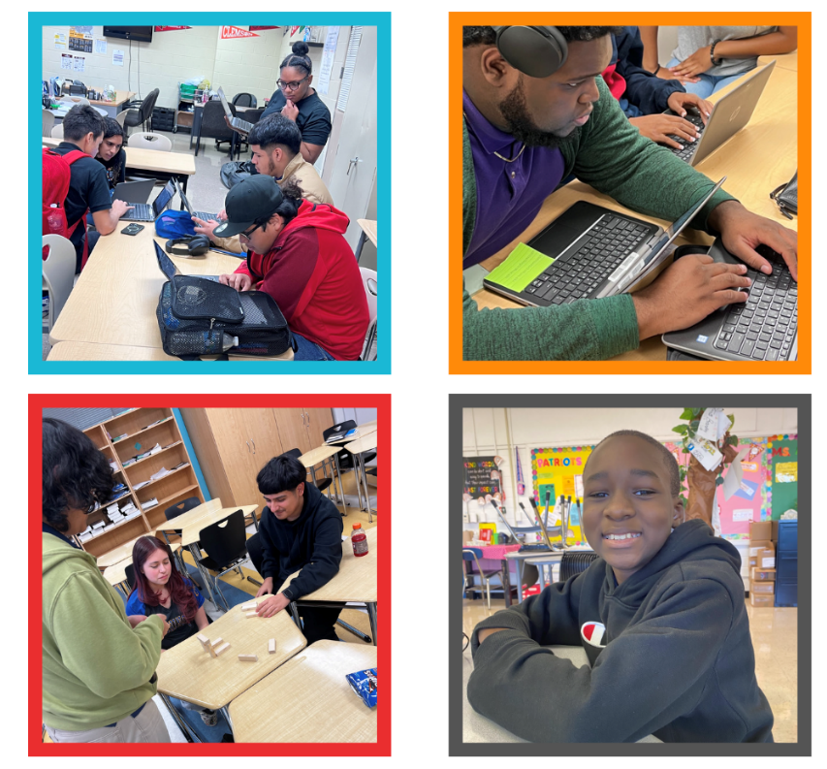
URBAN SCHOLAR SCHOOLS
CURRENT SCHOOLS
Attucks MS
Booker T Washington HS (District H
Expansion)
Clifton MS
Marshall MS (District H Expansion)
Sam Houston HS
Wheatley HS
Worthing HS

Slide 7
Amendment Request
The Amendment for additional time and spending authority was submitted to:
Add additional funding, which was provided by the reallocation of Council district dollars of $200,000, to the existing contract and by the addition of $600,000 from the Health Department’s 1115 Waiver Fund
Extend the performance period for the contract to include an additional school year through June 30, 2025
Change the project scope to add the 3 new school locations made possible with the district dollars

Slide 8
Amendment Request
Fiscal Year
 | FY18 | FY19 | FY20 | FY21 | FY22 | FY23 | FY24 | FY25
History of Council Action
Original Contract Signed 2018 Contract amended in FY20 to add time until 12/20 (NOTE: Time was added but insufficient funding added to cover services for full year) New 3 Year Contract Approved for FY21-23 Contract Amendment to 1) Add 2 years to 3-year contract and 2) add additional funds to support addition of 2 years for the original level of service and to add 2 to 3 additional schools with funding provided by former Council Member Karla Cisneros for schools in her district
Source of Funds
HHD 1115 Waiver Special Revenue | $250,000 |  | $150,000 | $250,000 | $250,000 | $250,000 | $250,000 | $350,000**
Funds from District H |  |  |  |  |  |  | $200,000
Total COH Funding for Amendment* |  |  |  |  |  |  | $450,000 | $350,000*
In Kind Match from SJLI | $250,000 |  | $150,000 | $250,000 | $250,000 | $250,000 | $250,000 | $350,000
Service Sites
School Year |  | Partial School Year | 2019-2020 | 2020-2021 | 2021-2022 | 2022-2023 | 2023-2024 | 2024-2025
 | Planning | Attucks MS Clifton MS Sam Houston HS Wheatley HS | Attucks MS Clifton MS Sam Houston HS Wheatley HS | Attucks MS Clifton MS Sam Houston HS Wheatley HS Worthing HS | Attucks MS Clifton MS Sam Houston HS Wheatley HS Worthing HS | Attucks MS Clifton MS Sam Houston HS Wheatley HS Worthing HS | Attucks MS Clifton MS Sam Houston HS Wheatley HS Worthing HS (District H expansion begins) Marshall MS Washington HS | Attucks MS Clifton MS Sam Houston HS Wheatley HS Worthing HS

Slide 9
Amendment Request Notes
*FY24 Allocation Request Summary
$250,000 Funds added from HHD Special Revenue for FY24
$200,000 Funds added from District Council Funds by former Council Member Cisneros to expand to 3 additional schools in district
$350,000 Funds added from HHD Special Revenue for FY25 services and to cover funds that were not previously added with the contract
extension approved in FY20
$800,000
**HHD is allocating an additional $100,000 from 1115 waiver funds for FY25 to sustain expansion funded by one-time funds of $200K from
District H
Social Justice Learning Institute is increasing the match for FY25 to match HHD’s $100,000 increase in funding.

Slide 10
THANK YOU

